Slide 1
Northern Pueblos RTPO FY 2026 TPF Proposal:
Lower Hondo Road Bridge BR7753
Presentation by Taos county for lower hondo road bridge BR7753
April 1, 2026

Slide 2
Planning: Support from existing planning documents and/or federal or state agencies
Includes bridge replacement and bridge foundation, approach slabs, modern safety hardware and modern roadway signing improvements.
Taos County is currently advancing the project through the Design/NEPA phase and requesting funds for:
Utility Hardship Relocations: $ 75,000.00
Estimated Construction Cost: $1,400,000.00
Construction Management And Testing: $ 78,000.00
Tax: $ 116,475.00
Total: $1,669,475.00

Slide 3
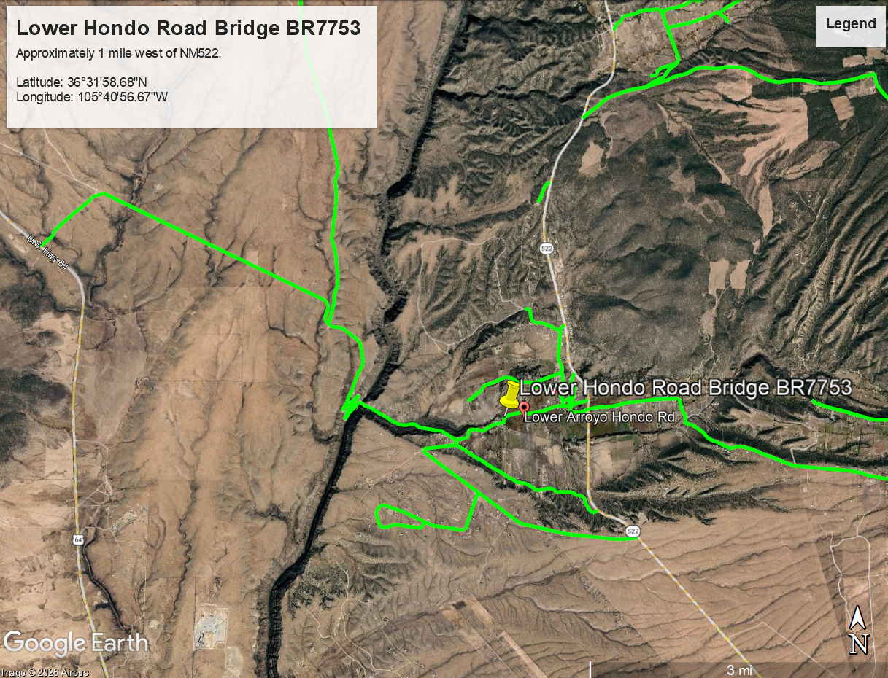
Project Description

Slide 4
Project Description
The Lower Hondo Road Bridge is a critical piece of infrastructure serving Taos County residents, New Mexico and out of state travelers, recreational users, and visitors accessing significant public lands. Lower Hondo Road provides direct access to Bureau of Land Management (BLM) land and the Rio Grande, both heavily used for rafting, fishing, hunting, hiking, and other outdoor recreation within the Rio Grande del Norte National Monument: an area recognized for its historical and cultural importance. The bridge is also a vital link supporting the local and regional recreation economy, including guided rafting, fishing, and hunting expeditions, as well as mountain biking and camping throughout the monument. Maintaining safe, reliable access is essential for emergency responders, residents, outfitters, tourists, and land‑management agencies, all of whom depend on this corridor for economic activity, public safety, and resource stewardship. Currently, the Lower Hondo Road Bridge is in a severely distressed condition and requires immediate replacement. The existing girders exhibit advanced rusting, and the top flanges are experiencing delamination, compromising the bridge’s structural integrity. The wingwalls show severe abrasion and scaling, indicating long‑term deterioration from water and weather exposure. The deck itself is heavily abraded, and a 7‑foot section of barrier curb is missing entirely, posing a significant safety hazard for all users. These deficiencies elevate risks for motorists and reduce the bridge’s overall load‑carrying capability. Replacing the Lower Hondo Road Bridge is essential to protecting public safety, preserving historic and recreational access, and maintaining a functional transportation network. Investment in this project will prevent further structural degradation, reduce ongoing maintenance costs, and guarantee that this critical infrastructure continues to serve Taos County well into the future.

Slide 5
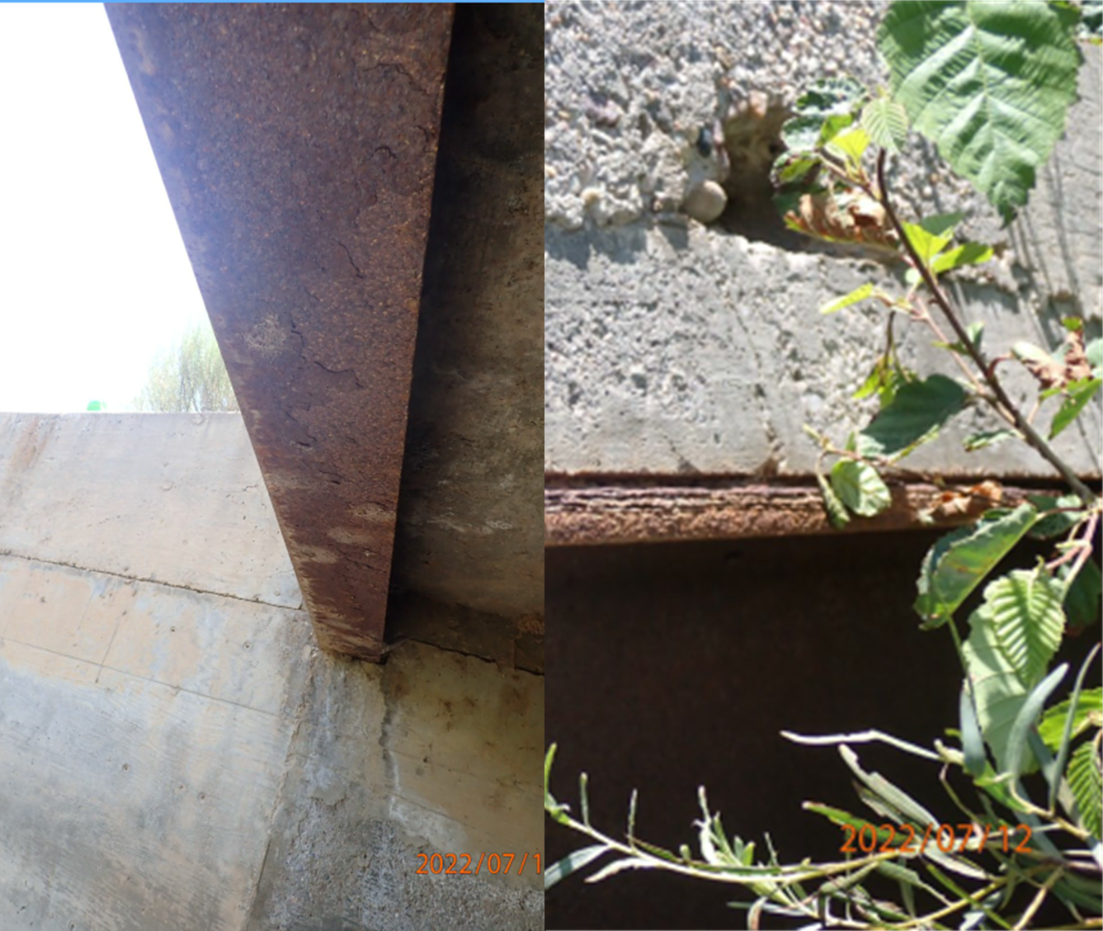
Project Summary
Project Description:
Girders are badly rusted. Top flanges are experiencing delamination.

Slide 6
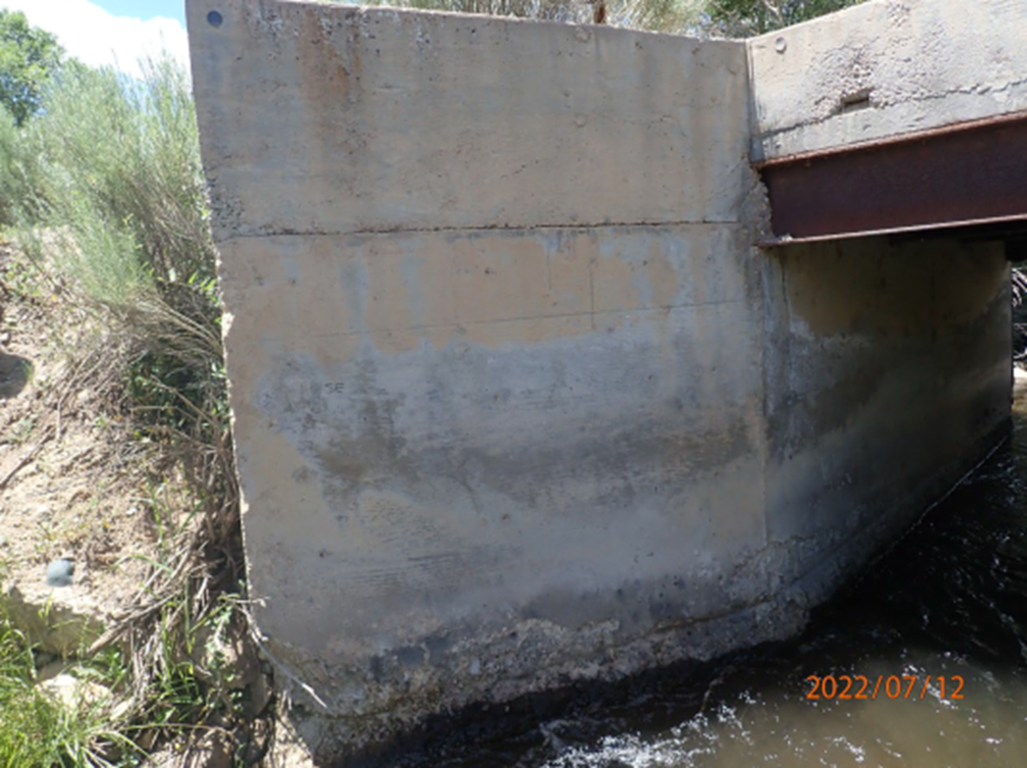
Project Summary
Project Description:
Wingwalls have severe abrasion and scalding.

Slide 7
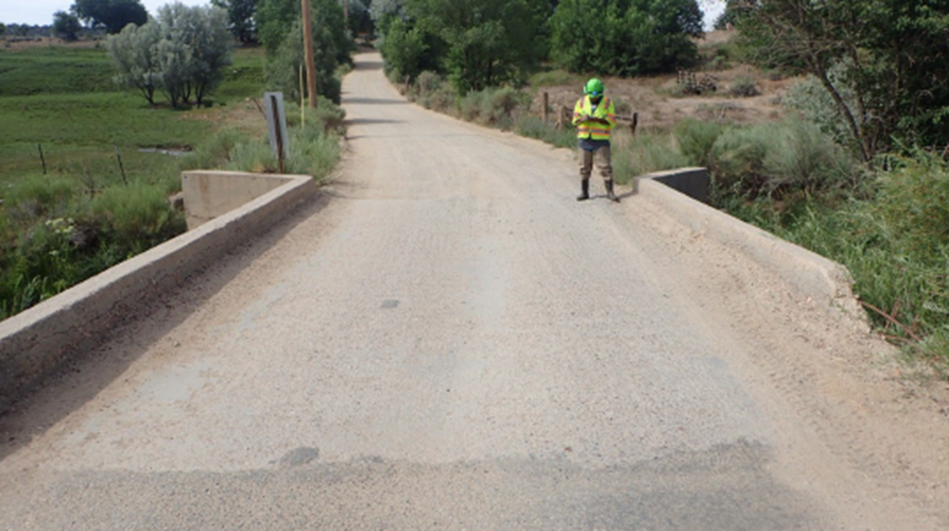
Project Summary
Project Description:
Deck is severely abraded. A 7’ section of barrier curb is missing.

Slide 8
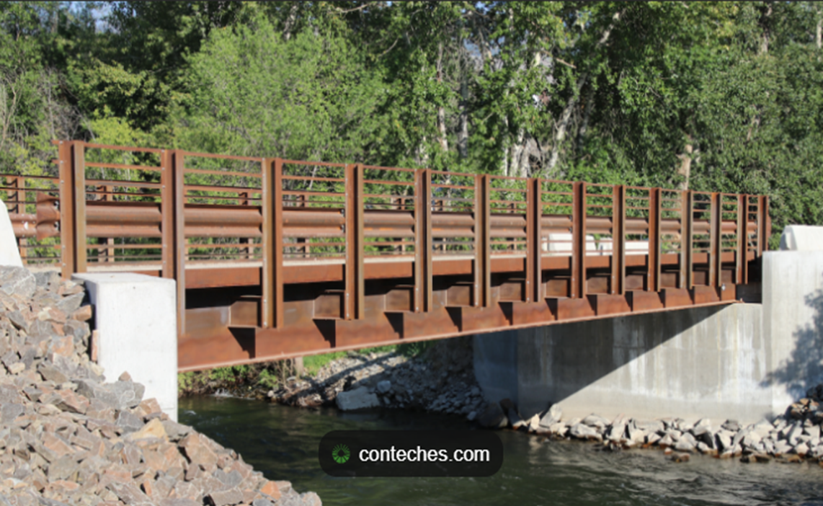
Project Summary
Project Description:
Proposed Design-Rolled Girder Bridge with removable railing.

Slide 9
Justification: Economic Impact, Project Need
Road infrastructure is the backbone of a healthy economy. The Lower Hondo Bridge project will support the local community by:
Resident commuter benefits: A safe, functional bridge reduces vehicle operating costs—such as suspension repairs, tire damage, and additional fuel consumption—caused by deteriorated road and bridge surfaces.
Protection for Taos County’s recreation economy: Lower Hondo Road provides access to the Rio Grande del Norte Monument, and the Rio Grande, both major destinations for rafting, fishing, hiking, and outfitter‑supported tourism. Maintaining reliable access protects local jobs and revenue generated by outdoor recreation.
Support for adjacent land use and future development: A structurally sound bridge ensures long‑term stability for surrounding parcels and supports uniform access for agricultural, residential, and recreational land use.
Preservation of a historic corridor: The area surrounding the bridge is considered a historical site. Failure to replace the structure could result in loss of access to culturally significant locations, negatively impacting heritage tourism and community engagement.
The Lower Hondo Road Bridge is essential to Taos County as it serves as a heavily used route connecting residents, outfitters, and recreational visitors. Its importance is heightened during peak summer and fall tourism seasons when river use and trail access are at their highest.
Local workforce to job sites, including recreation outfitters, land‑management agencies, and service providers
Safe travel routes for school transportation, ensuring buses can safely access rural student populations
Emergency response, providing critical access for fire, EMS, and law enforcement
Outdoor recreation and tourism, which represent a major economic driver for Taos County

Slide 10
Justification: Quality of Life, Safety, Environmental Sustainability
Replacing the Lower Hondo Road Bridge will significantly improve community well‑being, public safety, and environmental protection by:
Improving safety for all users through replacement of the severely deteriorated structure and restoration of the missing safety barrier.
Ensuring reliable access to Federal lands, the Rio Grande del Norte National Monument recreation area, and surrounding neighborhoods for residents, visitors, school transportation, and emergency responders.
Supporting environmental sustainability by eliminating deteriorated materials from entering the river and installing a modern bridge designed to better withstand weather and water impacts.
Reducing travel disruptions and detours, resulting in less fuel use, fewer emissions, and lower vehicle operating costs.
Strengthening community quality of life by maintaining safe, dependable access to outdoor recreation, historical areas, and local economic activity.

Slide 11
Request Readiness: R-O-W Acquisition,
Clearances, Planning Docs, Timeline
Funding request is for utility hardship relocations, construction, and construction management and testing.
$1,669,475.00
Taos County will be utilizing NV5 for Design/NEPA-County Expense
All required clearances will be completed if awarded
Construction of the project will take place when additional funding is appropriated.
Implementation of work if awarded grant would utilize NV5 Engineering Company to oversee the construction phase

Slide 12
Project Summary
Project Summary:
Replacing the Lower Hondo Road Bridge is necessary to maintain safe travel, protect public access to federal lands, support tourism‑based economic activity, preserve historical resources, and ensure reliable emergency response. Investment in this project strengthens the local economy while safeguarding vital community infrastructure. Investing in this project protects critical rural access, strengthens community safety, and ensures the continued delivery of essential services for the 60 households that rely on it daily.

Slide 13
Northern Pueblos RTPO FY 2026 TPF Proposal:
Pot Creek/Bridge Street BR8619
Presentation by Taos county for Pot creek/bridge street bridge BR8619
April 1, 2026

Slide 14
Planning: Support from existing planning documents and/or federal or state agencies
Includes bridge and foundation replacement, approach slabs, roadway signage modernization and minor roadway improvements.
1. Project Management $ 5,000.00
2. Add Survey $36,000.00
3. Add ROW Mapping/Property Boundaries $32,000.00
4. Appraisals (4 properties/for property impacts) $ 6,000.00
5. Supplemental SUE $ 4,500.00
6. Utility Coordination $ 4,500.00
7. Environmental
a. Wetland, T&E, Bio/Cult, Field Surveys, Reports $45,000.00
b. and SHPO coordination, NEPA document (PIM),401/404 permits)
8. Preliminary Drainage Report (Letter Format) $25,000.00
9. Geotech (bridge and all-weather driving surface) $36,000.00
a. (no visible lead base paint and asbestos features)

Slide 15
Planning: Support from existing planning documents and/or federal or state agencies
Includes bridge and foundation replacement, approach slabs, roadway signage modernization and minor roadway improvements.
10. 30% Roadway $20,000.00
11. 30% Bridge $30,000.00
12. 60% Roadway $18,500.00
13. Final Drainage Report & Recommendations $15,000.00
14. 60% Bridge $10,000.00
15. 90 % Roadway $15,000.00
16. 90% Bridge $10,000.00
17. PSE (Roadway & Bridge) $12,500.00
18. Final Plans and CDs $ 7,500.00
Rights of Way Easements (2) $75,000.00
Utility Hardship Relocations $75,000.00
Design/NEPA Fee Total Estimate including tax $548,250.00

Slide 16
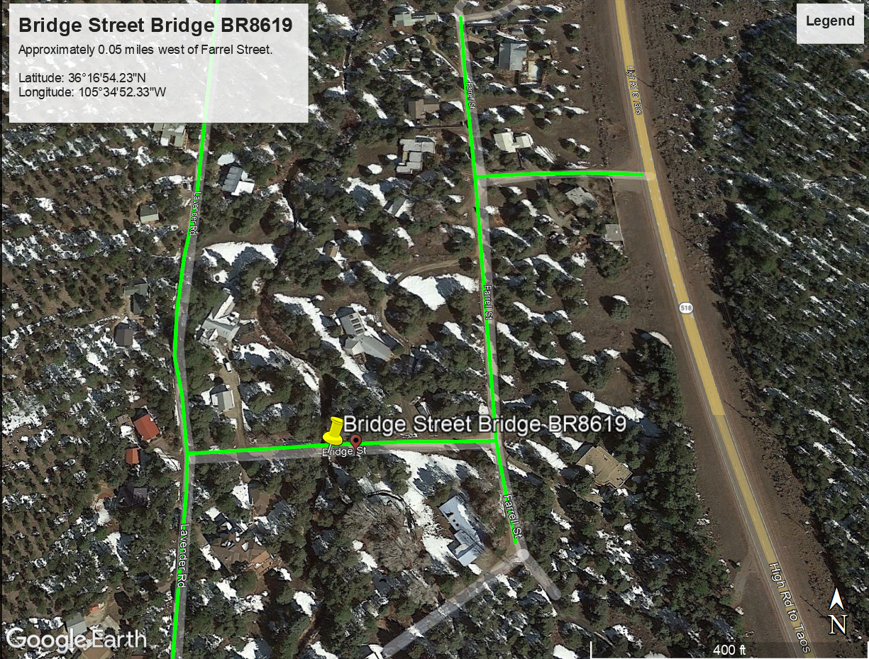
Project Description
The Bridge Street Bridge in the Pot Creek area is a vital access route for residents, emergency responders, and propane delivery services. The structure is showing significant deterioration, including buckling of the metal structural plates at bolted sections within the arch chord and cracked, weathered timber that restrains the cobble and soil fill above the arch. These conditions compromise the bridge’s load‑carrying capacity and pose increasing safety risks for heavier vehicles and daily users. The proposed project will replace the failing structure with a modern, durable bridge that restores safe access and ensures reliable service for the community and emergency operations.

Slide 17
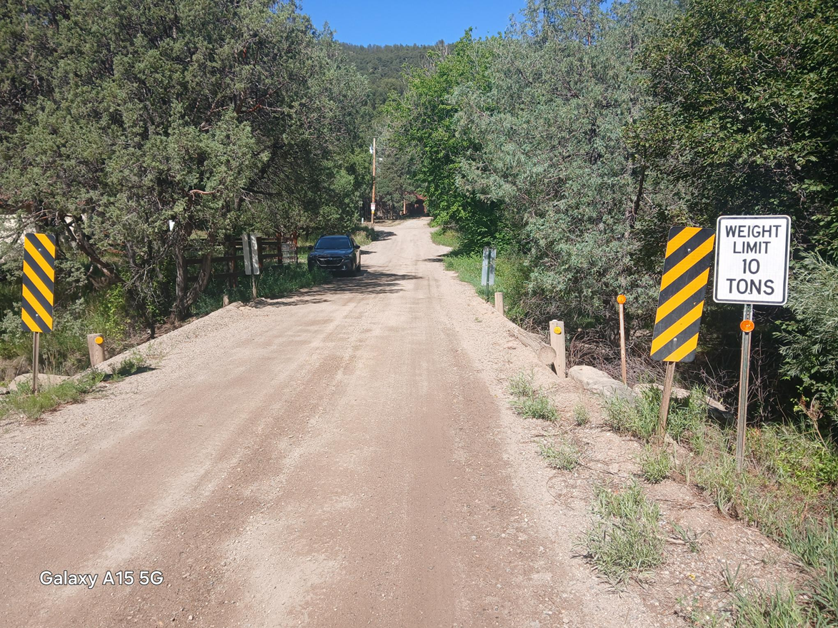
Project Summary
Project Description:
Bridge 8619 Bridge Street

Slide 18
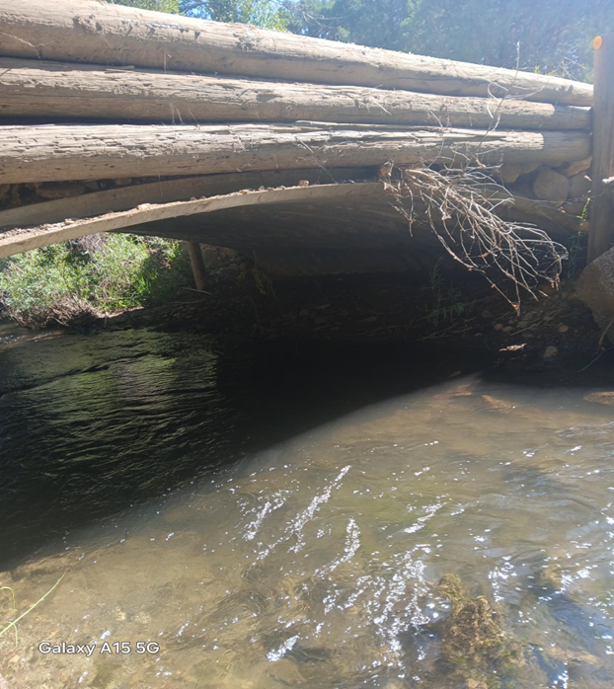
Project Summary
Project Description:
Metal structural plate exhibits minor buckling at bolted sections inside the chord of the arch.

Slide 19
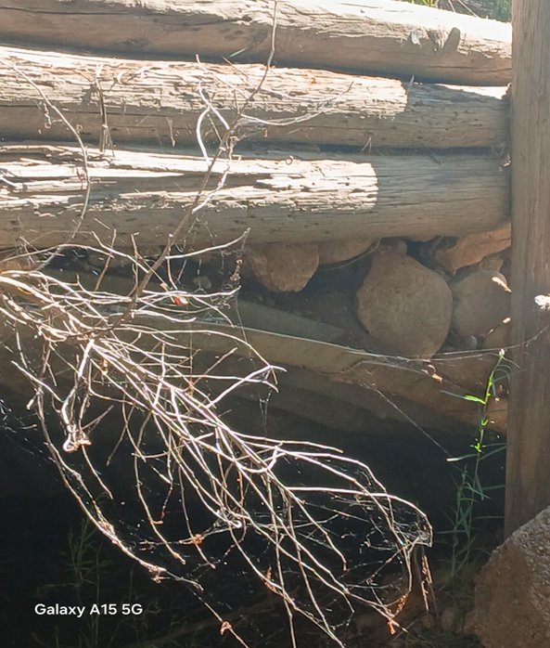
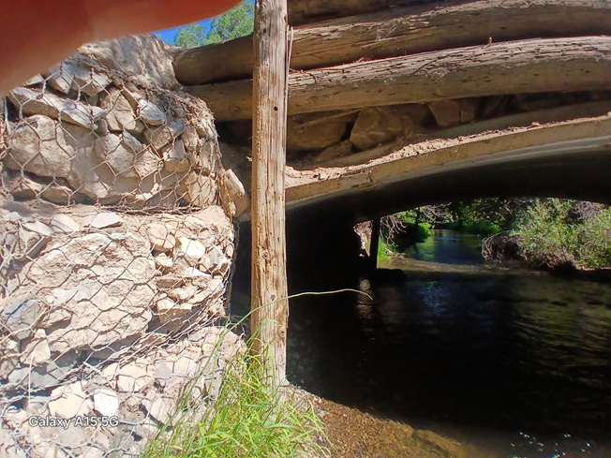
Project Summary
Project Description:
The timber used to restrain the cobble and soil fill above the arch is cracked and weathered.

Slide 20
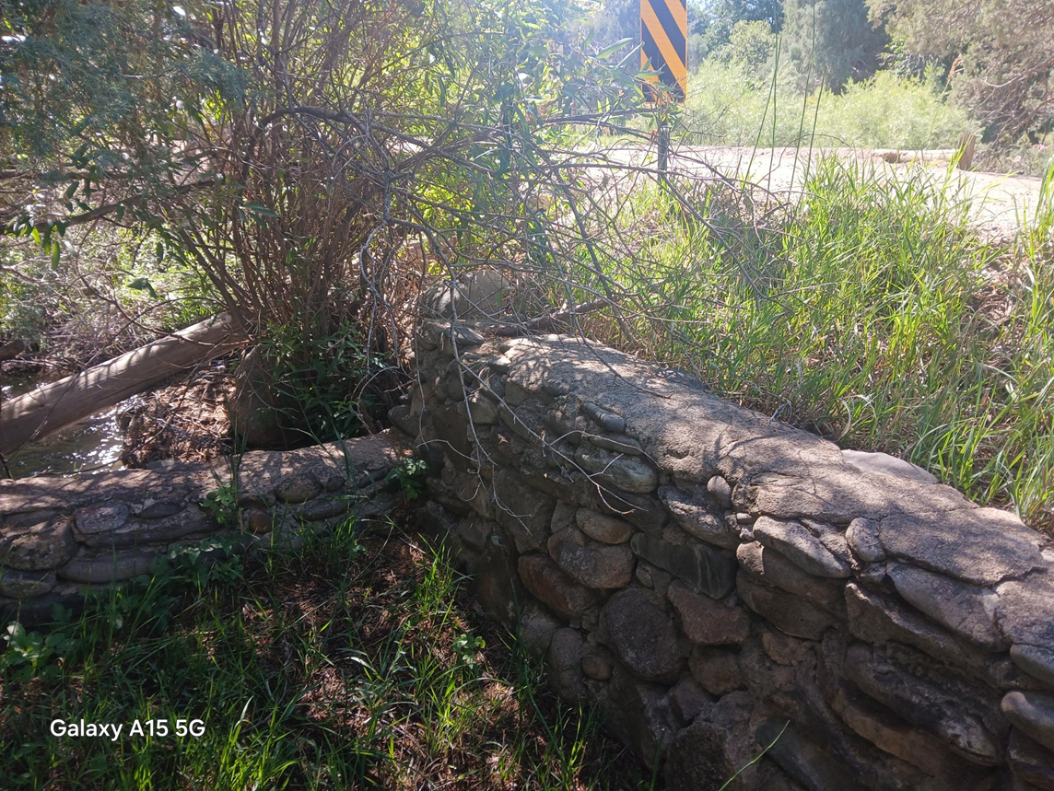
Project Summary
Project Description:
Stone fence that makes up southwest property boundary within 3 feet of the roadway.

Slide 21
Project Summary
Project Description:
Proposed Design-Rolled Girder Bridge with removable railing.

Slide 22
Justification: Economic Impact, Project Need
Road and bridge infrastructure is the backbone of a healthy economy. The Bridge Street Bridge project will support the Pot Creek community by:
Ensuring reliable access for residents: The bridge is the primary route for households in the Pot Creek area, and its deterioration threatens daily travel and mobility.
Supporting essential service deliveries: Propane trucks, utility vehicles, and service providers rely on this crossing to reach homes safely and maintain basic living conditions.
Reducing vehicle operating costs: A structurally sound bridge prevents damage to vehicles caused by unstable surfaces, buckled metal plates, and deteriorating timber components.
Maintaining safe load‑carrying capacity: Replacing the failing structural plates and weathered timber will ensure the bridge can continue supporting heavier vehicles such as emergency apparatus and delivery trucks.
Protecting property value and land access: A reliable, modern bridge supports local development, secure land access, and the long‑term stability of surrounding residential parcels.
The Bridge Street Bridge is essential to Taos County because it directly connects:
Local residents to work, services, and daily needs
Emergency responders, including fire, EMS, and law enforcement, requiring dependable access in critical situations
Propane and essential fuel delivery trucks serving rural homes through the winter season
Maintenance and utility providers that support rural infrastructure and community safety

Slide 23
Justification: Quality of Life, Safety, Environmental Sustainability
Replacing the Bridge Street Bridge will significantly improve community safety, access, and long‑term environmental resilience by:
Improving safety for all users by eliminating buckled metal plates and deteriorated timber that currently compromise the bridge’s structural integrity.
Ensuring reliable access for residents, emergency responders, and propane delivery, all of whom depend on this bridge as the only functional route into the Pot Creek area.
Providing stable, dependable access for utility providers and service trucks, reducing the risk of service interruptions that affect heating, electricity, and essential home needs.
Supporting environmental sustainability by removing failing materials and replacing them with a modern structure that is more resilient to weather, erosion, and long‑term environmental wear.
Reducing vehicle wear, idling, and emissions by preventing slow crossings or detours caused by unsafe bridge conditions.
Strengthening overall quality of life by ensuring families, emergency crews, and service providers can safely and consistently reach rural homes without disruption.

Slide 24
Request Readiness: R-O-W Acquisition,
Clearances, Planning Docs, Timeline
Funding request is for Design/NEPA, Rights of way easements, and utility hardship relocations.
$548,250.00
Taos County will be utilizing NV5 for Design/NEPA
All required clearances will be completed if awarded
Construction of the project will take place when additional funding is appropriated.

Slide 25
Project Summary
Project Summary:
Replacing the Bridge Street Bridge in the Pot Creek area is essential to maintain safe and dependable access for residents, emergency responders, propane delivery services, and utility providers. The bridge’s structural deterioration, including buckled metal plates and failing timber components—poses increasing risks that could lead to service disruption, emergency delays, or unsafe travel conditions. Investing in this project protects critical rural access, strengthens community safety, and ensures the continued delivery of essential services for the 25 households that rely on it daily.

