Slide 1
NPRTPO FY 2027 TPF #2:
East River Street Improvements Project
Presentation by TOWN OF RED RIVER AND DEC
April 1, 2026

Slide 2
Project Scope
Project scope is plan, design, construct and construction phase services for street and drainage improvements to East River Street between Pioneer Street and Copper King Trail.
Improvements consist of subgrade preparation, base course, hot mix asphalt, curb, valley gutters, drop inlets, utility adjustments, and stripping.
High Street
Mallette Canyon
Jay Hawk Tr.

Slide 3
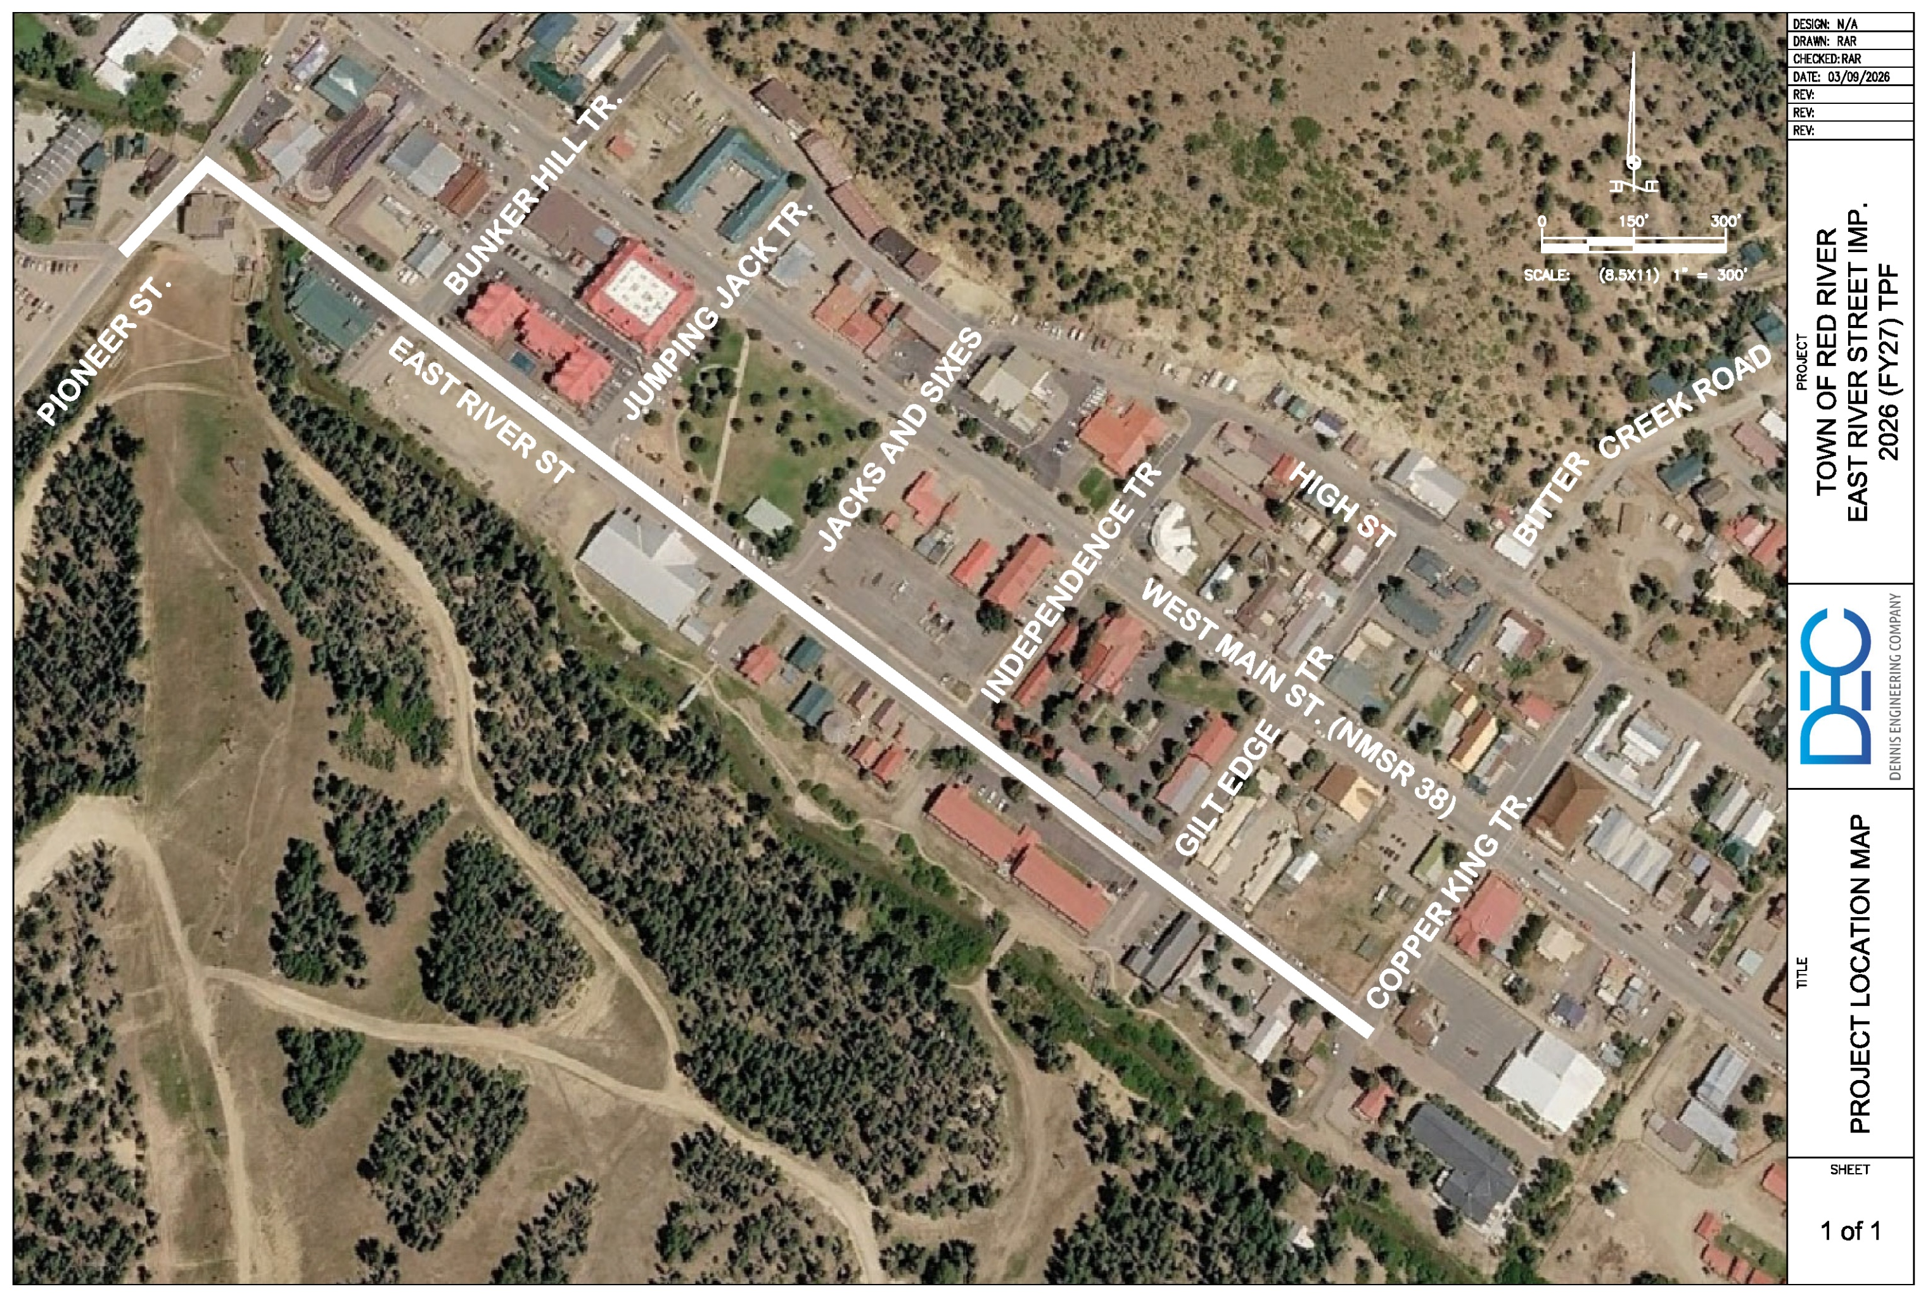
Project Location Map
High Street
Mallette Canyon
Jay Hawk Tr.

Slide 4
Planning: Secured other Funding Sources, Matching Funds
The funding for this project is as follows:
  NMDOT TPF: $2,745,500
  Town Match: $ 144,500
  Total Project Cost: $2,890,000
  Matching Funds will be paid for by Town’s street fund

Slide 5
Project Description: Level of coordination with RTPO and NMDOT in project development
The project has been discussed with Northern Pueblo RTPO and NMDOT.
The project is not on an NHS route or ROW owned by NMDOT.

Slide 6
Justification: Economic Impact and Project Need
East River Street provides access to:
                Ski area
                Faith Mountain Fellowship
                Multiple lodges (River Lyric, Worldmark, Riverside)
                Municipal Parking Lot
                Outdoor Recreation/Trailheads
                Apartments, Homes and Condominiums
                Two emergency evacuation centers, including the
                Conference Center

Slide 7
Justification: Quality of Life, Safety, and Environmental Sustainability
This project will improve the quality of life and safety for the residents and tourists by providing safe passages from the east side of town to the west side.
There are three main parallel and east/west roads in Red River (High Street, NMSR 38 and River Street). Each one can serve as a bypass for the other two should an incident occur requiring evacuation (i.e. wildfire) or if one of the roads is under construction.
An independent sewer line replacement project is currently on-going for East River Street in order to avoid disturbing the road placed by the TPF funding.

Slide 8
Request Readiness: R-O-W Acquisition, Clearances, Planning Docs, Timeline
No additional R.O.W. will need to be acquired. The Town owns the R.O.W. for East River Street.
A Professional Services Agreement (PSA) is in-place and the project can commence immediately after funding is received (anticipated to be in the fall of 2026).

Slide 9
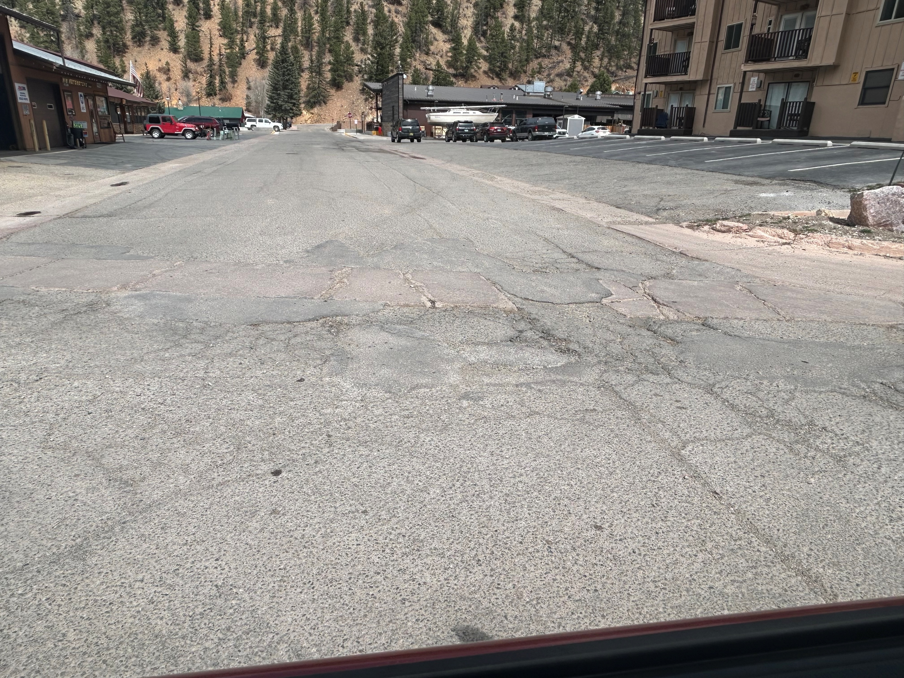
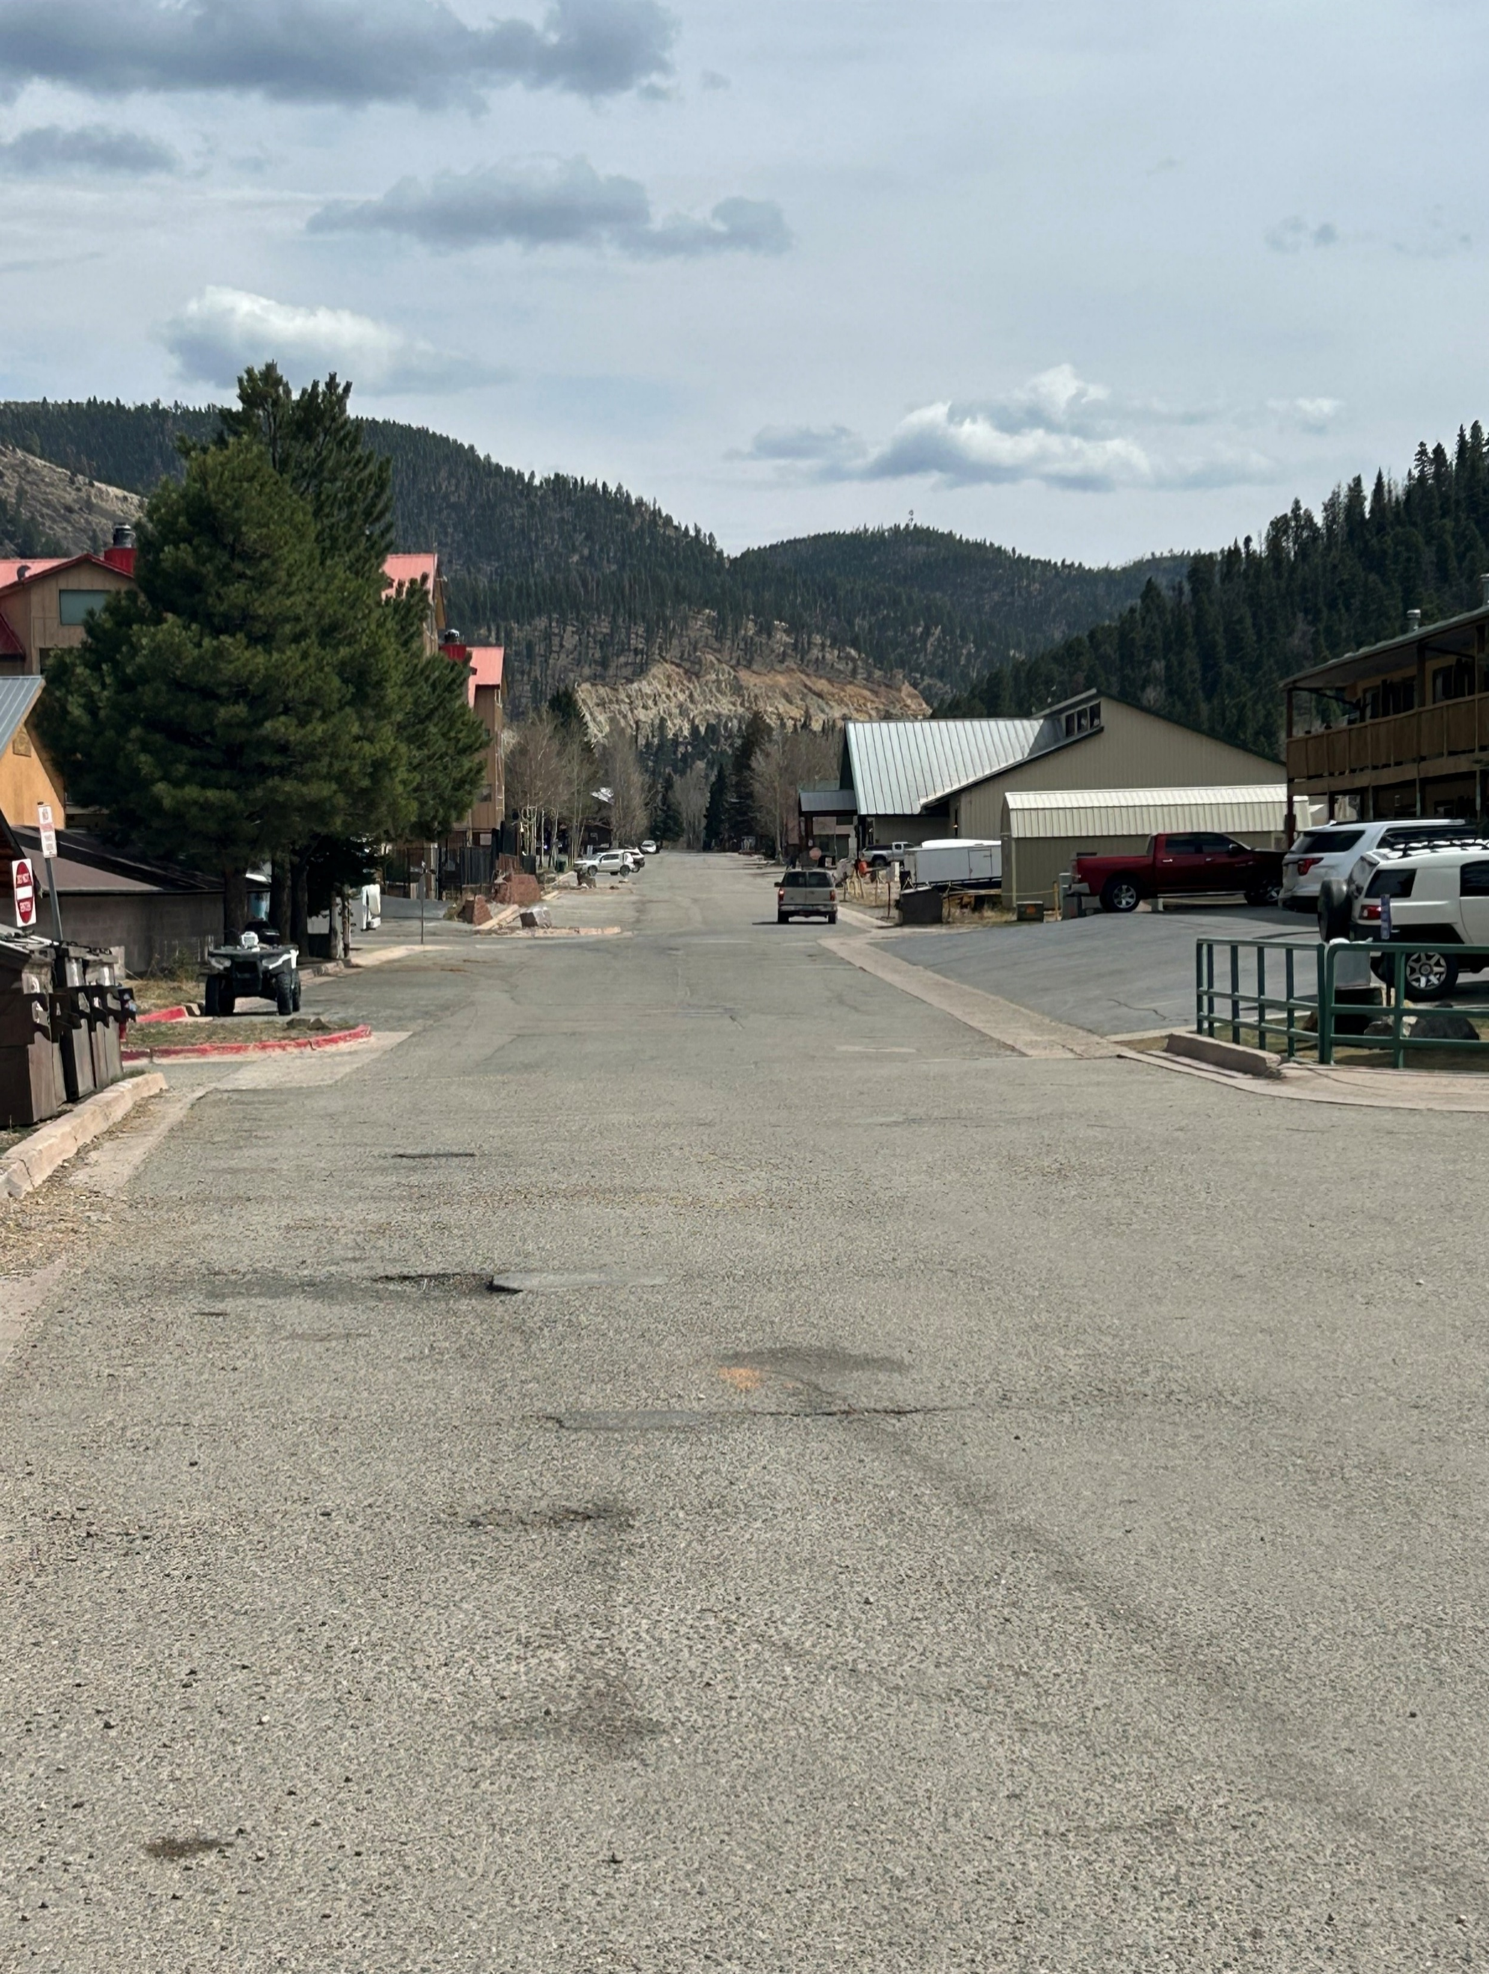
Pictures – Existing Road Conditions

Slide 10
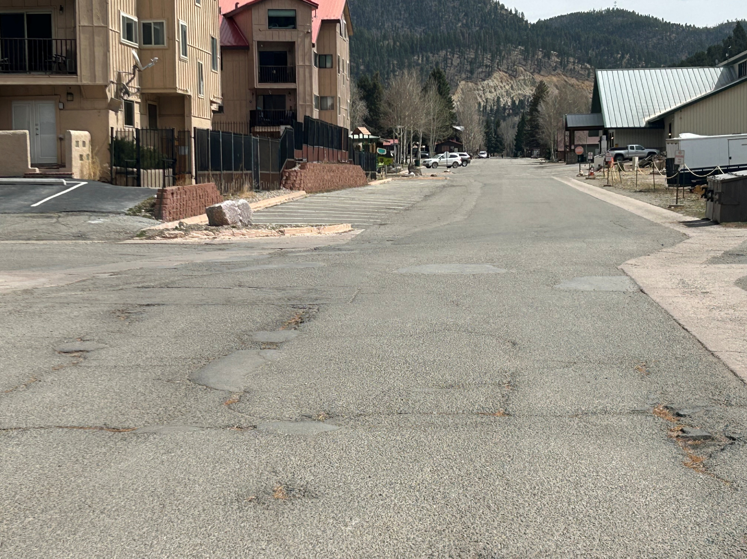
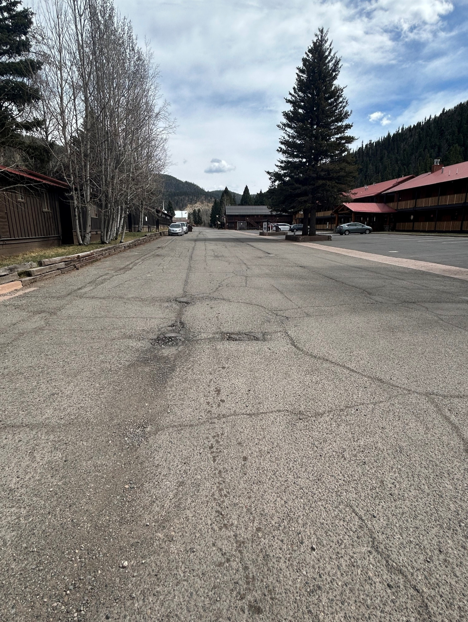
Pictures – Existing Road Conditions

Slide 11
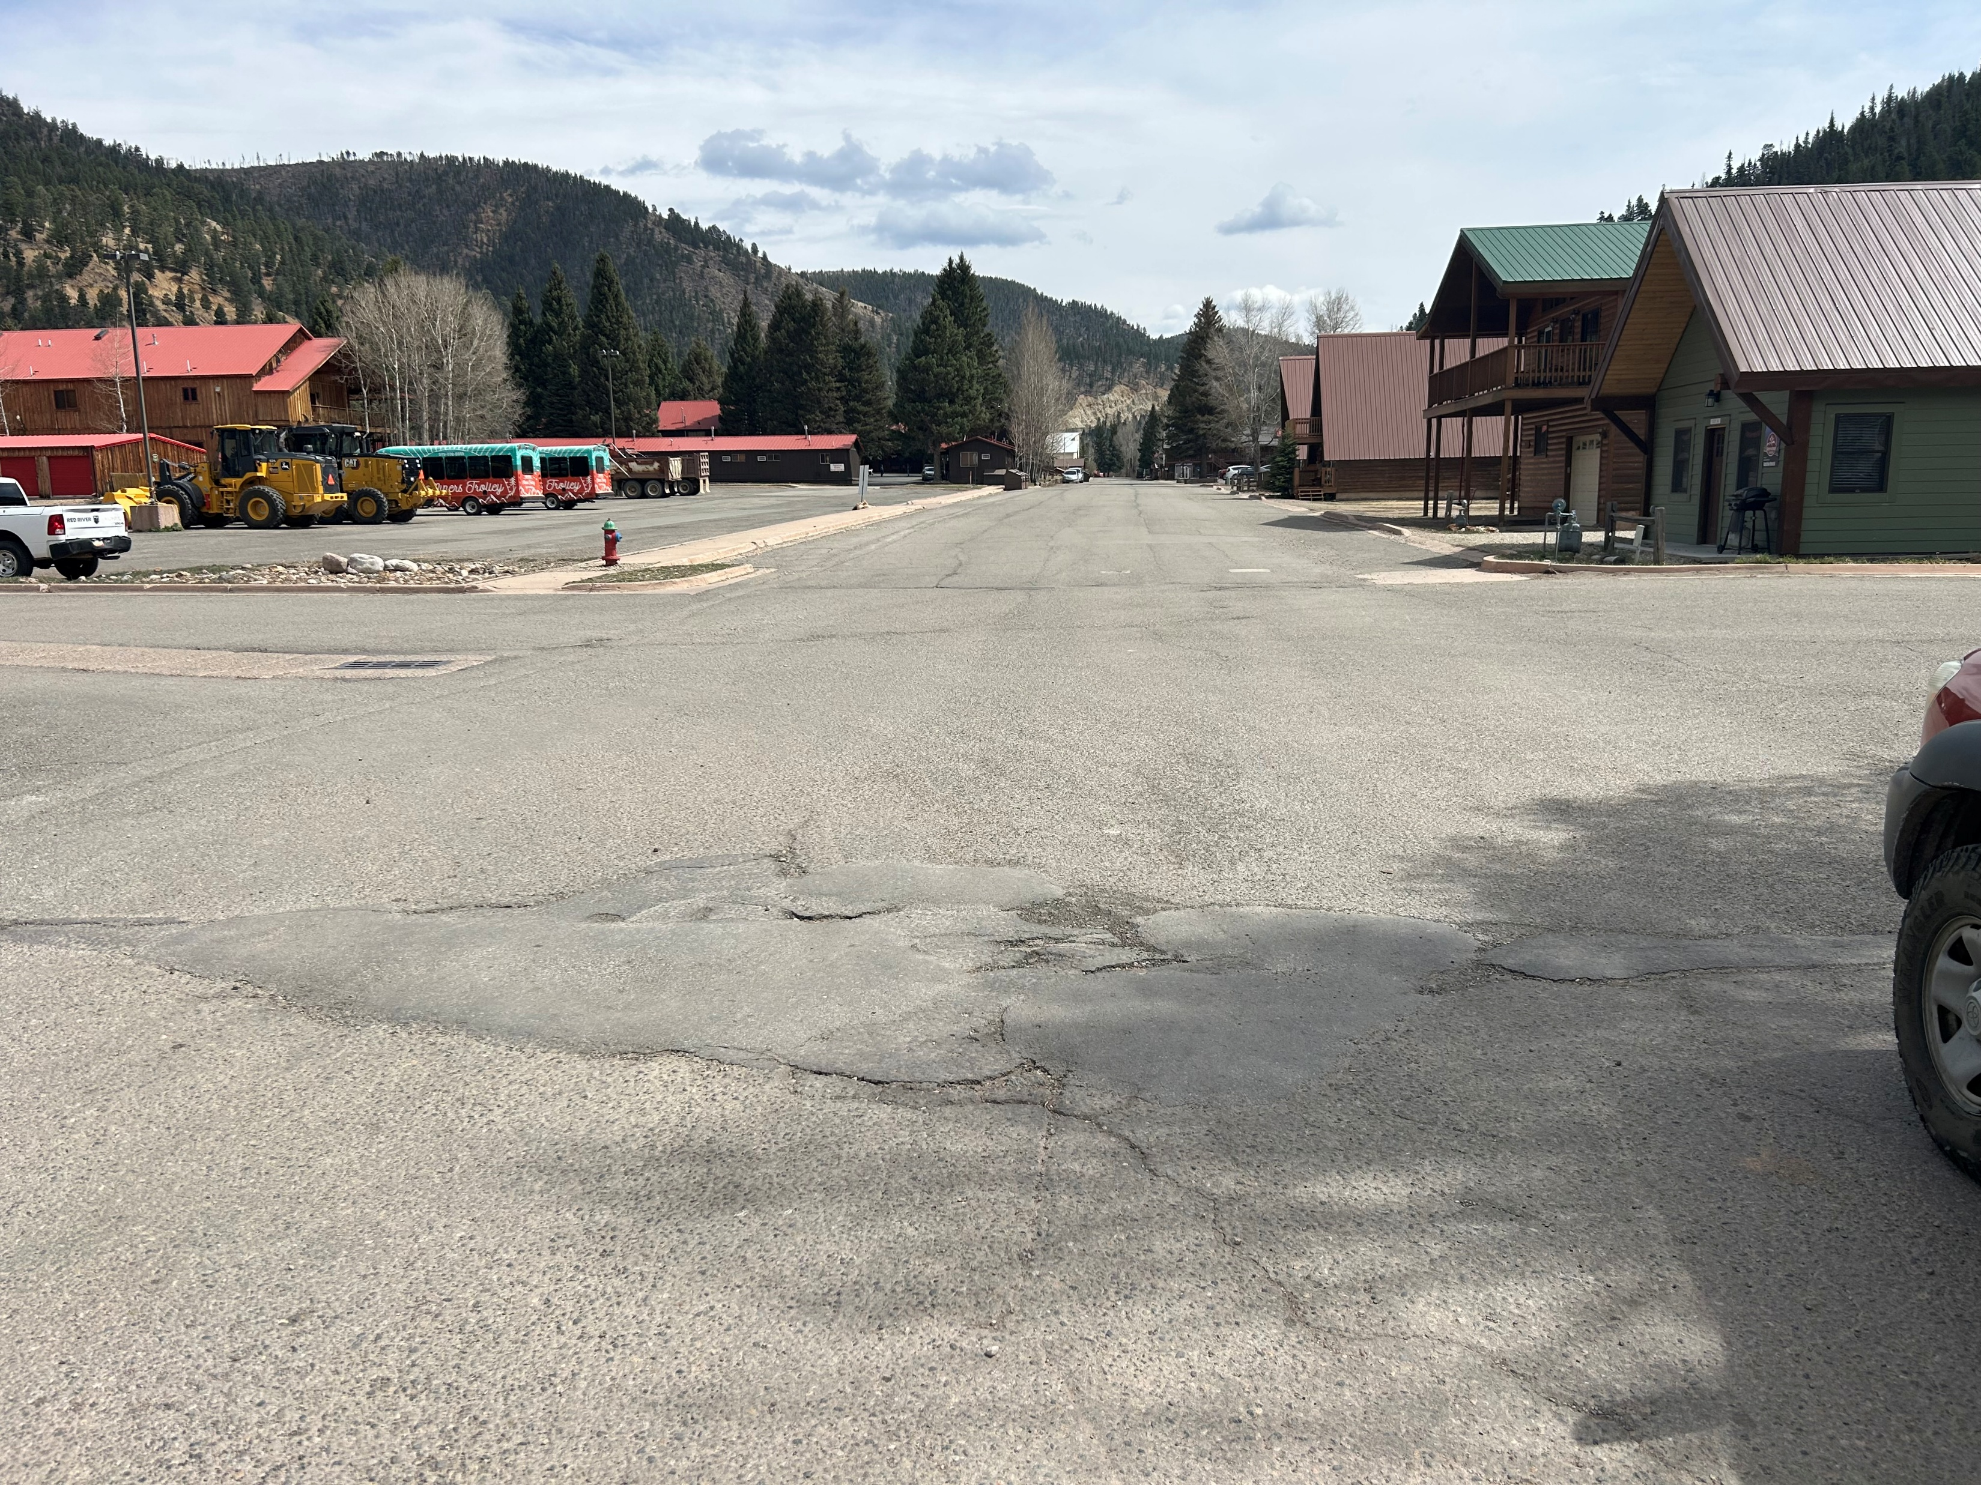
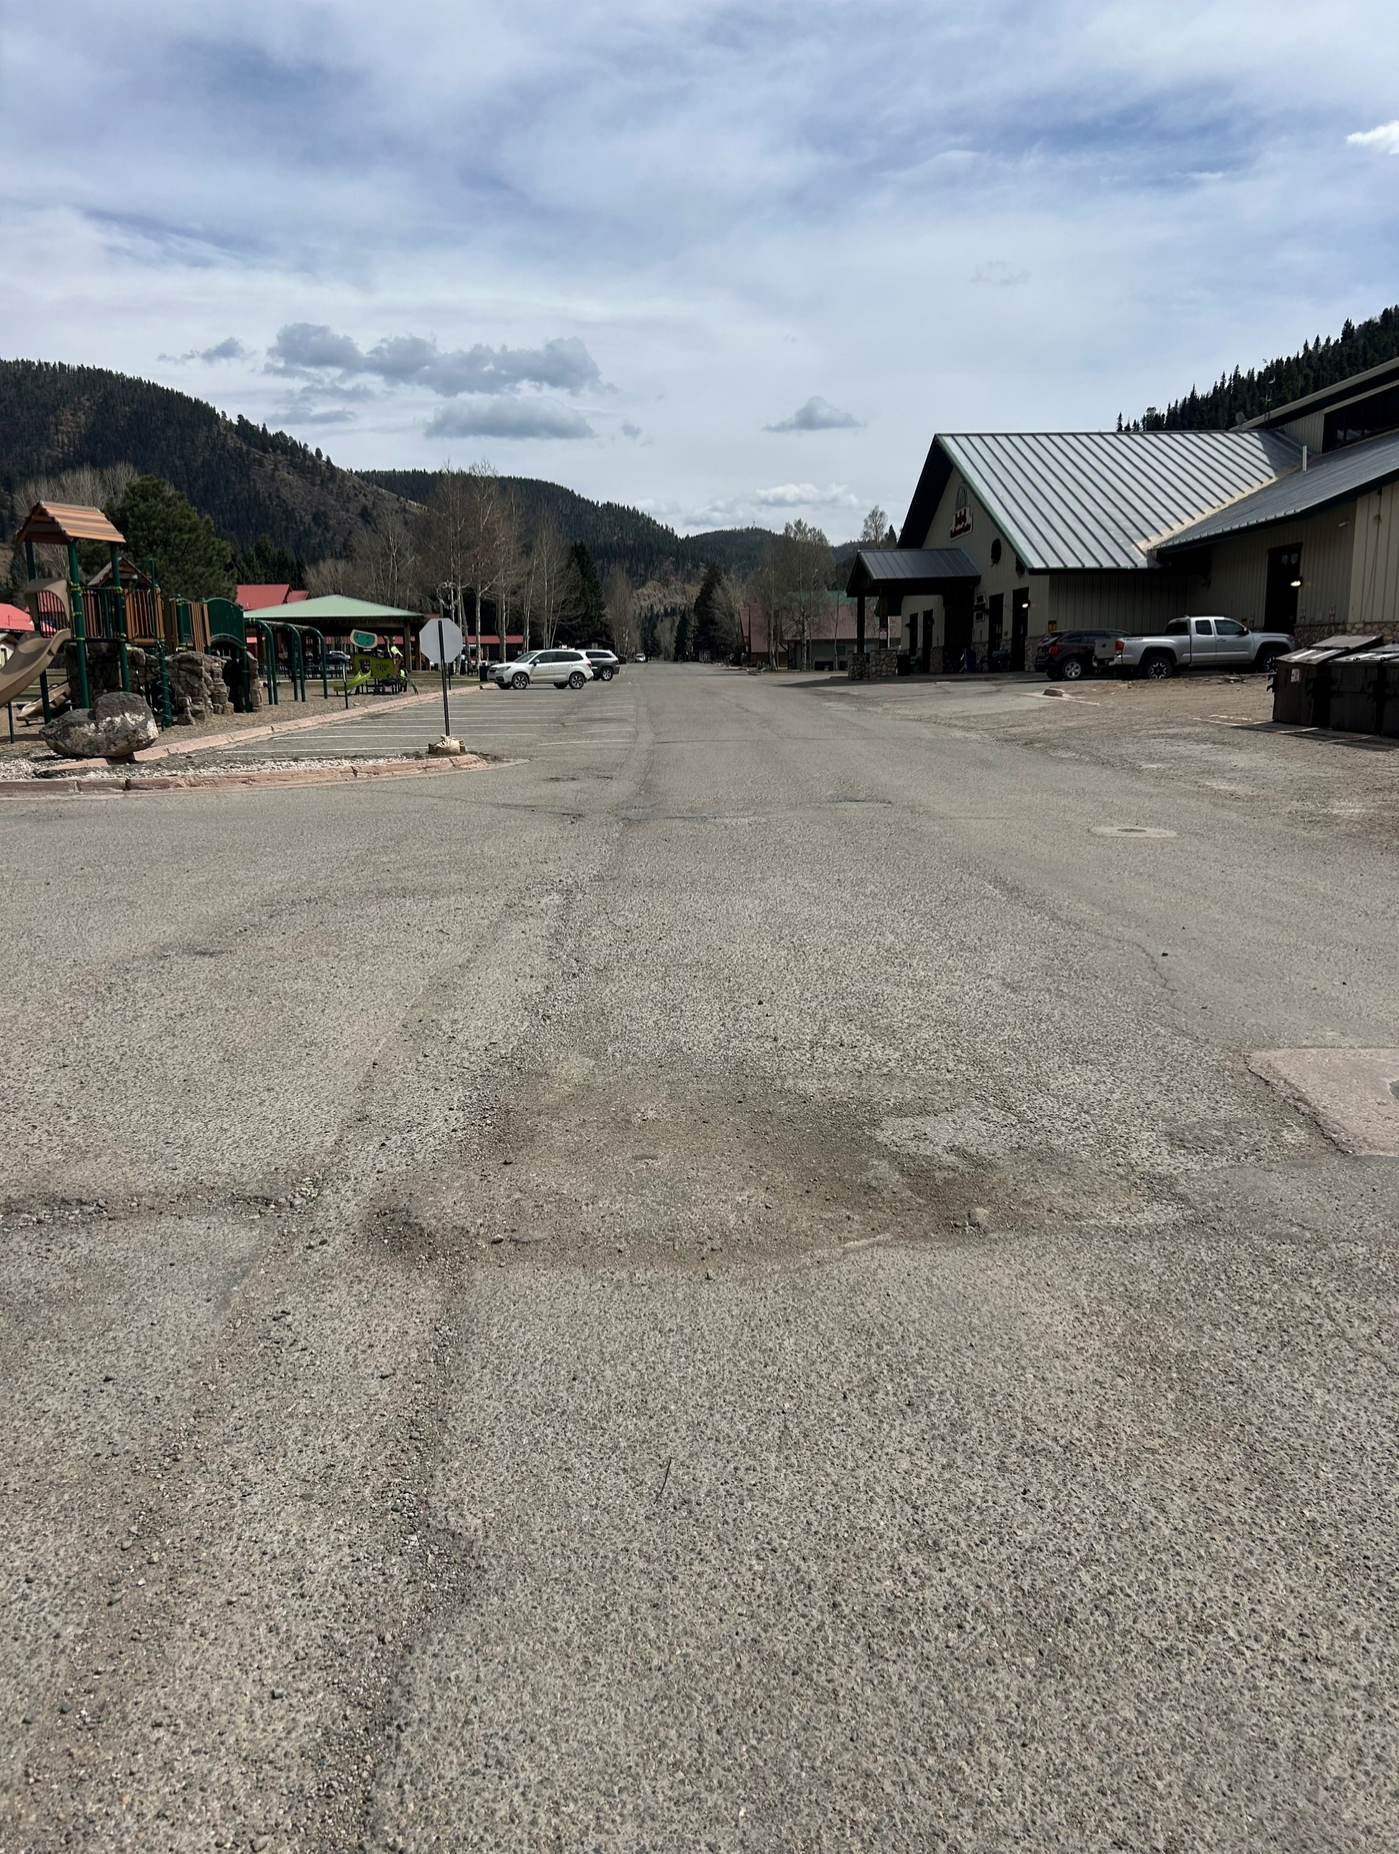
Pictures – Existing Road Conditions

Slide 12
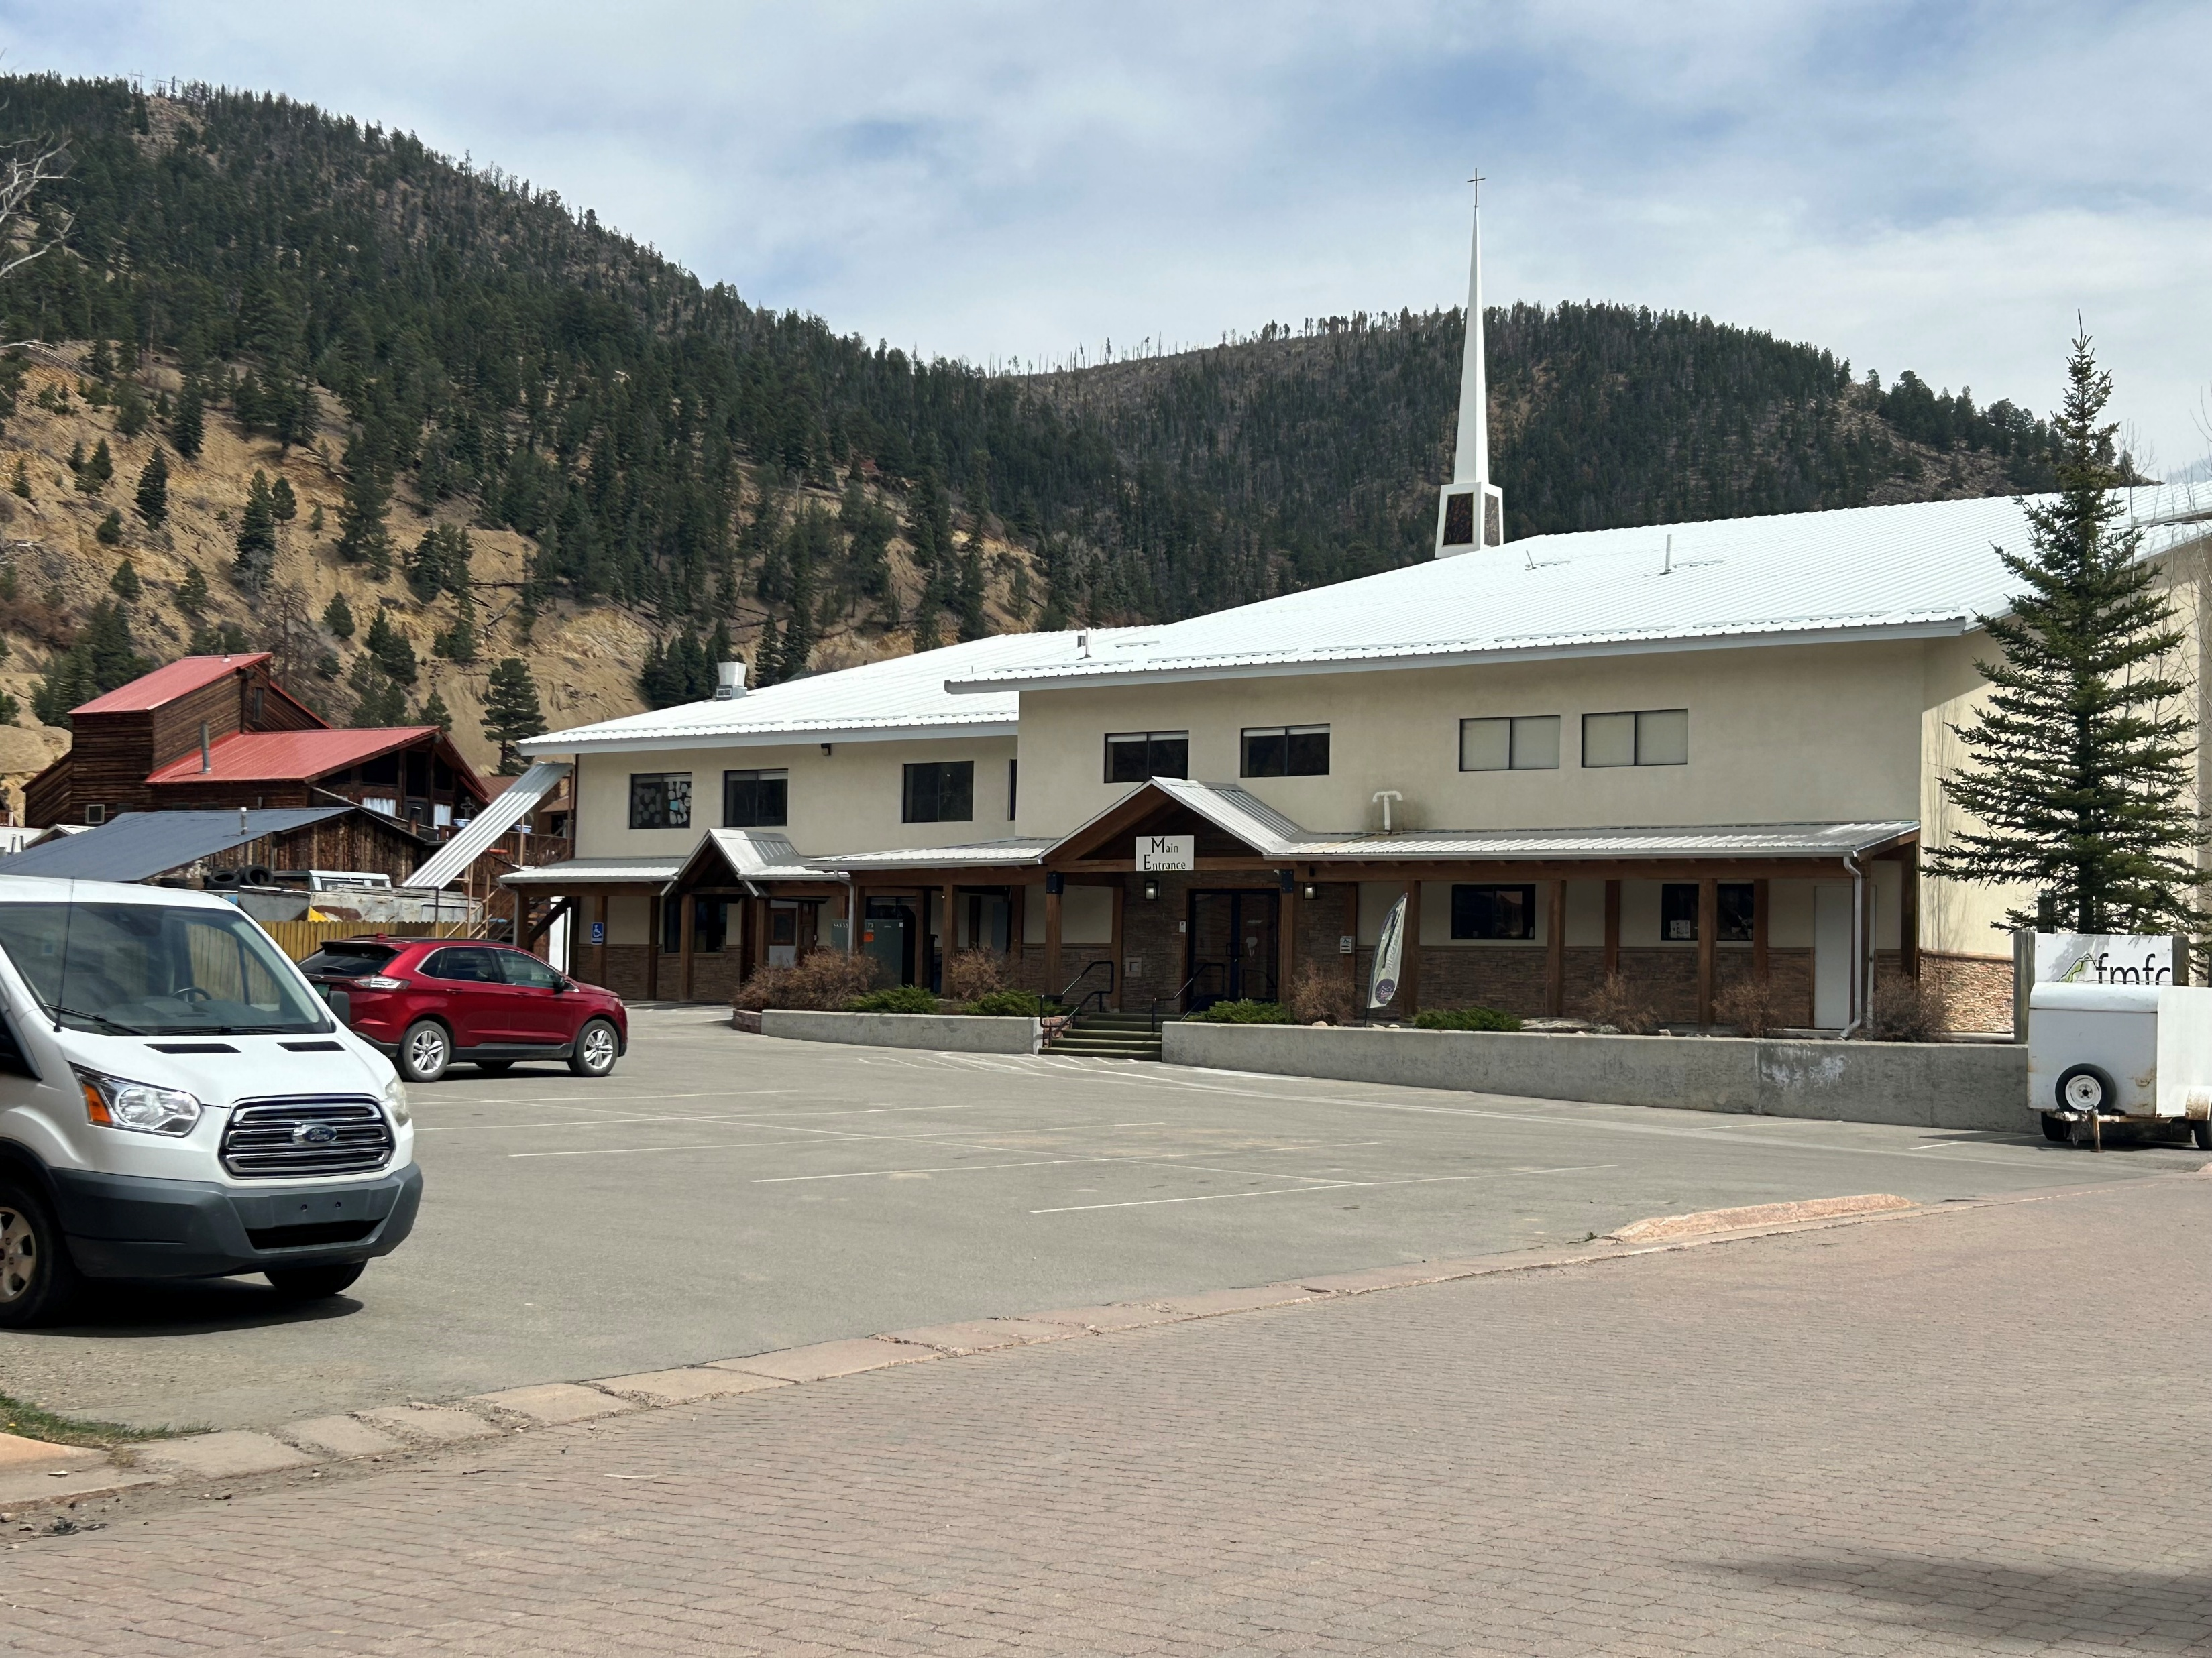
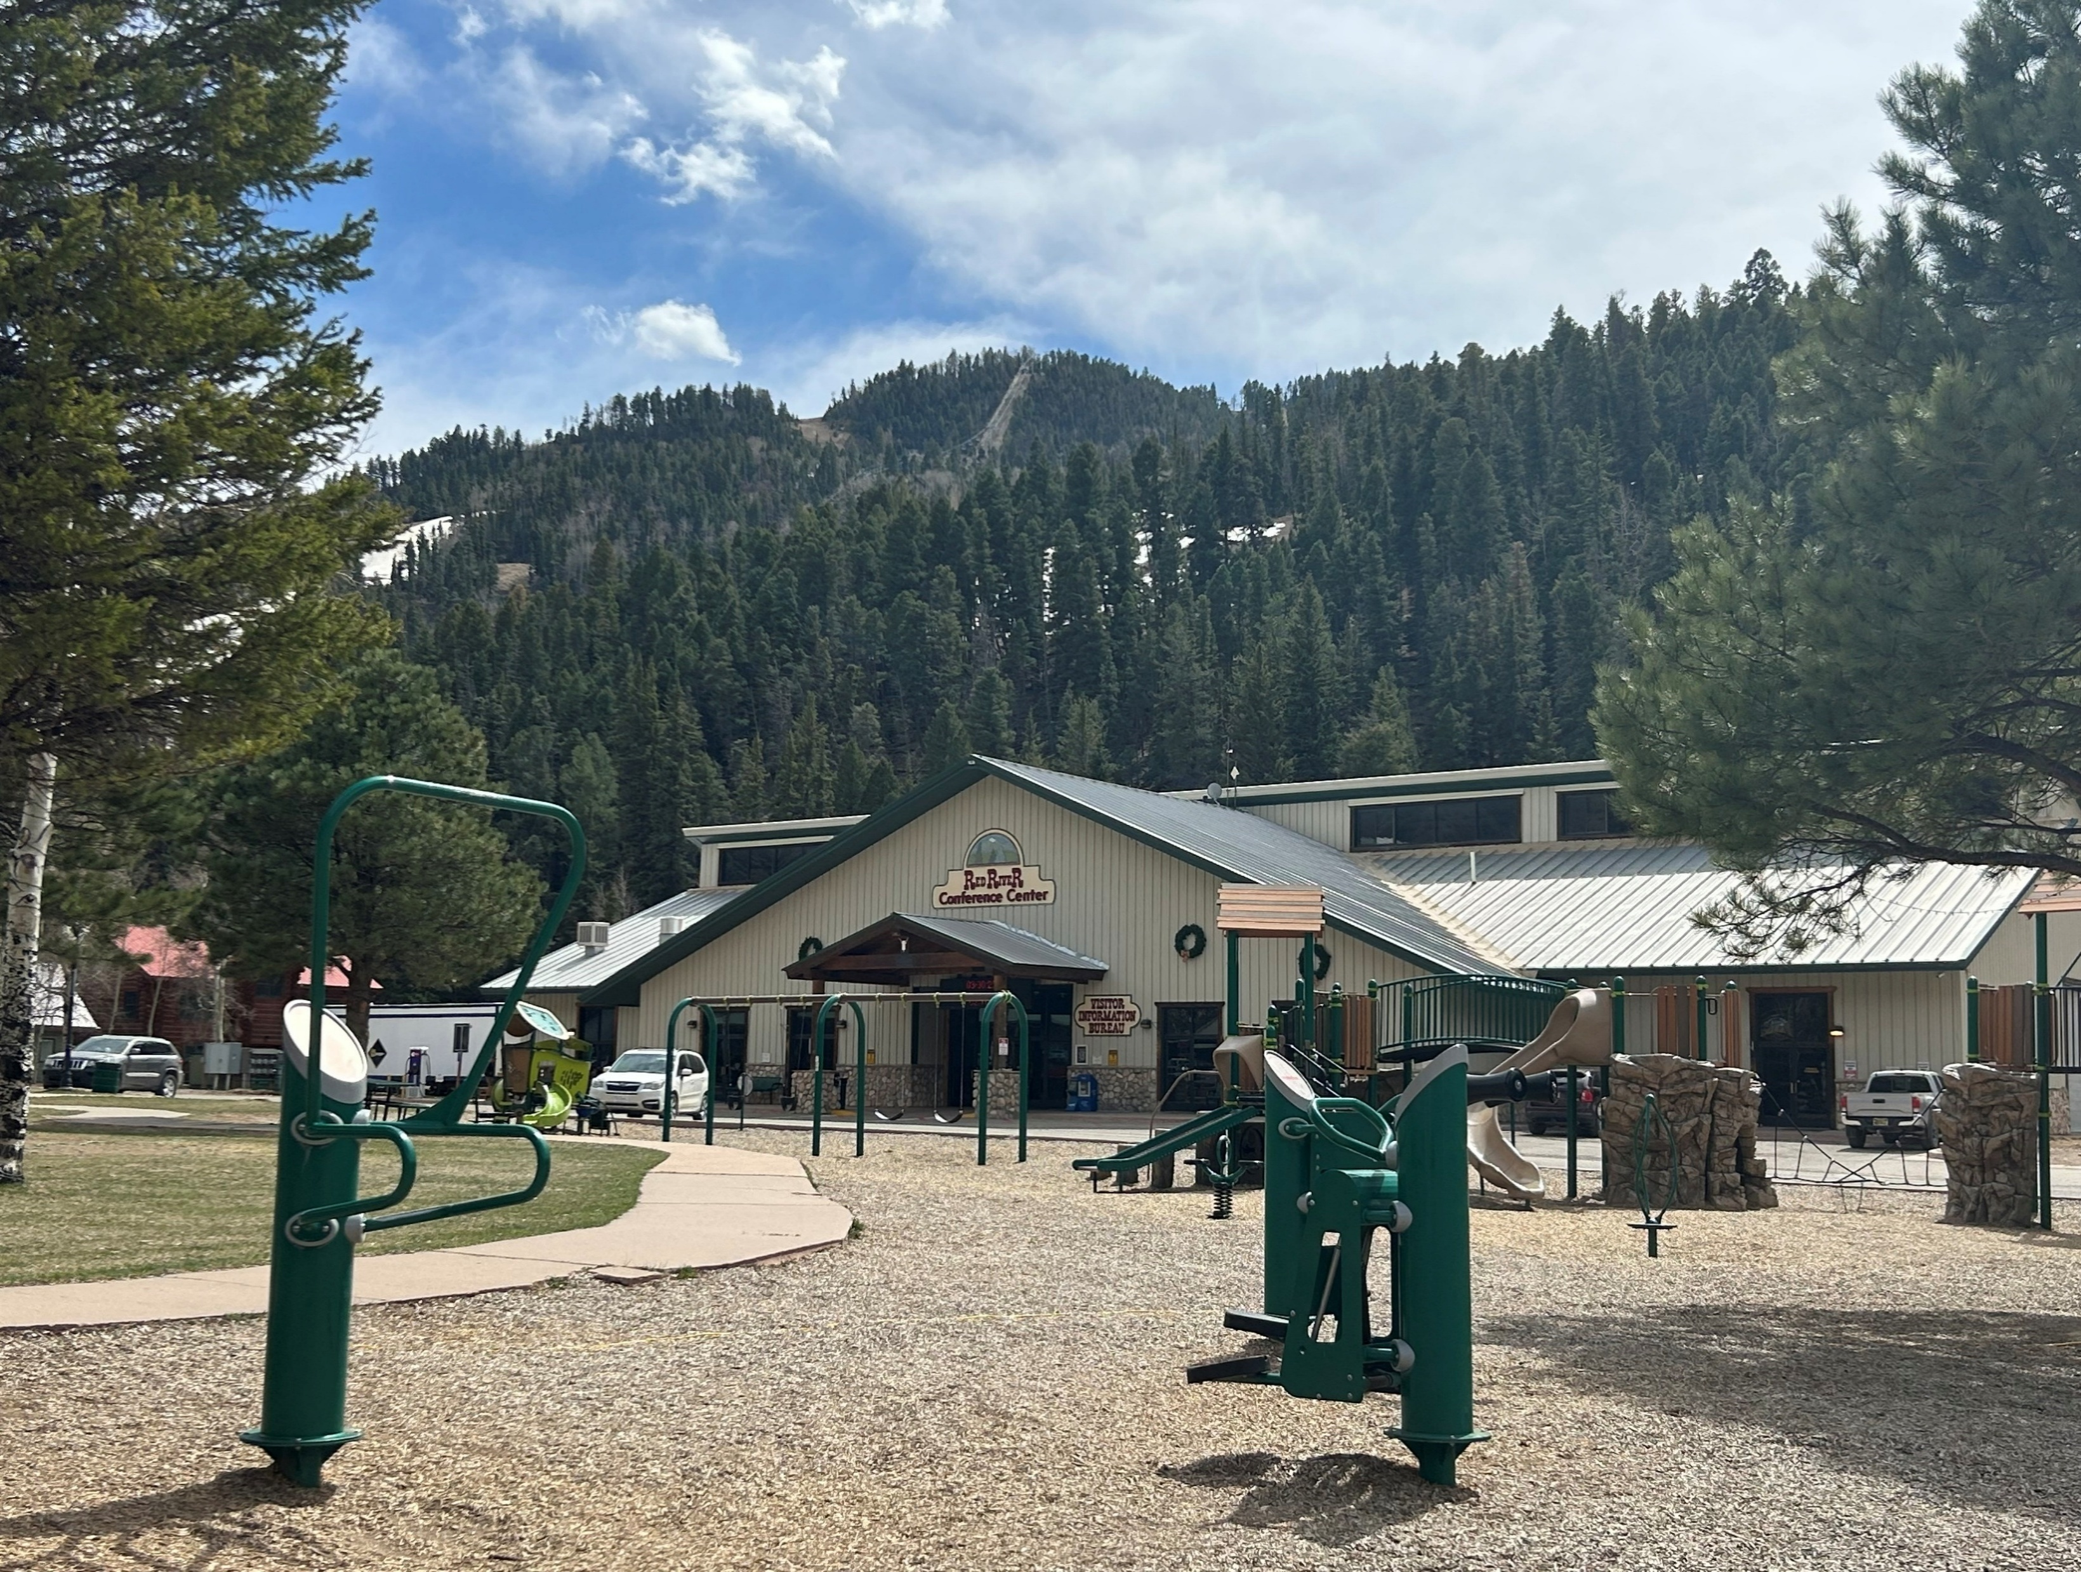
Pictures – Emergency Evacuation Centers

Slide 13
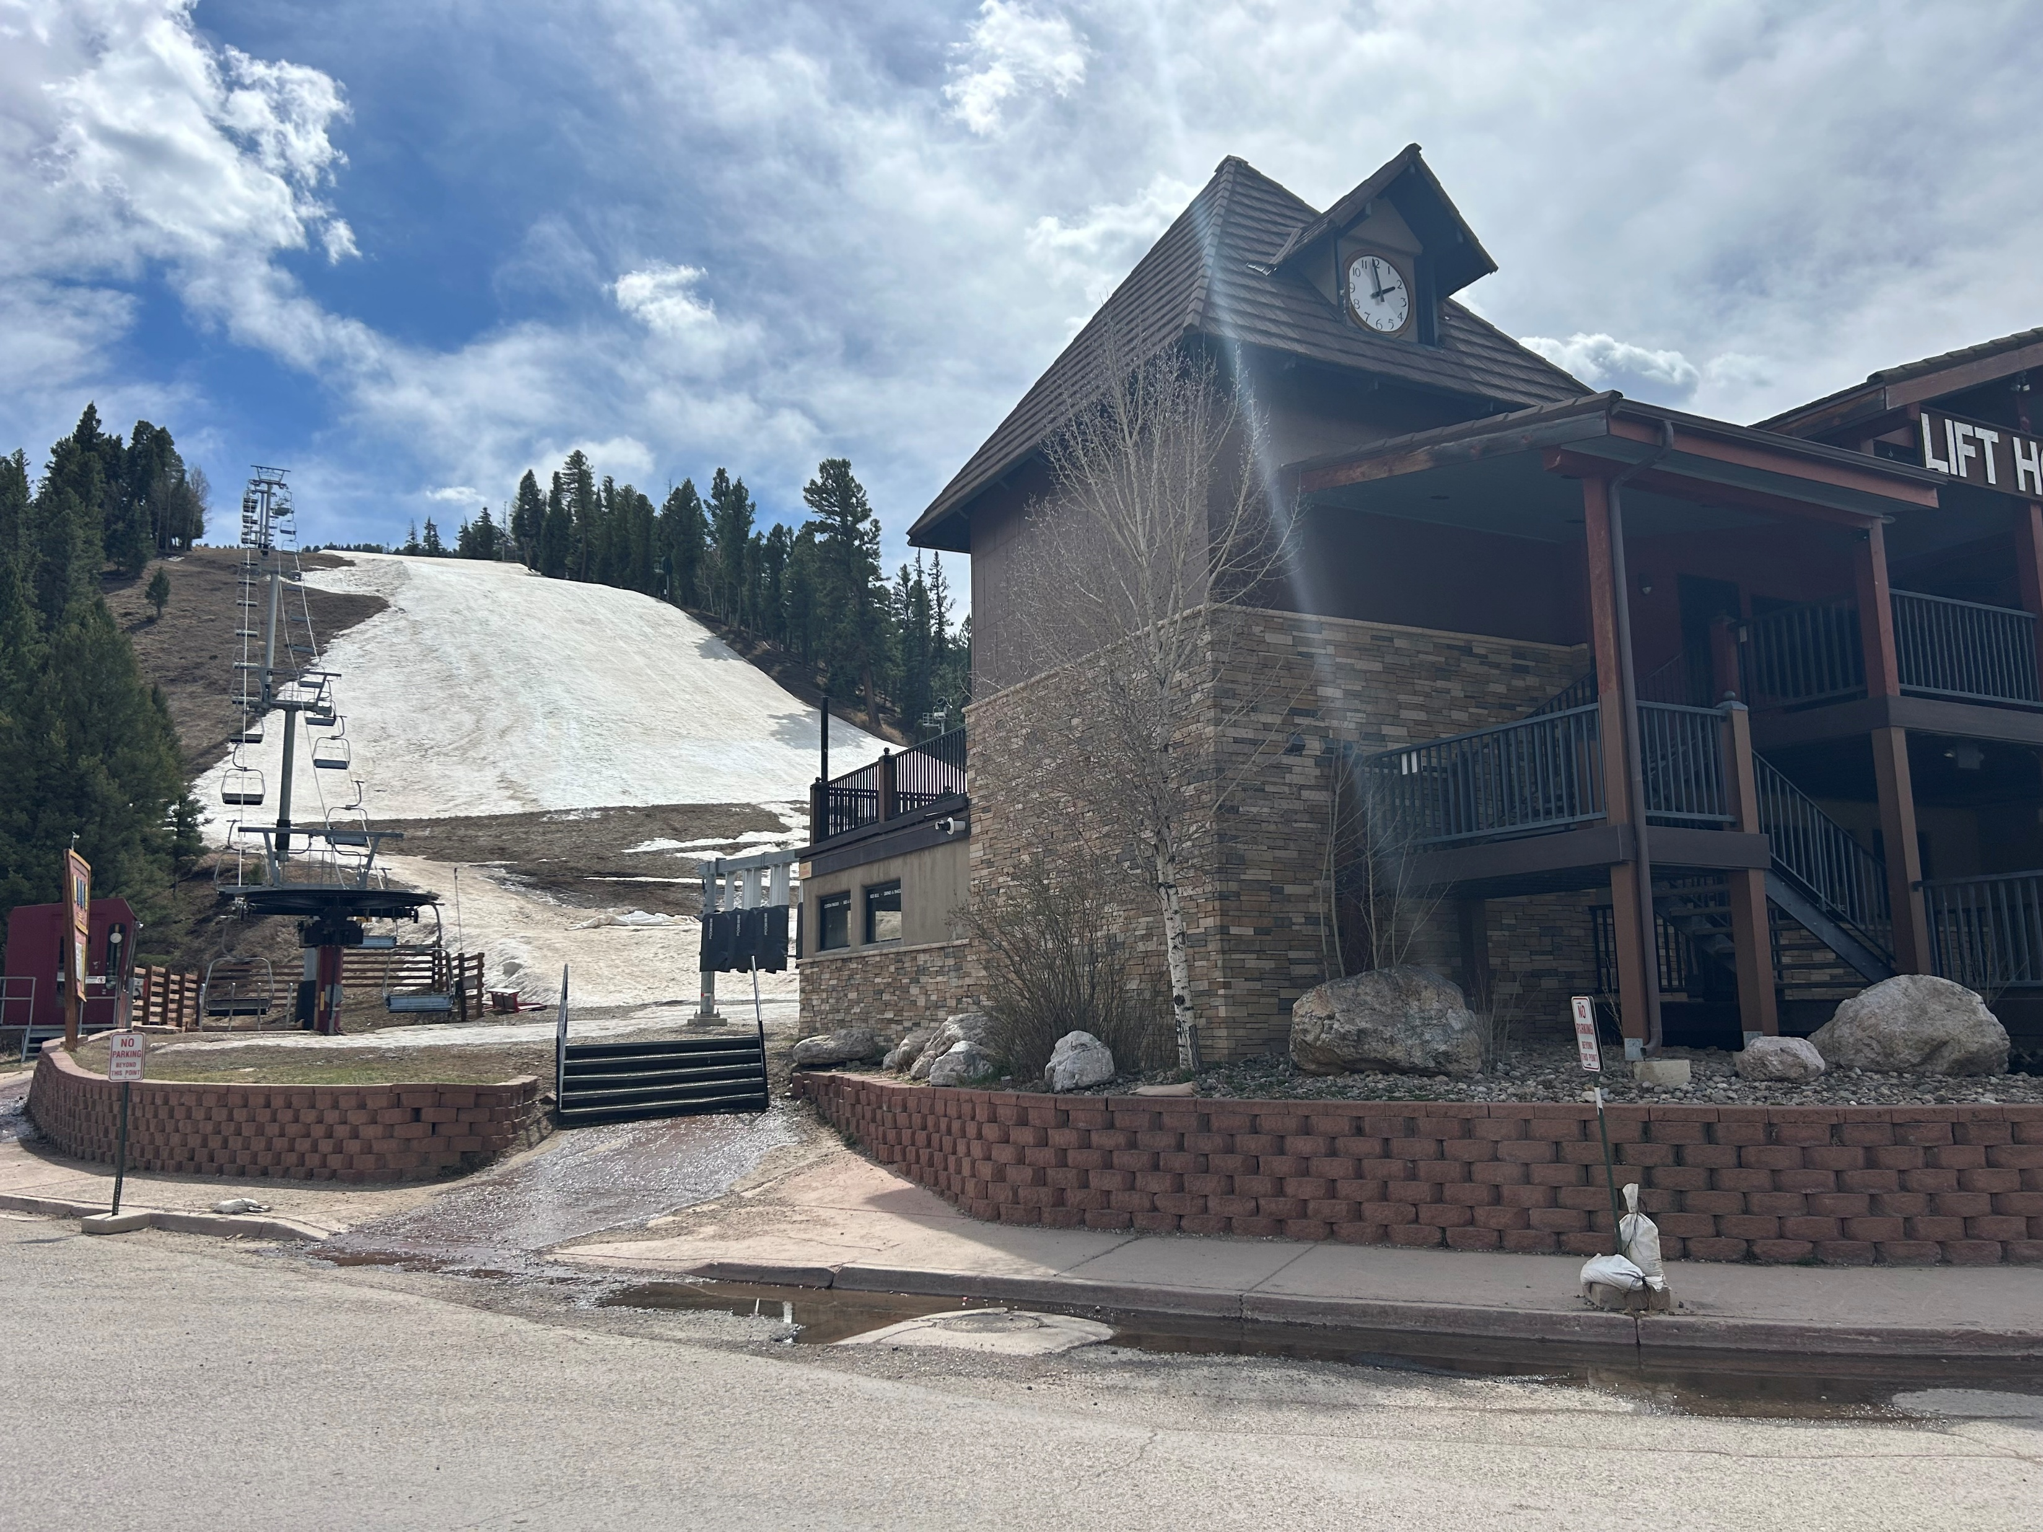
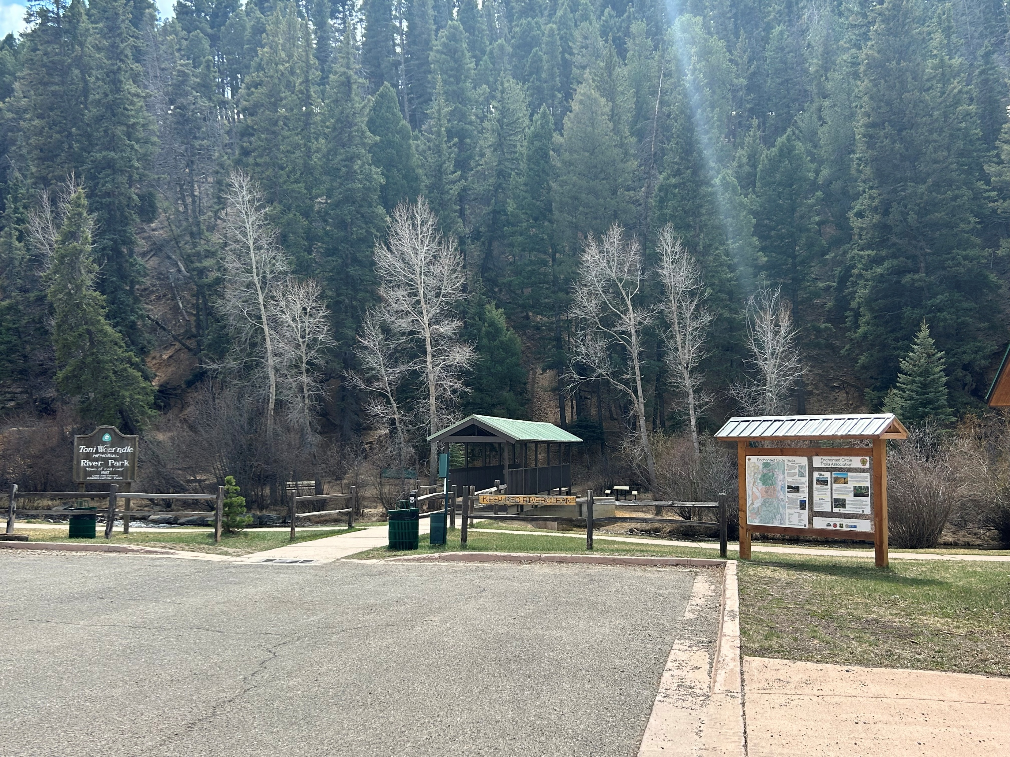
Pictures – Access to recreational areas

Slide 14
The End
The Town of Red River sincerely appreciates your interest in this project.
THANK YOU

