Slide 1
Northern Pueblos RTPO
FY 2026 TPF Proposals:
Village of Taos Ski Valley
Presentation by VTSV AND DENNIS ENGINEERING COMPANY
April 1, 2026

Slide 2
PROJECT LOCATION MAP
Today, the Village of Taos Ski Valley will be
discussing three TPF applications:
1) Twining Road Retaining Wall
2) Zaps and Porcupine Road Drainage Imp.
3) Kachina Road and Drainage Improvements

Slide 3
Planning: Secured other Funding Sources, Matching Funds
 | Priority #1 | Priority #2 | Priority #3
 | Twining Road Retaining Wall | Zaps and Porcupine Road and Drainage Improvements | Kachina Road and Drainage Improvements
NMDOT Share | $950,000 | $3,325,000 | $3,325,000
Village Share | $50,000 | $175,000 | $175,000
Total Est. Cost | $1,000,000 | $3,500,000 | $3,500,000
Existing funds - design phase | HW2L500522 NMDOT: $84,540 Local: $28,180 | HW2L500564 NMDOT: $113,741 Local: $37,914 | HW2L500609 NMDOT: $115,000 Local: $38,333
The Village of Taos Ski Valley will be requesting match waivers.

Slide 4
Timeline: Design and Construction
 | Priority #1 | Priority #2 | Priority #3
 | Twining Road Retaining Wall | Zaps and Porcupine Road and Drainage Improvements | Kachina Road and Drainage Improvements
Estimated Design Completion Date | July 17, 2026 | May 13, 2026 | June 30, 2026
Assuming award of TPF funds in September 2026, projects can be
completed within the 2.5 years allocated by the TPF program.

Slide 5
Planning: Support from existing planning documents and/or federal or state agencies
All three projects are currently in the design phase.
        Twining Road Retaining Wall 50% Complete
        Zaps and Porcupine Road and Drainage Improvements 75% Complete
        Kachina Road and Drainage Improvements 23% Complete
Design phases will be completed by June 30, 2026
NMDOT ROW Support is not necessary as none of the project intersect or are within NMDOT ROW
All three projects have been reviewed with NPRTPO and NMDOT

Slide 6
Project Description: Location of Project, and Details of Proposed Development
Priority 1: Twining Road Retaining Wall
The Twining Road Retaining Wall project consists of a gabion basket style retaining wall for a length of approximately 148’.
The purpose of this project is to provide erosion control and protect the road from mud/snow slides. There is a residence near the top of the slope which could be negatively impacted by the erosion. There is also a pond opposite of the retaining wall and minimizing debris from entering the pond will help protect the natural habitat.

Slide 7
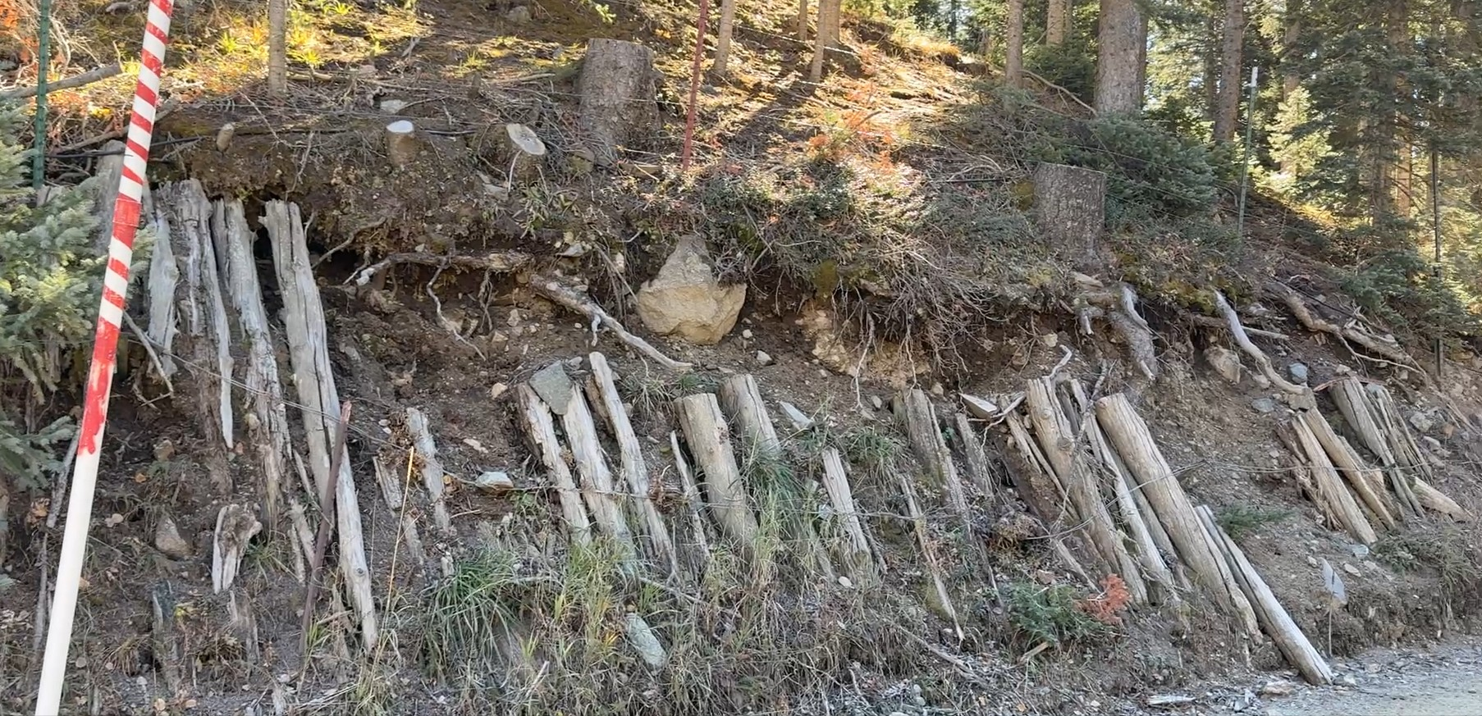
Project Description: Location of Project, and Details of Proposed Development
Priority 1: Twining Road Retaining Wall
Gabion Baskets were chosen for this site because of the ease of construction within a narrow ROW, availability of material, and relatively low cost compared to other solutions.

Slide 8
Project Description: Location of Project, and Details of Proposed Development

Slide 9
Project Description: Location of Project, and Details of Proposed Development
Priority 2: Zaps and Porcupine Road and Drainage Improvements
The Zaps and Porcupine Road project commences at Upper Twining Road and ends at Kachina Road. Improvements consist of subgrade prep, base course, hot mix asphalt, curb, valley gutters, curb returns and approximately 1,500 lf of storm drain with drop inlets.
These roads are major ingress/egress roads for tourism, Village businesses and emergency evacuation routes.

Slide 10
Project Description: Location of Project, and Details of Proposed Development
Priority 3: Kachina Road Improvements
The Kachina Road project commences at Porcupine Road and continues south for approximately 3,500 lf. Improvements consist of subgrade prep, base course, hot mix asphalt, curb, valley gutters, curb returns and approximately 1,500 lf of storm drain with drop inlets.
These roads are major ingress/egress roads for tourism, Village businesses and emergency evacuation routes.

Slide 11
Project Description: Level of coordination with RTPO, NMDOT, and State entities in project development
The Village of Taos Ski Valley has coordinated with the following entities:
  NMDOT
  NPRTPO
  Engineering Firms
  Local Residents

Slide 12
Justification: Economic Impact and Project Need
The Twining Road Retaining Wall project is necessary from a safety perspective. During periods of inclement weather (rain, snow, etc.), runoff and debris wash onto the road and into the body of water across the street. There is also a residence on top of the hill behind the proposed wall while not in danger yet, it is just a matter of time before enough erosion occurs to be come an issue.
Zaps Road, Porcupine Road and Kachina Road are critical roads to the Village. Not only do they provide ingress/egress capabilities for tourism and other economic drivers, they are needed for safety out of the Village as well.

Slide 13
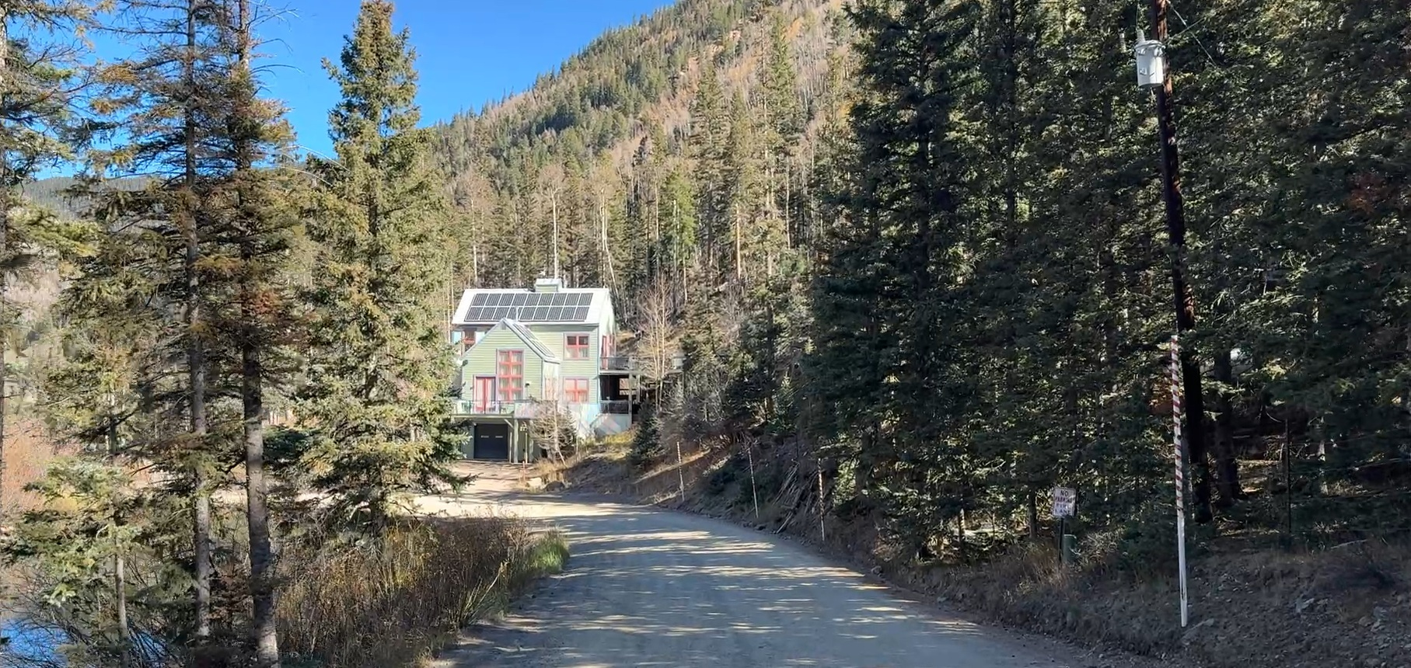
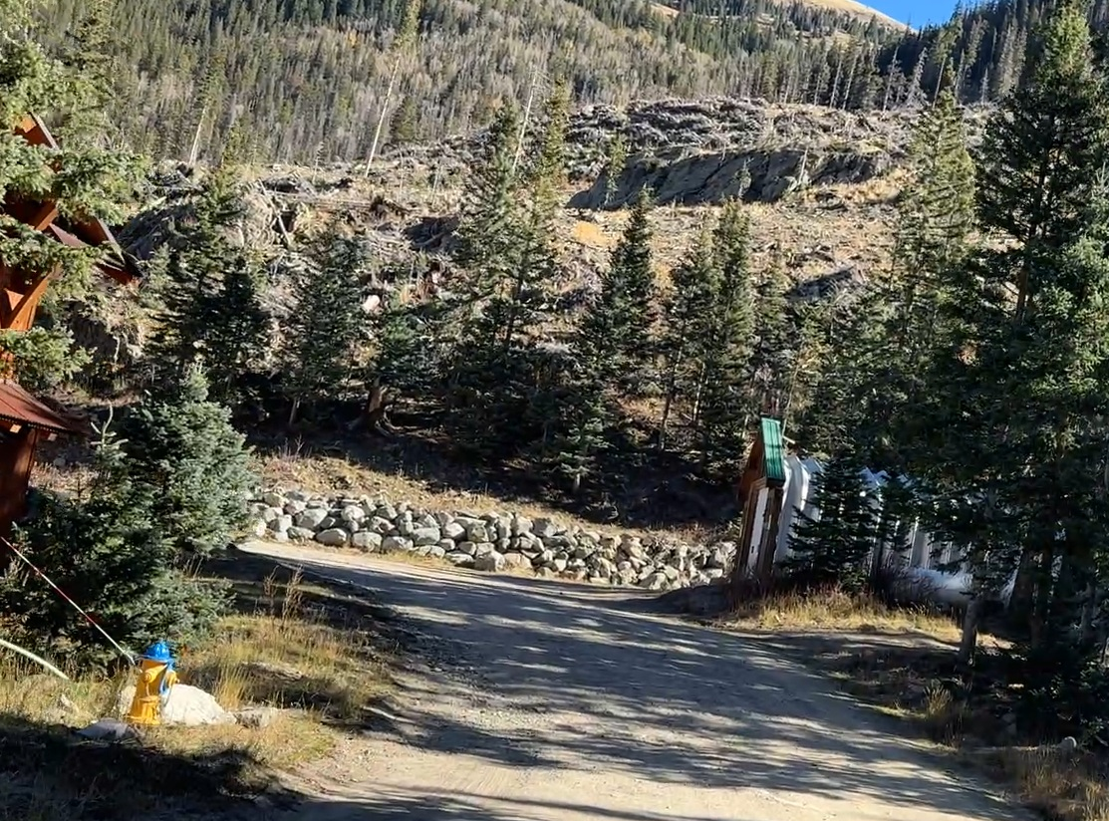
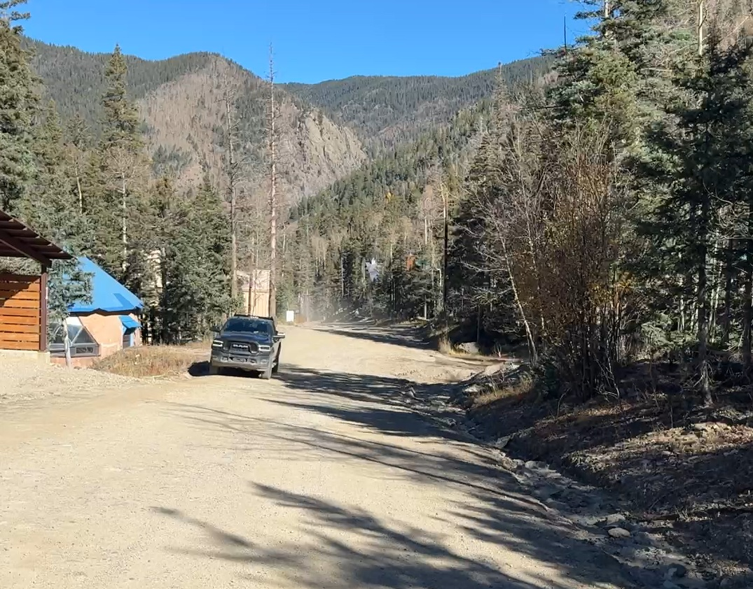
Project Photos:
Zaps and Porcupine Road
And Drainage Improvements
Kachina Road and
Drainage Imp.
Twining Road Retaining Wall

Slide 14
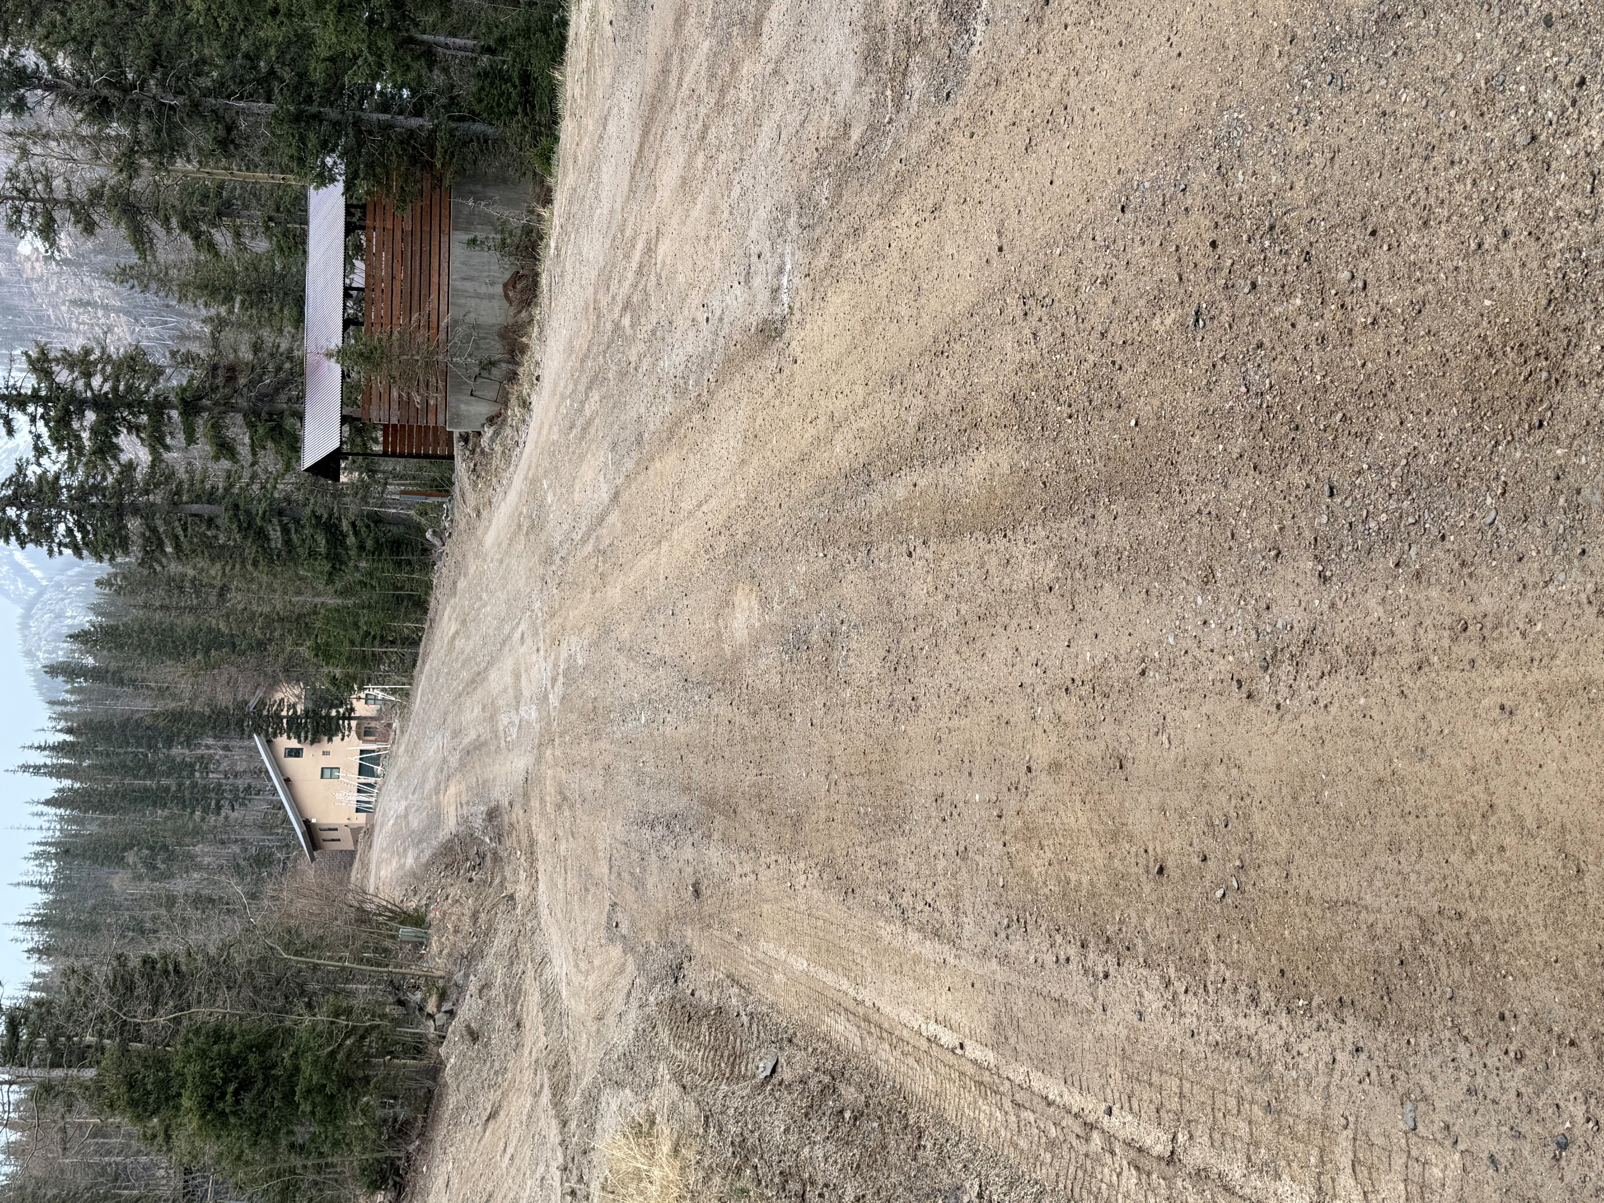
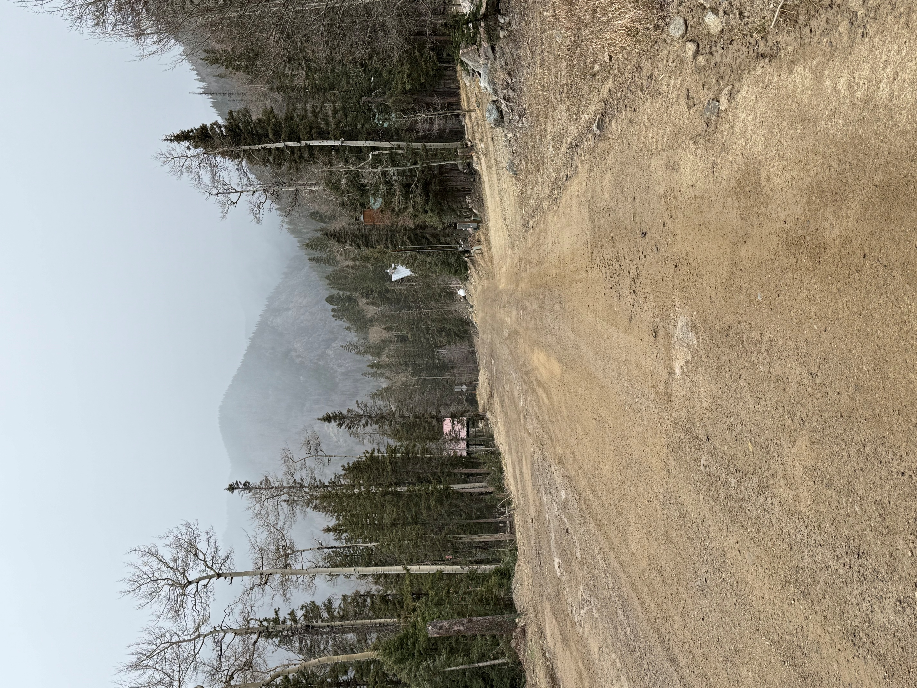
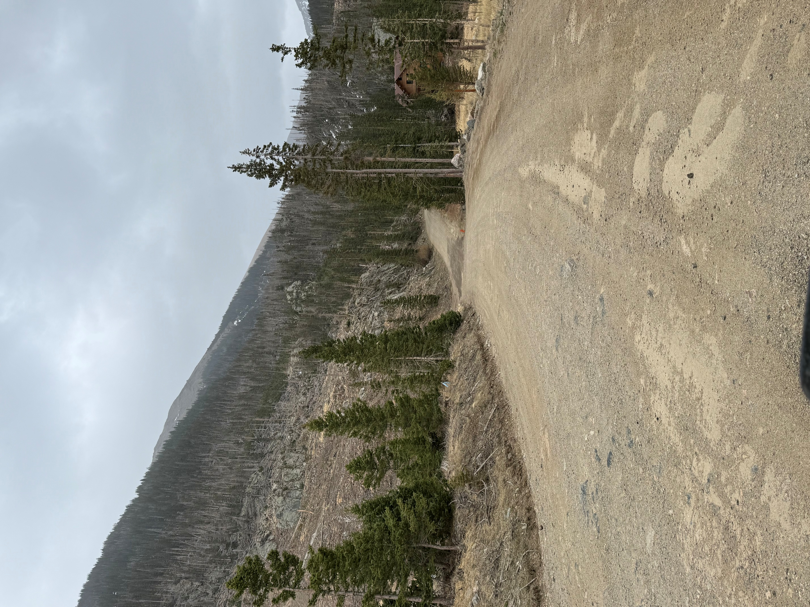
Project Photos:
Zaps Road
Kachina Road
Zaps Road

Slide 15
Project Summary
In summary, the Village of Taos Ski Valley is requesting funding for three projects: Twining Road Retaining wall, Zaps and Porcupine Road and Drainage Improvements and Kachina Road and Drainage Improvements.
The improvements to this area will greatly enhance the area, provide opportunity for economic growth which will increase our GRT base, increase safety for the traveling public as well as emergency personnel, and perhaps mostly importantly, allow for paved access to/from the area in the event of an evacuation.
The Village of Taos Ski Valley thanks you for your support when ranking our projects.

