Slide 1
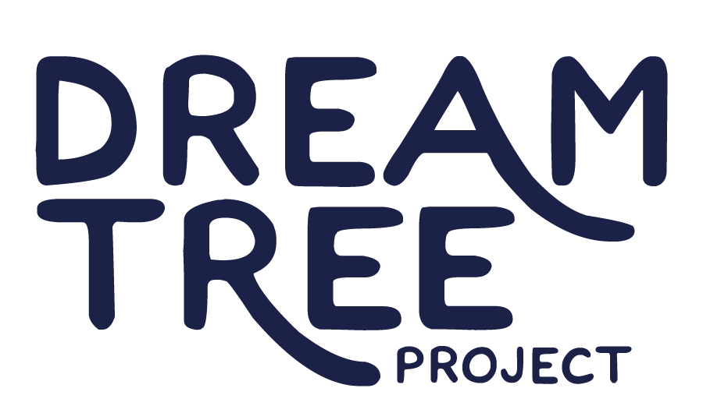
FY27 5310
VEHICLE REQUEST-
EXPANSION

Slide 2
OUR VISION
Everyone in northern New Mexico has stability, support, and the opportunity to pursue their dreams.
OUR MISSION
To provide housing and compassionate support services to youth, adults, and families experiencing housing instability.

Slide 3
DreamTree Project Youth Programs and Services in 2026
Program | Overview
Emergency Youth Shelter (EYS) Located in Taos | - 24/7 emergency shelter and support - Serving 12-17 year olds
Transitional Living Program (TLP) Located in Taos, Española, Ratón and Las Vegas | - Independent housing and support - Serving young people 16-24 (and their children)
Street Outreach (SOP) Occurs in Taos, Rio Arriba, Colfax, Mora, Union and San Miguel Counties | - Mobile outreach meeting people on the street, providing resource info, snacks, hygiene packs and survival gear - Serving youth, adults and families
Taos NEST Located in Taos | - Emergency overnight shelter and family resource center, service navigation support and referral - Serving youth, adults and families
National Safe Place Occurs throughout all of NCRTD’s service area | - In partnership with NCRTD, all buses and stops designated as Safe Place where youth can ask for help

Slide 4
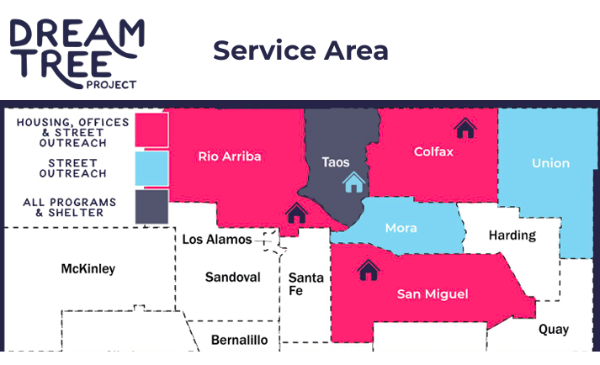

Slide 5
One-Way Ridership by Trip Type in 2024
TRIP TYPE | RIDERSHIP
Education | 717
Employment | 303
Medical Appointments and Pharmacy | 149
Nutrition, Shopping | 210
Social/Recreational | 4382
Other; To/From Center | 84
TOTAL | 5845

Slide 6
Program Justification
Causes of youth homelessness: domestic violence, abuse, neglect, family rejection, poverty, aging out of foster care.
Rural northern NM adds barriers: long distances, limited supports, isolation, and seasonal road closures.
Distance and geography make access to essential services difficult.
Over 90% of DreamTree youth have behavioral health diagnoses (SED).
Local rates of youth homelessness (~7.5%) far exceed national average (1 in 30 youth).

Slide 7
Program Justification
Many youth live in new, unfamiliar communities, away from family and schools.
DreamTree provides 24/7 on-demand transportation to health care, counseling, dental, vision, school, work, and community activities.
Reliable transportation connects youth to vital services, builds stability, and aligns with State Management Plan goals.

Slide 8
Program Coordination
DreamTree coordinates transportation through existing providers whenever possible.
Youth use bikes, walk, or take NCRTD Blue Bus, Santa Fe Trails, Golden Spread, City of Las Vegas Transit, or NM RailRunner.
Emergency or supervised rides provided when needed.

Slide 9
Program Coordination
Some vital services especially medical and dental care lie outside existing transit coverage.
Most youth have Medicaid; nearest Medicaid-accepting dentists are in Peñasco and Angel Fire, too far for unaccompanied minors.
DreamTree’s supplemental demand transit fills these critical access gaps.

Slide 10
Maintenance, Safety and ADA
DreamTree Project follows the manufacturer preventative maintenance recommendations for all of the vehicles in its fleet.
DreamTree maintains a Fleet Replacement Plan that meets the needs of its expanding services and the region it serves.
All staff that drive DreamTree Project vehicles are required to participate in defensive driving, pre/posttrip inspection, accident reporting and other safe driving trainings before they are able to drive a vehicle.
All driving staff are trained on proper lift usage, safe securement of mobility devices and customer service.

Slide 11
FY27 5310 Request
DreamTree expanding service to Española, Raton, and Las Vegas.
Seeking funding for three AWD SUVs to serve the six-county area.
Vehicles will transport youth to essential services and community activities that improve quality of life.

Slide 12
FY27 5310 Request
Lift-equipped vehicle usage since 2016: 0 instances.
SUVs without lifts increase seating and efficiency.
DreamTree can deploy a lift-equipped Ford Transit (based in Taos) as needed.
Approach ensures flexibility and accessibility across rural terrain.

Slide 13
FY27 5310 Request
AWD SUVs are safe, fuel-efficient, and well-suited for rural, mountainous roads.
Provide reliable access to critical lifeline services year-round.

Slide 14
FY27 5310 Request
Transportation should feel supportive and non-institutional.
Vans often associated with government or law enforcement can discourage youth from seeking help.
SUVs provide privacy, comfort, and dignity encouraging youth participation.

Slide 15
Thank you for your time and consideration of DreamTree Project’s FY27 5310 request for vehicles to support program expansion.
If you know a youth who needs support, contact DreamTree Project:
TEXT 24/7: 575.770.7704 CALL Monday-Friday: 575.758.9595

