Slide 1
Northern Pueblos RTPO
FY 2027 TPF Proposal:
Mundo Ranch Project
Presentation by Jicarilla Apache Nation Contract Roads
April 1, 2026

Slide 2
Planning: Secured other Funding Sources, Matching Funds
Matching funding for the Mundo Ranch Roads project is identified as Tribal Capital Outlay for Fiscal Years 2026–2027, reflecting the Tribe’s commitment to investing its own financial resources alongside external funding sources to support critical infrastructure improvements. This allocation demonstrates local stakeholder participation and strengthens the project’s competitiveness for grants by ensuring that a portion of the total project cost is secured through dedicated tribal funds. The Tribal Capital Outlay will be used to complement requested funding, helping to cover planning, design, construction, and related project expenses necessary to improve road conditions, accessibility, and safety within the Mundo Ranch area.

Slide 3
Planning: Support from existing planning documents and/or federal or state agencies
Planning for the Mundo Ranch Housing Development began over 20 years ago in collaboration with Chaney Eco and Walters, during which initial layouts and road alignments were established and formally plotted. While this early work provided a strong foundation for the project, the existing plans now require updates to meet current engineering standards, regulatory requirements, and site conditions. As a result, additional funding is needed to support updated engineering design, surveys, and technical analyses to ensure the project can move forward efficiently and in compliance with modern infrastructure and safety expectations

Slide 4
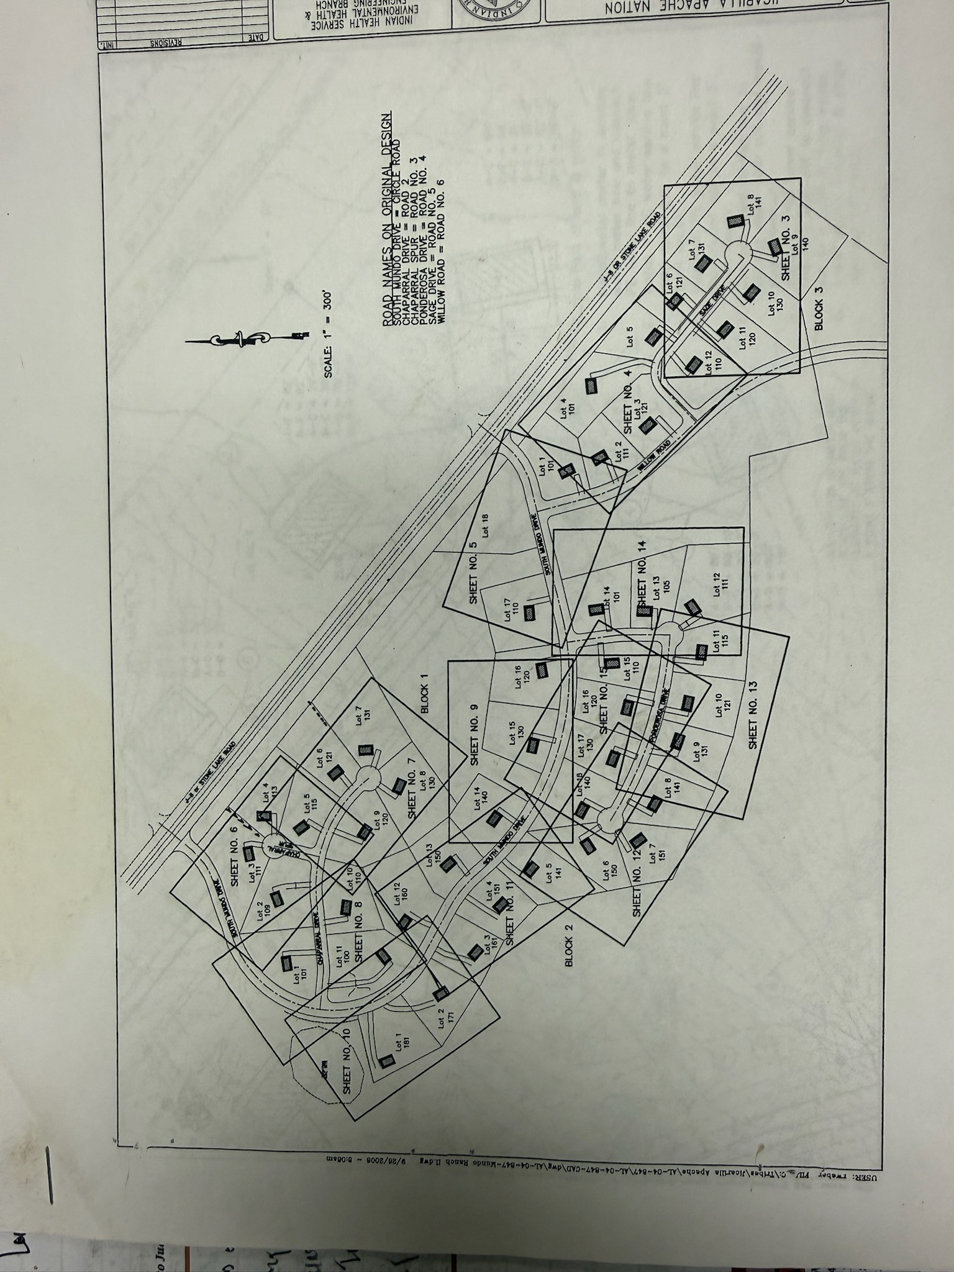
Project Description: Location of Project, and Details of Proposed Development
The proposed scope of work for the Mundo Ranch Roads project in Dulce, located adjacent to J-8 Street (Willow Road, approximately 1.25 miles) and the surrounding areas of South Mundo Drive and Sage, includes comprehensive roadway rehabilitation and maintenance to restore safe and reliable access. Work will consist of repairing deteriorated road sections through reclaiming and reconditioning the existing asphalt surface, followed by crack sealing to prevent further moisture intrusion and structural damage. Maintenance activities will address potholes through filling and asphalt patching, ensuring a smoother and safer driving surface. The project will also include paving improvements across designated segments, including up to two inches of new asphalt overlay where needed, to extend the lifespan of the roadway and improve overall durability and performance.

Slide 5
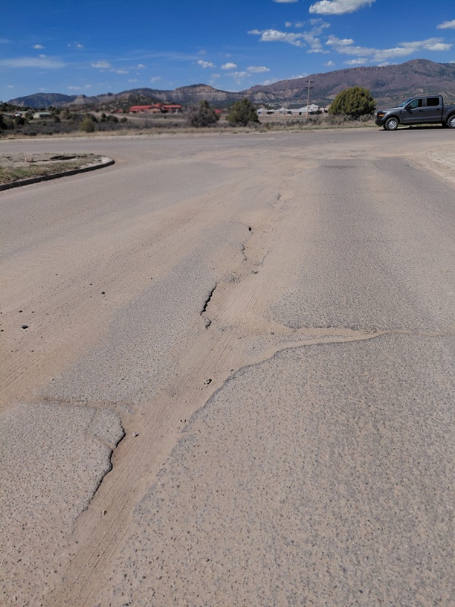
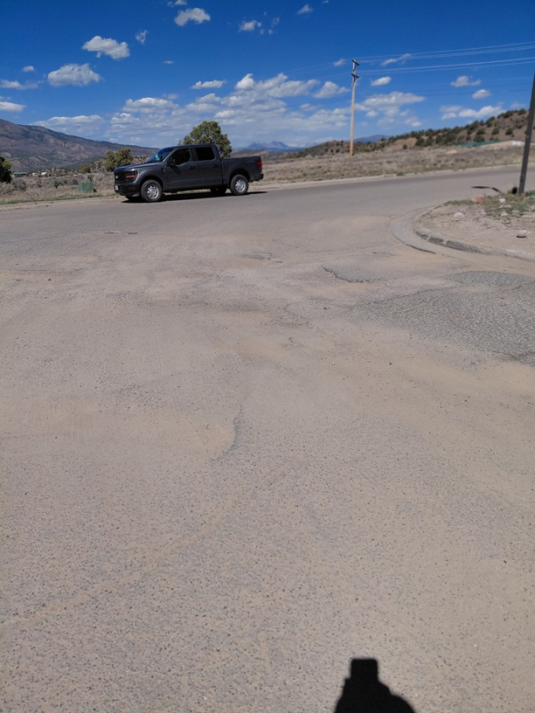
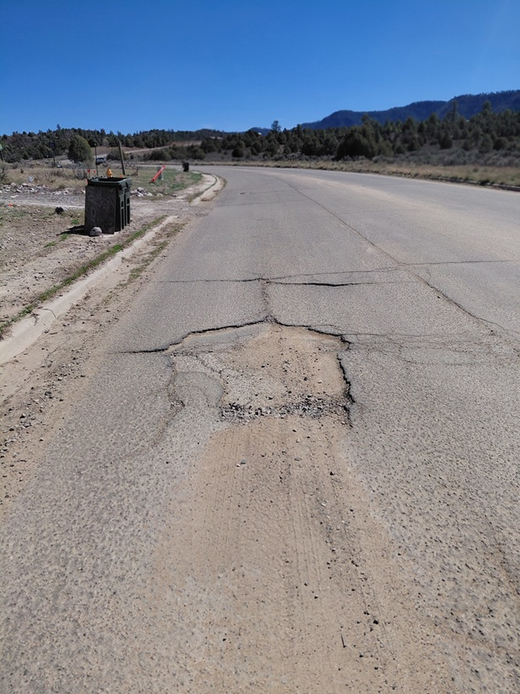
Road’s filled with Sand

Slide 6
Project Description: Level of coordination with RTPO and NMDOT in project development
The Jicarilla Apache Nation, under the leadership of President Adrian Notsinneh, has maintained active coordination with the New Mexico Department of Transportation, including ongoing communication with the regional highway director. The project has been supported through technical guidance and planning assistance from Patrick Million and Angelia Trujillo. Additionally, Kathryn Valdez meets monthly with the New Mexico Tribal Transportation Program (NPRTPO) and plays an active role in project coordination and communication as an alternate member, helping to ensure continued collaboration and alignment among tribal, state, and transportation partners.

Slide 7
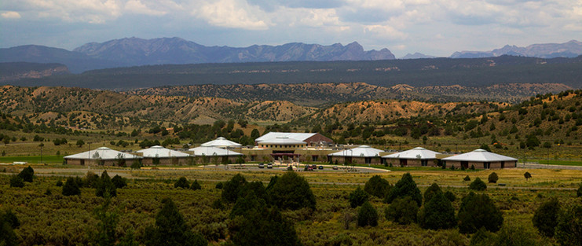
Justification: Economic Impact and Project Need
This project supports economic development by serving key community facilities, including the elementary school, Dulce Indian Health Center, the Dialysis Center, and other local businesses. These roads are essential for daily transportation, as school buses, law enforcement, and fire department vehicles rely on them for safe and timely travel. Without proper maintenance and repairs, the deteriorating road conditions create significant safety hazards, increasing the risk of accidents and delays in emergency response. Improving these roads will enhance public safety, ensure reliable access to critical services, and strengthen the overall infrastructure that supports the community’s economic stability.

Slide 8
Justification: Quality of Life, Safety, and Environmental Sustainability
The Mundo Ranch Roads project will significantly improve the quality of life for community members by creating safer and more reliable roadways. With repaired roads, residents will experience less wear and tear on their vehicles, reducing the financial burden of frequent repairs and maintenance. Improved road conditions will also enhance safety for all travelers, especially for local public safety departments such as police, fire, and emergency medical services, allowing them to respond more quickly and efficiently. Families will benefit from safer daily travel, whether commuting to school, work, or essential services, reducing the risk of accidents and delays. Overall, maintaining and improving these roadways will provide a stronger, safer infrastructure that protects residents, supports emergency response, and promotes a higher quality of life for the entire community.

Slide 9
Request Readiness: R-O-W Acquisition, Clearances, Planning Docs, Timeline
The Mundo Ranch Roads project is considered shovel-ready, as there are already established roadways in place and existing plans that support the proposed improvements. No additional right-of-way acquisition is required because the work will occur within the current road corridors. Similarly, environmental clearances are expected to be minimal, as the project focuses on maintenance and repair rather than new construction or expansion into undisturbed areas. Planning documents are already in place or can be quickly updated to reflect the scope of work, allowing the project to move forward without delay. Because the project is limited to improving and maintaining existing roads, all necessary clearances and approvals can be completed efficiently. Once funding is secured, the project can begin immediately, with an estimated timeline of approximately six months to complete road maintenance and deliver fully improved, safer road conditions for the community.

Slide 10
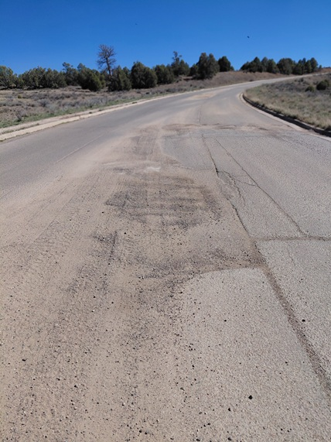
Project Summary
The Mundo Ranch – Willow Road Project is a road maintenance initiative focused on improving existing roadway conditions to better serve the community. The project will repair and maintain established roads, requiring no new right-of-way acquisition, which allows for immediate implementation. These improvements will enhance safety for school transportation, local residents, and public safety services such as police, fire, and emergency response. By addressing current road conditions, the project will reduce vehicle wear and tear, improve travel reliability, and support access to key community facilities. With a projected timeline of approximately six months, the project is shovel-ready and designed to quickly deliver safer, more dependable roadways for the Willow Road area. This will be an ongoing project in the future to fix other connecting roadways.

