Slide 1
NMDOT District 4 Permitting Program
NERTPO Meeting
Mora, NM
February 27, 2019

Slide 2
NMDOT Permits
Utility Permit
Traffic Control/Roadway Work Permit
Driveway Permit- Residential and Commercial
Special Event Permit
Landscape Agreement
Interstate Access Permit
Fencing Removal Agreement

Slide 3
Utility Permit
Required for any publicly, privately, cooperatively, municipally or governmentally owned facility used for carriage, distribution or transmission of water, gas, electricity, oil and products derived therefrom, sewage, stream, or other product carried by means of pipelines, conduits, wires, culverts, ditches, conveyors or other methods.
Review Period – normally up to 40 work days from submittal of “complete” permit application.
Incorrect or incomplete permit applications will be returned for correction/completion.

Slide 4
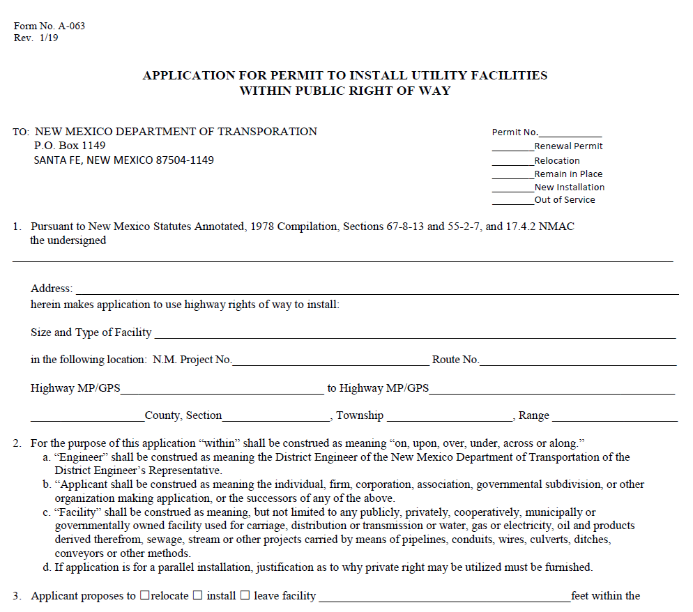
FORM NO. A-063

Slide 5
Utility Permit
Requirements for application:
Four completed Utility Permit Applications
Must be signed by Owner or Official Designee
Vicinity Map of Work Area
Four 11”x17” copies of utility relocation/installation plans
Environmental/Cultural Resources Clearances
Clearance Received from NMDOT Environmental Section
Copy of Certificate of Insurance
Must be in the amount of $1,000,000 per occurrence during the project-with the NMDOT named as also insured

Slide 6
Utility Permit
Requirements for application (continued):
Traffic Control Plan
Proof of compliances with National Pollutant Discharge Elimination System (NPDES).
If disturbance is more than 1 acre
Other approvals/authorizations/permits must be obtained and copies attached, from Indian, Federal and other State agencies where required.
Proof of compliance with SWPPP
SWPPP Plan Must be approved BY NMDOT Drainage Section

Slide 7
Traffic Control/Roadway Work Permit
Used for permitting any work impacting an NMDOT facility, such as utility repair work, signal & lighting work, etc.
Application Requirements:
Completed Application
Traffic Control Plan
Copy of Certificate of Insurance
Must be in the amount of $1,000,000 per occurrence during the project-with the NMDOT named as additionally insured
Hold Harmless/Indemnification Agreement
Must be notarized

Slide 8
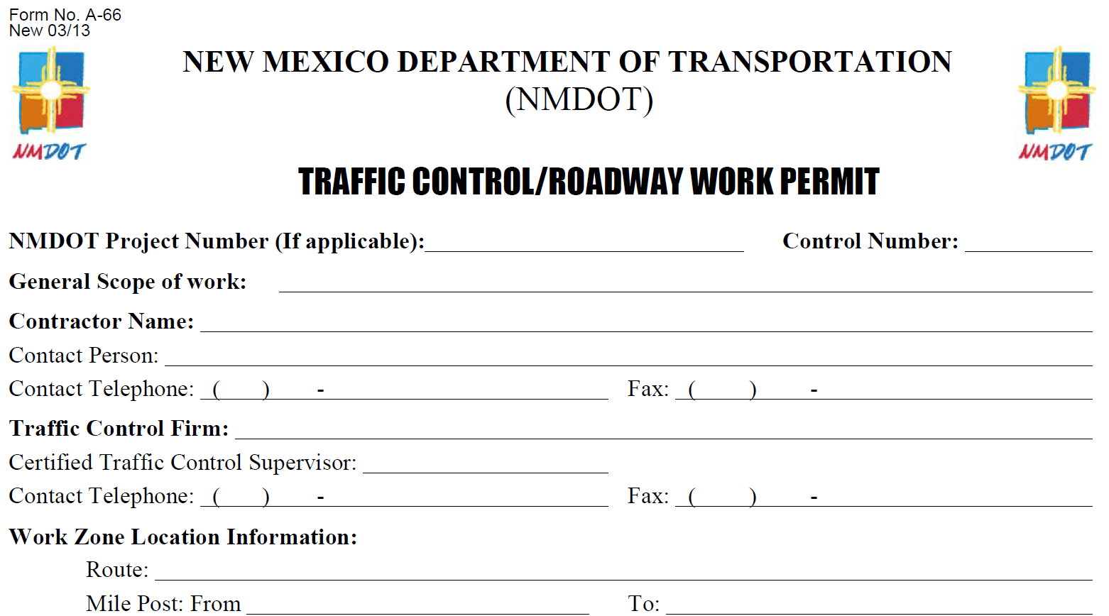
FORM NO. A-66

Slide 9
Driveway Permit
Covered by 18.31.6 NMAC 2017 & NMDOT State Access Management Manual
Required for:
All New Accesses, permanent or temporary
Modification or transfer of existing lawful access permit
Upgrading and existing illegal access to a lawful access
Changes in property use

Slide 10
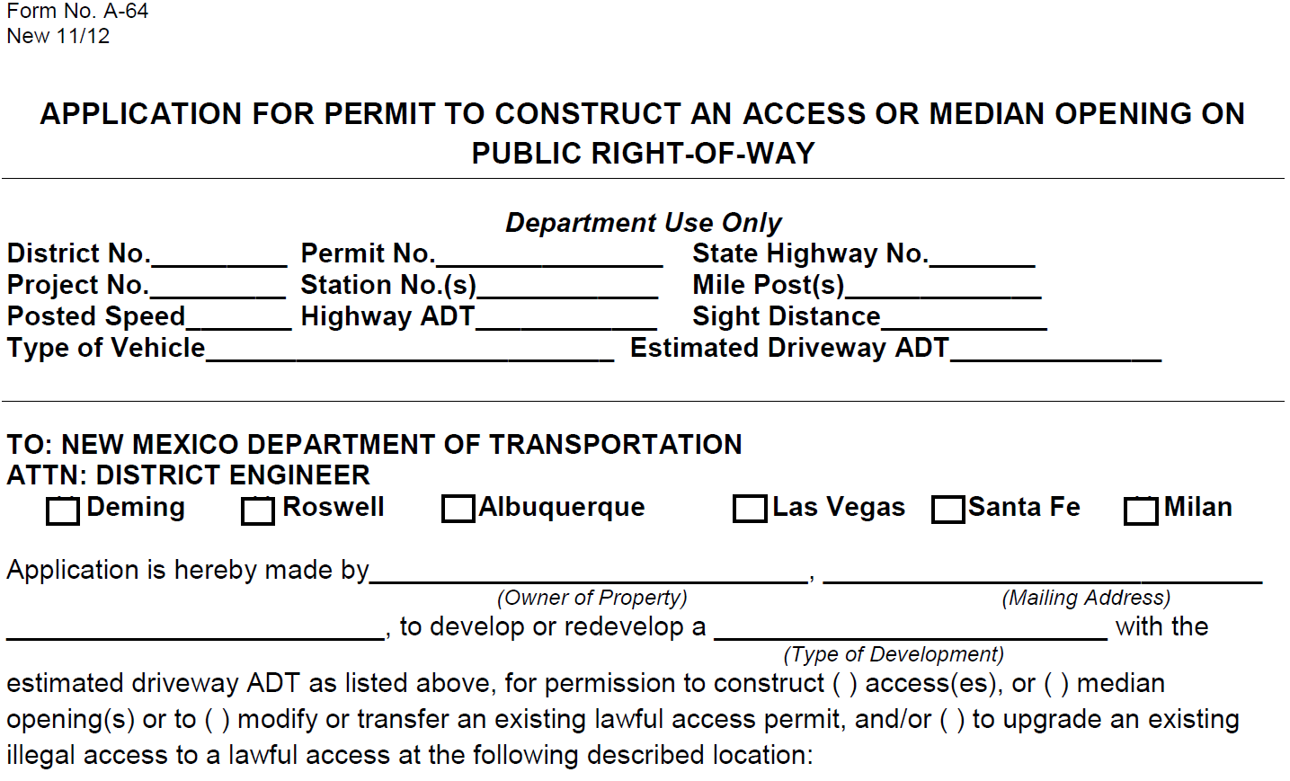
FORM NO. A-64

Slide 11
Driveway Permit
Residential Driveway Permit Requirements:
Proof of Ownership (A copy of one of the following documents)
Warranty Deed
Survey Plat
Copy of Current Property Owners Tax Bill
Notarized
Permits must be signed and notarized by the owner.
Contact Phone Numbers
Location of Proposed Driveway(s)
Route number and Milepost to the nearest 1/10 of a mile
Mark proposed driveway location with some type of marker such as ribbon, flag, etc. (Identify Type of Marker on Application)

Slide 12
Driveway Permit
Commercial Driveway Permit Requirements:
Updated access management requirements.
18.31.6 NMAC 6/27/2017
Same requirements as residential driveway plus the following:
Site layout on an 11’ x17” sheet
Traffic Analysis (Level required depends on traffic generated)
Site Threshold Assessment (STH) - No longer required
Site Traffic Analysis (STA) – Required for all development
Traffic Impact Analysis (TIA) – More than 100 Peak Hour Trips
Design Plans for any roadway geometric improvements
Plans to include detailed dimensional layouts of all improvements
Traffic Control Plan
Site Grading and Drainage Plan
Must be approved BY NMDOT Drainage Section

Slide 13
Driveway Permit
Commercial Driveway Permit Requirements:
SWPPP Plan
Must be approved BY NMDOT Drainage Section
Environmental/Cultural Resources Clearance
Clearance Received from NMDOT Environmental Section
Driveway must be constructed within 6 months of date of issuance of the permit or permit will expire.
If unable to construct within 6 months, an extension can be requested, in writing. Must include explanation of why it was unable to be constructed within the required 6 months.
It is the applicants responsibility to construct and maintain the access.
Permit review period is normally up to 45 work days from submittal of “complete” permit application.

Slide 14
Special Event Permit
Permit Application Requirements
Cover Letter explaining event and need to use NMDOT Right of Way
List of local government approvals
Traffic Control Plan
If utilizing law enforcement, must have written acknowledgement/ concurrence from the law enforcement agency
Clear map of proposed route
Certificate of insurance
Must be in the amount of $1,000,000 per occurrence
NMDOT must be listed as additionally insured
Hold Harmless/Indemnification Agreement
Must be notarized

Slide 15
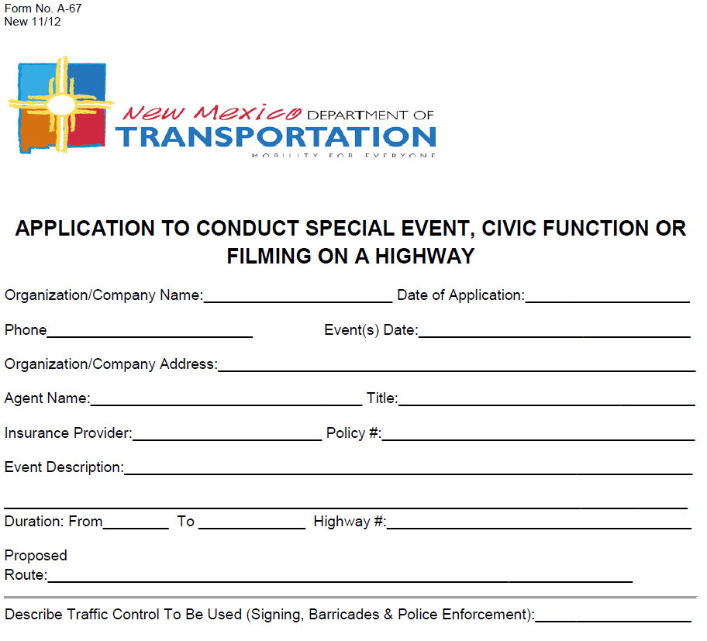
FORM NO. A-67

Slide 16
Landscaping Agreement
Allows private individuals, business, or local governments to place and maintain landscaping in NMDOT Right of Way.
Requirements:
Completed and signed permit application
Indemnification and Hold Harmless Agreement
Must be notarized
Plan sheets of proposed landscaping
Must show dimensions from edge of roadway, curb line, etc.
Must show all materials to be used

Slide 17
Landscaping Agreement
No shrubbery or bushes that could interfere with sight lines shall be planted or allowed to grow higher than 36” above roadway .
Trees may be planted but lowest portion of lowest limbs must be 6 feet above roadway.
Nothing will be allowed to overhang the curb or encroach on the roadway shoulder.
All costs and expenses for the construction and maintenance of the landscaping shall be borne by the applicant.

Slide 18
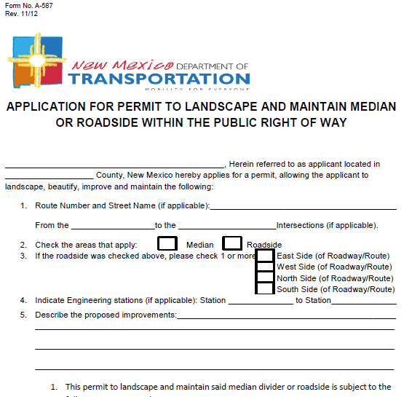
FORM NO. A-587

Slide 19
Other Permits
Interstate Access Permit Request
Construction Project Access
Must be associated with a current construction project
Other - Pre-manufactured Home
Must obtain general liability insurance covering the move in the amount of $1,050,000
Must submit a traffic control plan. If utilizing law enforcement, must have written acknowledgement/ concurrence from the law enforcement agency

Slide 20
Other Permits
Fencing Removal Agreement
Permits adjacent land owner to install their own fence and remove the NMDOT’s fence
Owner is responsible for the construction and maintenance of the fence and all associated costs.
Must indemnify and hold harmless the NMDOT
Must supply drawing or plan of proposed fencing
New fence shall be constructed parallel to the Department’s fence and approximately 3 feet onto the Owner’s property
Shall be constructed such that livestock is kept on private property

Slide 21
NMDOT Traffic Section Contacts
Gabriel Lucero, P.E. Karl Gonzales
District 4 Traffic Engineer (505) 617-5265
(505) 490-7709
Stephen Sena
(505) 652-8054
Permits & Checklists can also be found at:
http://dot.state.nm.us/content/nmdot/en/Infrastructure.html

