Slide 1
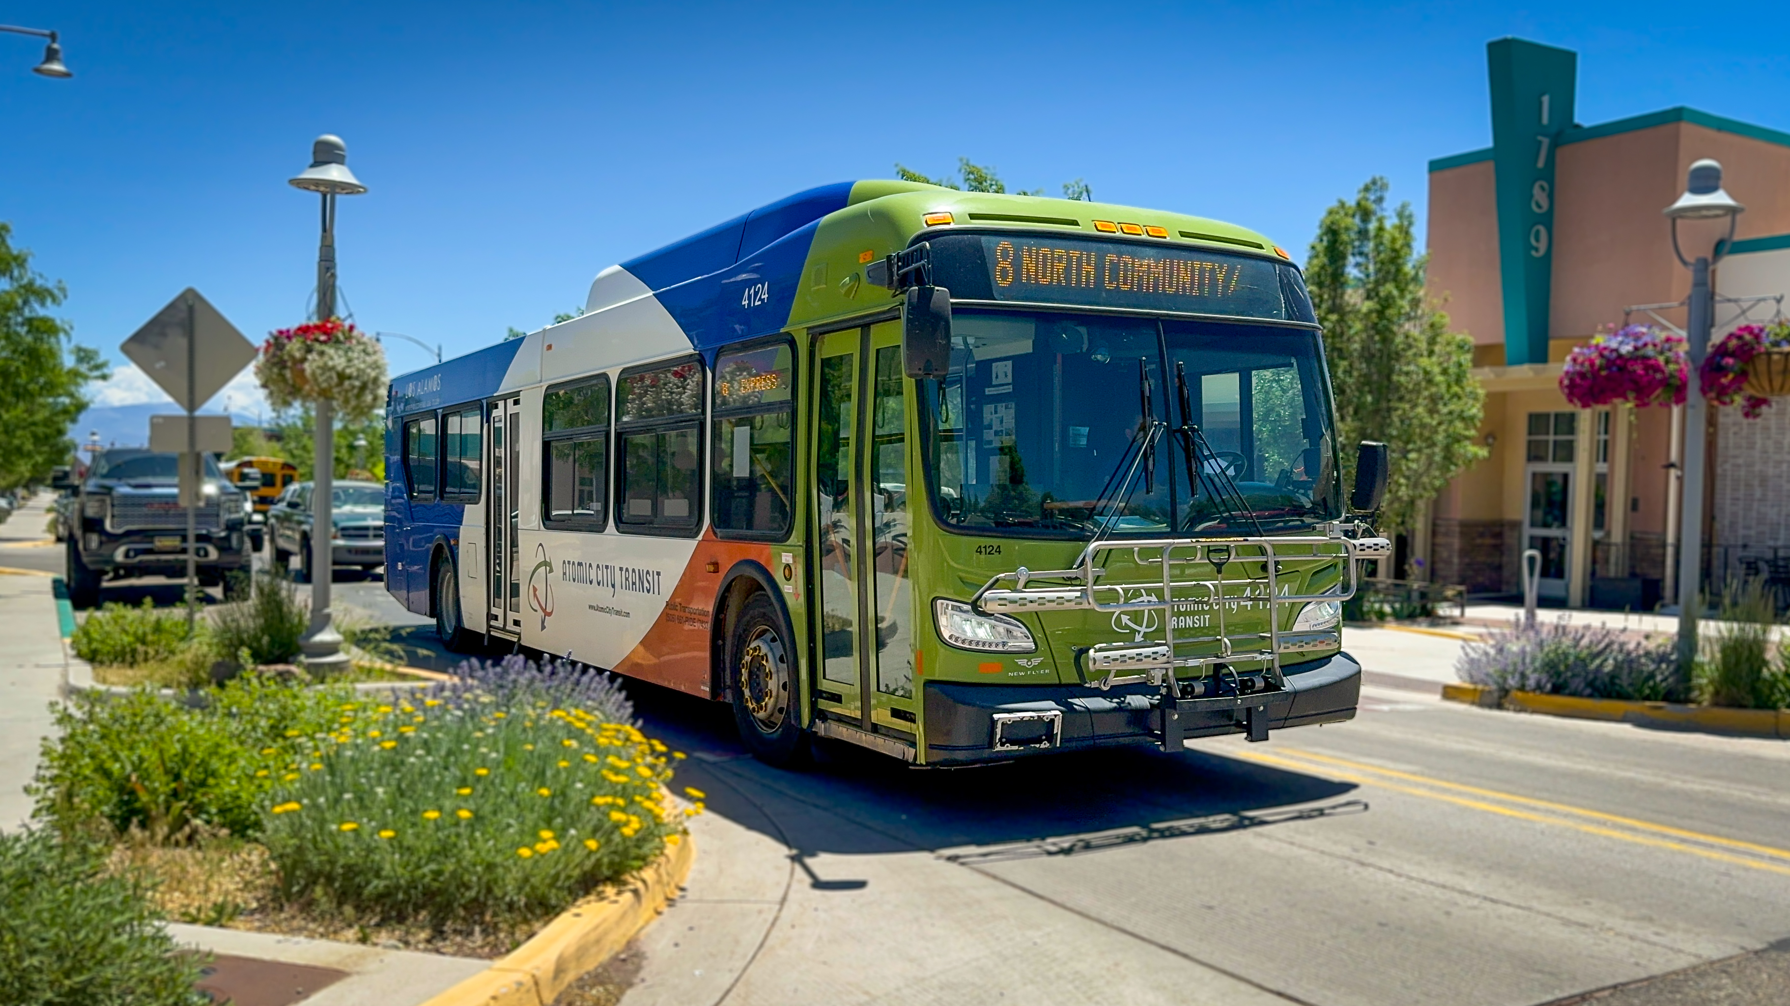
NPRTPO Transit Prioritization
November 12, 2025
ATOMIC CITY
TRANSIT
SECTION 5310 & 5311

Slide 2
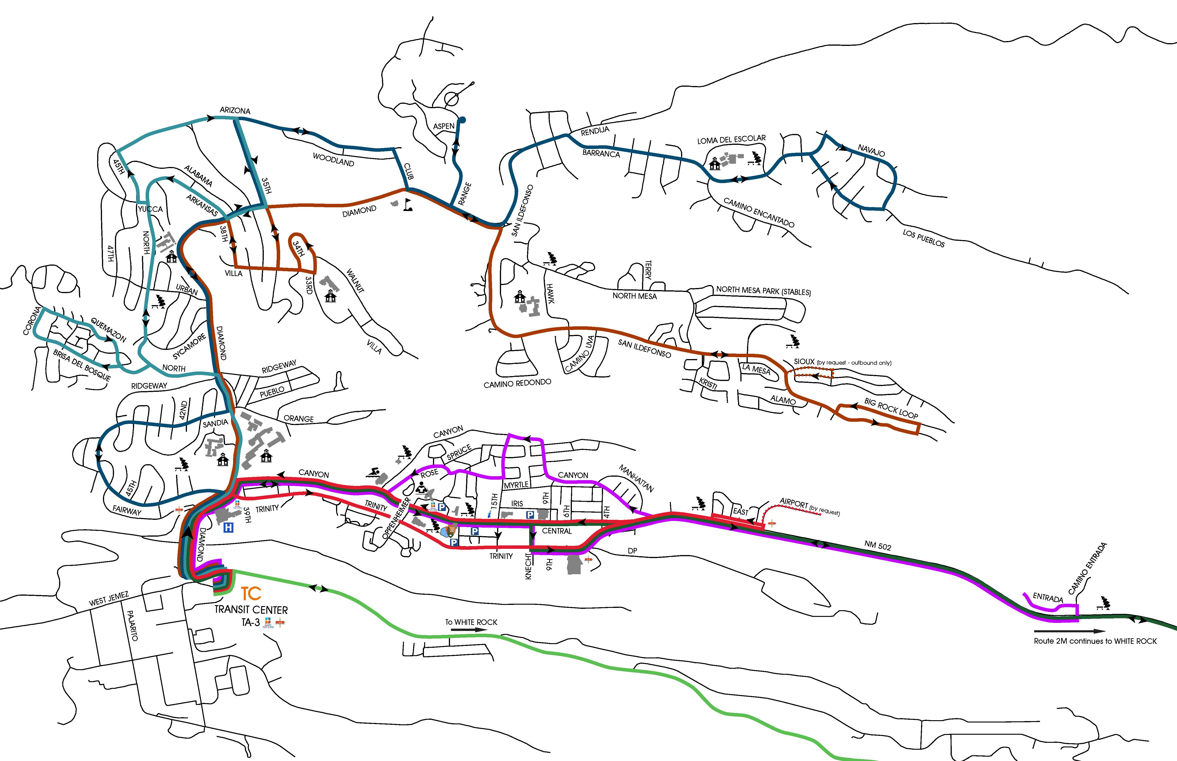
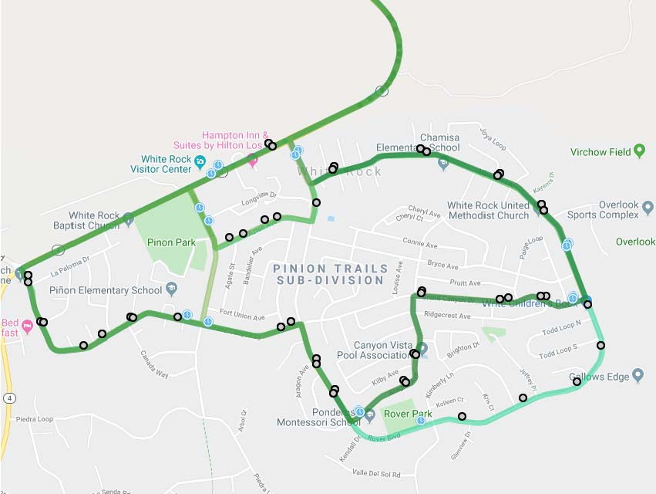
2025 Service Area
White Rock Area

Slide 3
Current Service Provided
Hourly service in eight neighborhood routes (Main Hill to/from White Rock, Truck Route to/from White Rock, Canyon/Central, North Community, Barranca Mesa and North Mesa) between 6:00 a.m. and 7:30 p.m.
Twice an hour service on four neighborhood route North Mesa (during peak hours), North Community, Downtown, and Canyon and White Rock
Service every 15 minutes on the Downtown Circulator during peak periods
ADA Complementary Paratransit Service for individuals with disabilities during the same days and hours of the fixed route service
Dial-a-Ride service for the general public between 5:15 a.m. to 6:00 a.m. and 6:30 p.m. to 9:00 p.m. Monday through Friday all vehicles are ADA accessible
Seasonal service between White Rock and Bandelier National Monument 7 days per week from approximately 9:00 a.m. to 5:00 p.m. Frequency is every 30 minutes on weekdays and 20 minutes on weekends and holiday weeks.
Afternoon Express Service operates only on school days and is open to the general public. In addition to scheduled drop off locations, Afternoon Express buses drop riders off at other marked bus stops along each of the routes, with the exception of bus stops located on Trinity Drive.
Public transportation service is provided during community events throughout the year

Slide 4
Employees
1 Manager
1 SR Management Analyst
1 Senior Office Specialist
2 Supervisors
2 CSR / Dispatchers
3 Lead Operators
23 Transit Operators
6 Limited Term (Seasonal) Transit Operators

Slide 5
Ridership Summary
FY is July through June
FY08 - 254,502 one-way trips
FY09 - 403,342 one-way trips
FY10 - 433,819 one-way trips
FY11 - 449,729 one-way trips
FY12 - 562,226 one-way trips
FY13 - 550,808 one-way trips
FY14 - 526,333 one-way trips
FY15 - 538,613 one-way trips
FY16 - 511,553 one-way trips
FY17 - 456,983 one-way trips
FY18 - 444,373 one-way trips
FY19 - 451,793 one-way trips
FY20 - 321,840 one-way trips
FY 21 - 42,739 one-way trips
FY22 - 195,208 one-way trips
FY23 - 267,617 one-way trips
FY24 - 254,349 one-way trips
FY25 - 269,205 one-way trips
FY26 - 61,929 one-way trips
(July thru September)

Slide 6

Transit Service Plans
August 2007 – 5-year
April 2009 – 5-year updated
March 2015 – 5-year Service Plan
June 2023 –5-year Service Plan
Marketing Plan – 2024
Maintenance Plan - 2024
Mission
The Mission of Atomic City Transit is to improve and strengthen mobility in Los Alamos County through an effective, efficient and dependable transit system.

Slide 7
Coordination Efforts
Local Businesses and Organizations
  LANL
  University of New Mexico- Los Alamos
  Los Alamos Medical Center
  Bandelier National Monument (NPS)
  DWI Council of Los Alamos
Other Transportation Services
  NCRTD – The Blue Bus
  Park-and-Ride
  LAC Senior Center Transportation
  LANL Taxi Service

Slide 8
Ongoing Funding
Atomic City Transit receives annual formula funding through competitive process overseen by NM DOT
In addition, Atomic City Transit receives funding from NCRTD for regional services provided through a service plan approved by NCRTD board
Atomic City Transit also receives funding through yearly County budget preparation and allocated GRT as needed to provide service to the community

Slide 9
Public Involvement
Service Changes:
Focus Group
Marketing Survey
Public Presentations
Ongoing:
Transportation Board
Comment Cards
Feedback form on website
Collect input from riders in person
Citizen Survey every 2 years

Slide 10
Regional Transportation Plan
Atomic City Transit system is included in the NM DOT Coordinated Human Services Transportation Plan as well as NM DOT State Transportation Plan
Historical and current ridership, identifies the need and use of Atomic City Transit exists
Atomic City Transit gained 50% over the last 5 years of fixed route calendar ridership
In 2025 ACT Assist increased 128% since 2019 in the paratransit calendar ridership
Atomic City Transit continues to support the Los Alamos National Laboratories of their increase labor force

Slide 11
Performance Measures
2024 Community Survey
74% of Los Alamos residents rate the overall quality of the public transportation in the area as excellent or good.
82% of residents rate the ACT bus service as excellent or good
67% of Los Alamos residents rate the ease of travel with public transportation as excellent or good.
45% of Los Alamos residents used public transportation instead of driving.

Slide 12
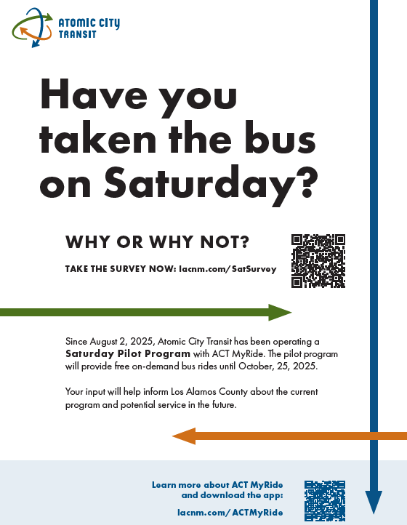
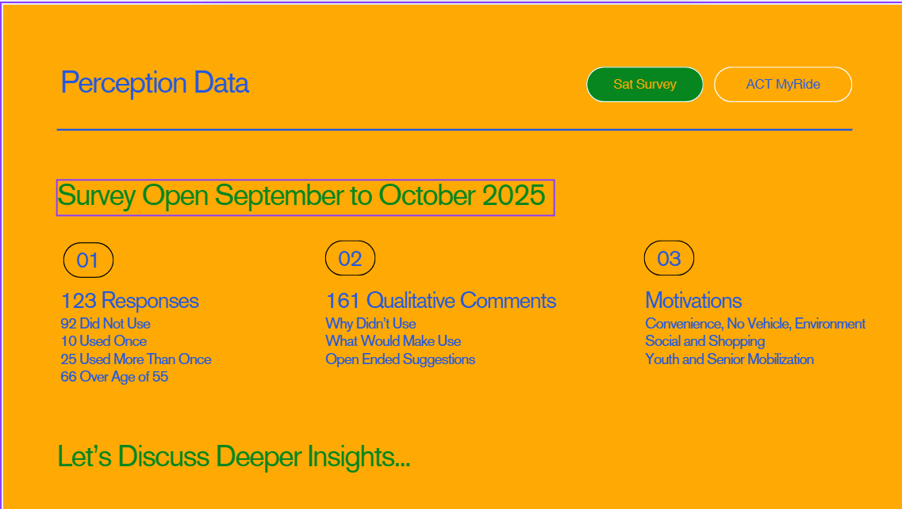
2025 Saturday Service Survey

Slide 13
Performance Measures
2023 Short Range Transit Plan
Onboard surveys indicated an overall high level of satisfaction with the service: 83 % of answers were either good or particularly good, and the overall service ranked an average of 4.5 out of 5.
The highest ranked service characteristics were safety (4.8) and driver courtesy (4.7)
Bus stop amenities were rated 3.8, the lowest ranked characteristic

Slide 14
Marketing Plan
Promote Brand
  Clean
  Reliable
  Safe
  Friendly
www.AtomicCityTransit.com
Newspaper Ads
Social Media
Community Events
School Trainings

Slide 15
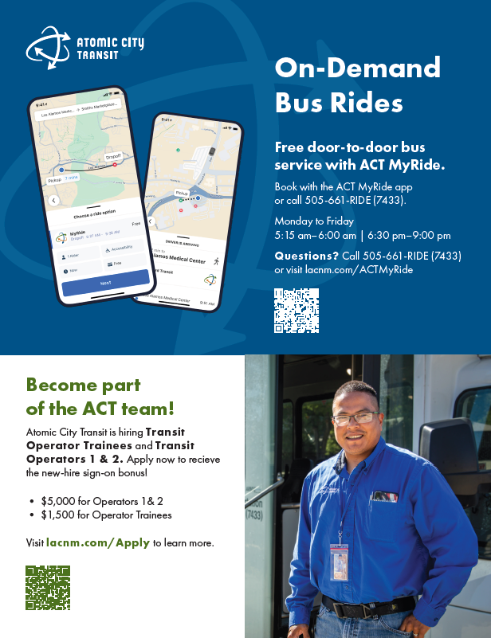
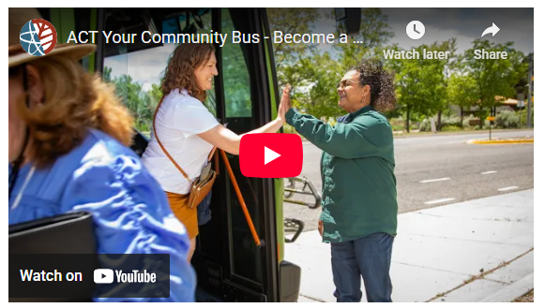

Samples of Marketing Material

Slide 16
Maintenance
Utilizes AssetWorks Software
Operates Monday – Friday
  7:30 am – 4:30 pm with on-call services
    1 Fleet Manager
    1 Fleet Supervisor
    2 Fleet Foreman
    1 Senior Office Specialist
    6 Fleet Mechanic II
    1 Fleet Mechanic I

Slide 17
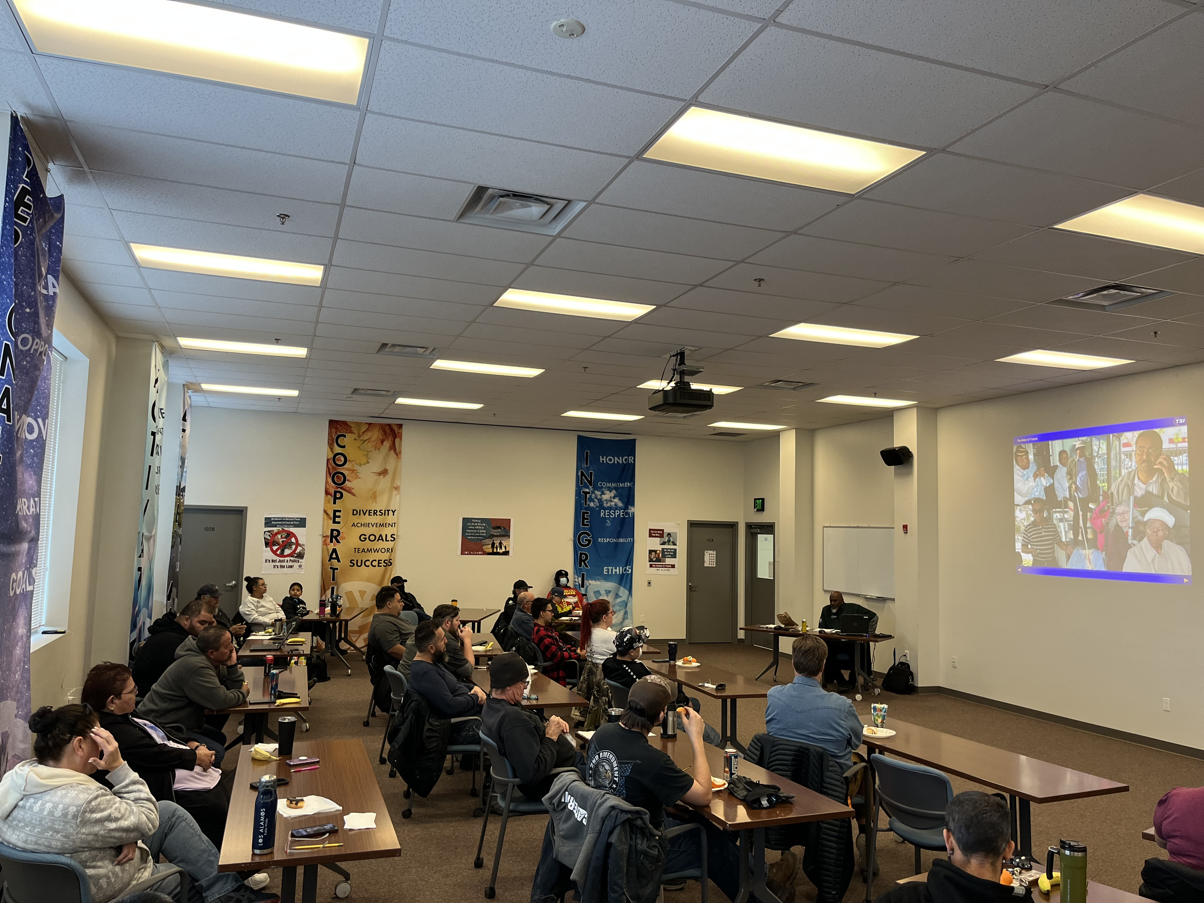
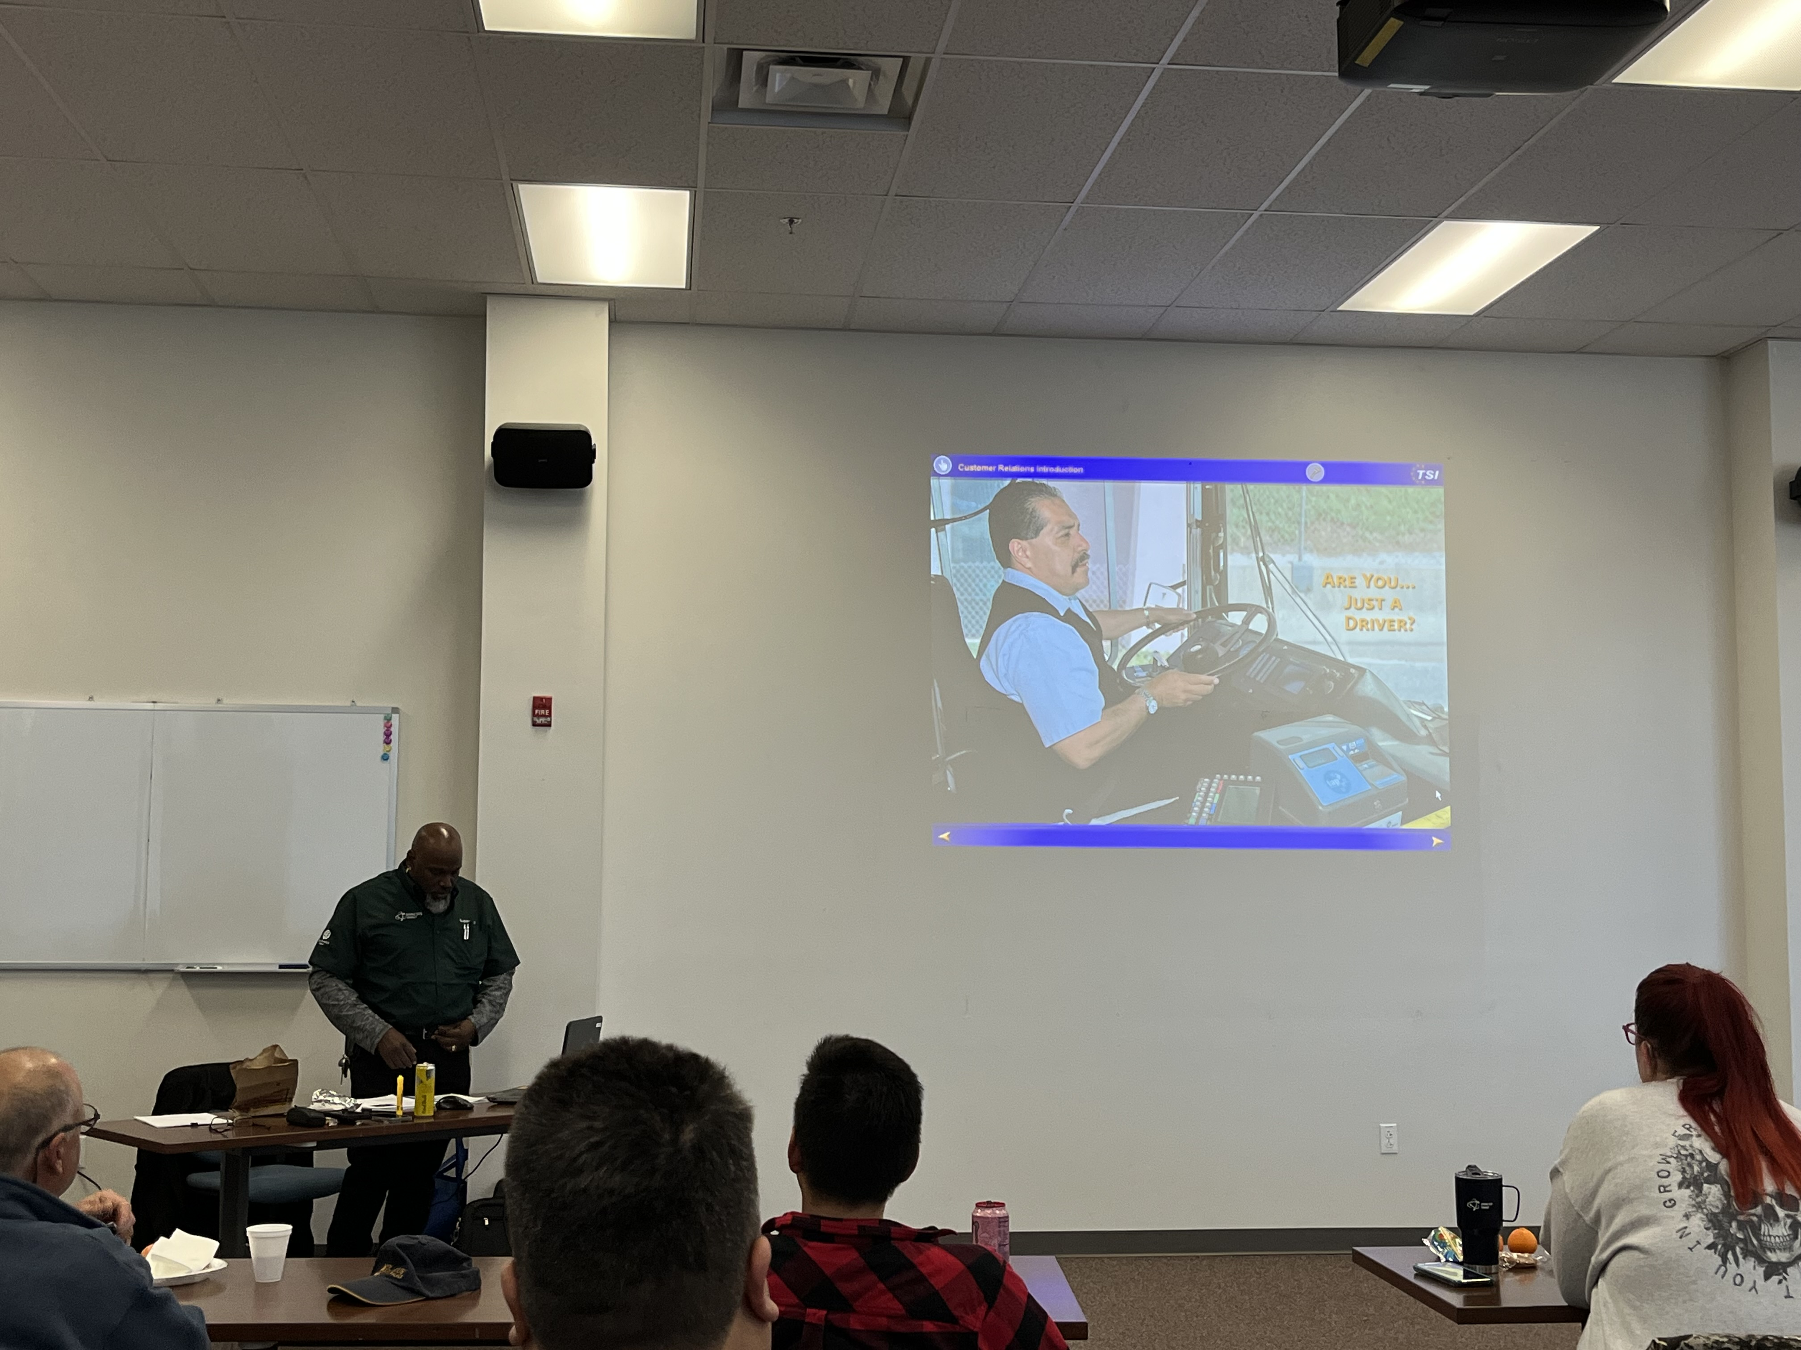
Trainings
New Hire
  2 Weeks ELDT/TSI Training
  CDL Written & Skills Test
  NM DOT New Hire Required
  Route Training
Employee Refresher Yearly
  First Aid & CPR (every 2 years)
  Blood Borne Pathogens
  Defensive Driving (every 2 years)
  Customer Service & Sensitivity (every 2 years)
  Crisis Management (every 2 years)
  Winter Driving
  Wheelchair Securement testing
  Drug & Alcohol Awareness
  Passenger Management
  Emergency Evacuation
  Pre/Post Trip Inspection (every 2 years)
  Security & Safety (every 2 years)

Slide 18
Summary Request for 5310 & 5311

Slide 19
Coordination Efforts
Local Businesses and Organizations
  LANL
  University of New Mexico- Los Alamos
  Los Alamos Medical Center
  Bandelier National Monument (NPS)
  DWI Council of Los Alamos
Other Transportation Services
  NCRTD – The Blue Bus
  Park-and-Ride
  LAC Senior Center Transportation

Slide 20

Questions?

