Slide 1


🛣️ Camino del Medio Reconstruction – 1.1 Miles
🏛️ Town of Taos – Public Works Department
Northern Pueblos RTPO FY 2027 TPF Proposal
Presentation by Town of Taos
April 1, 2026

Slide 2
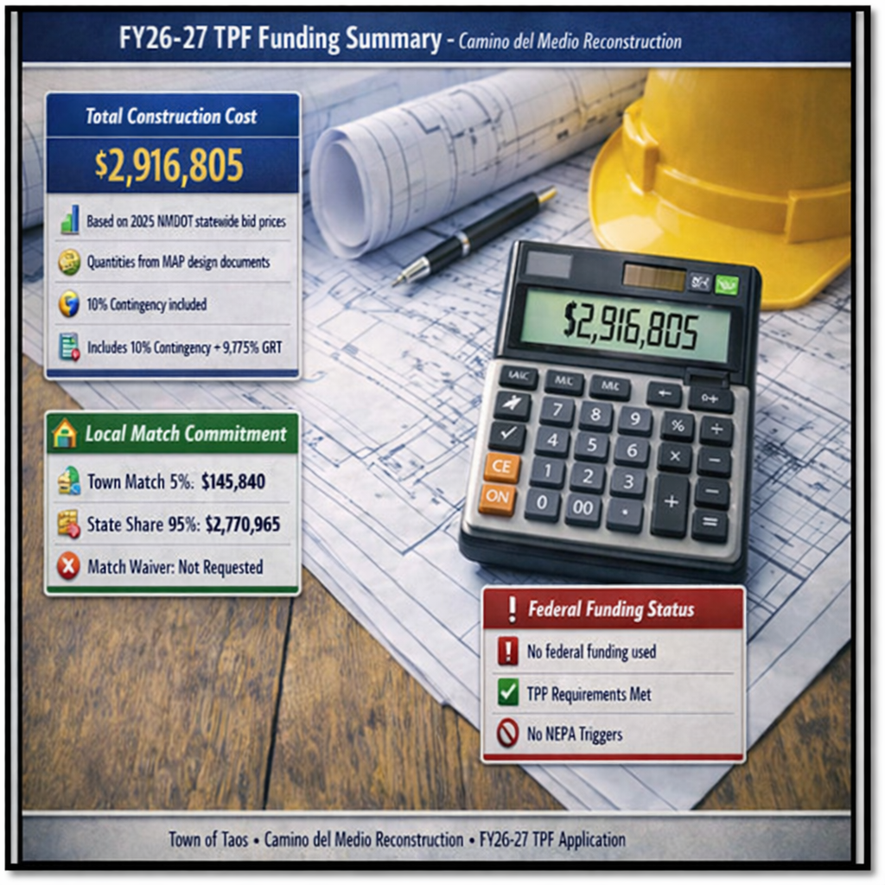
Planning: Secured other Funding Sources, Matching Funds
💵 Total Construction Cost: $2,916,805.00
• Based on 2025 NMDOT statewide bid prices
• Quantities from MAP design documents
• Includes 10% contingency + 9.175% GRT
🏛️ Local Match Commitment
• Town match: 5% ($145,840.00)
• State share: 95% ($2,770,965.00)
• Match waiver: Not requested
❗ Federal Funding
• No federal funding used (TPF requirement)

Slide 3
Planning: Support from existing planning documents and/or federal or state agencies
Support from Planning Documents
FY24–25 MAP phase completed all design, ROW survey, geotechnical investigation, drainage analysis, and public involvement (“engineering and design…is complete”).
24-25 MAP documents confirm all technical studies required for construction were completed, including pavement design, hydrology, and ROW verification.
NMDOT District 5 coordination occurred during MAP phase, including participation in public meetings. Project is consistent with Town roadway rehabilitation priorities and supports ICIP‑listed needs.

Slide 4
Project Description: Location of Project, and Details of Proposed Development
📍 1.1‑mile corridor from Ranchitos Road (NM‑240) to Camino de la Merced Intersection. Serves residential neighborhoods, agricultural lands, irrigation systems, businesses, and school/commuter routes.
🌉 “The Rio Fernando bridge lies within the project limits but is not part of this TPF request.”
🛠️ Improvements include full‑depth reconstruction, subgrade, base course, asphalt surfacing, curb and gutter, valley gutter, drainage upgrades (CMP replacements, riprap),guardrail, signing, striping, and multimodal accommodations.

Slide 5
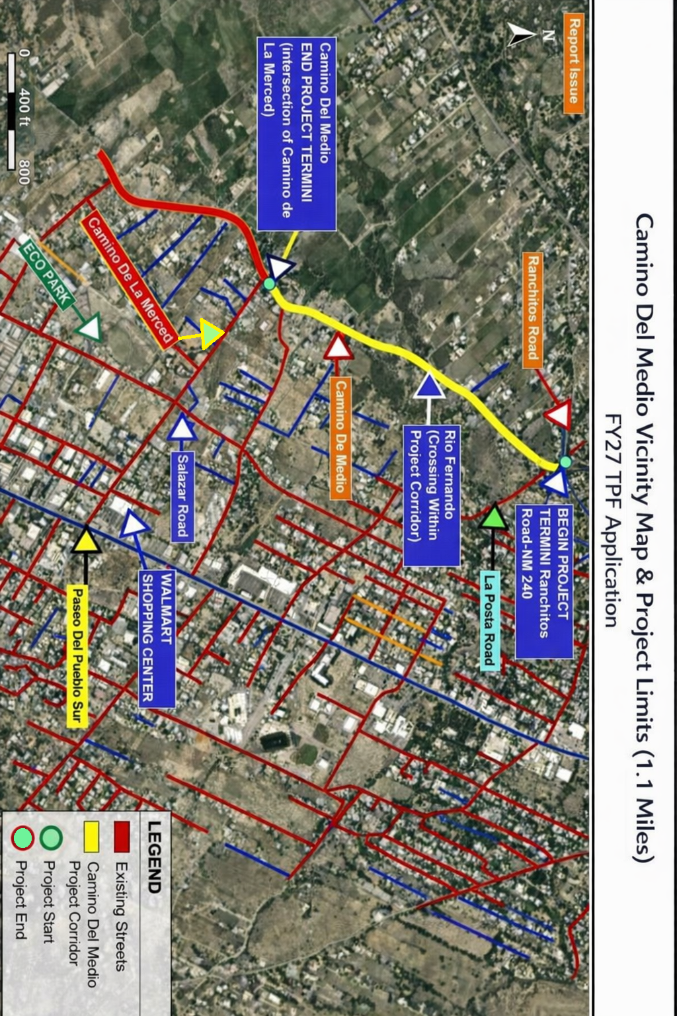

Slide 6
⭐ Existing Roadway Conditions
• Important north–south local connector parallel to NM‑68, used as an alternate route by residents.
• Provides access to major east–west streets including Chamisa Road, Paseo del Cañon West, Herdner Road, Camino de la Merced, La Posta Road, and Ranchitos Road.
• Existing two‑lane roadway with narrow lanes and no shoulders, creating safety issues for drivers, pedestrians, and cyclists.
• Pavement is in poor condition with cracking, edge failures, and subgrade distress.
• Spot drainage problems throughout the corridor; several drainage structures are undersized, silted, or plugged.
• Multiple irrigation/acequia crossings and access points require improved safety and drainage management.
• Includes the Rio Fernando crossing, where erosion and drainage deficiencies contribute to roadway deterioration.

Slide 7
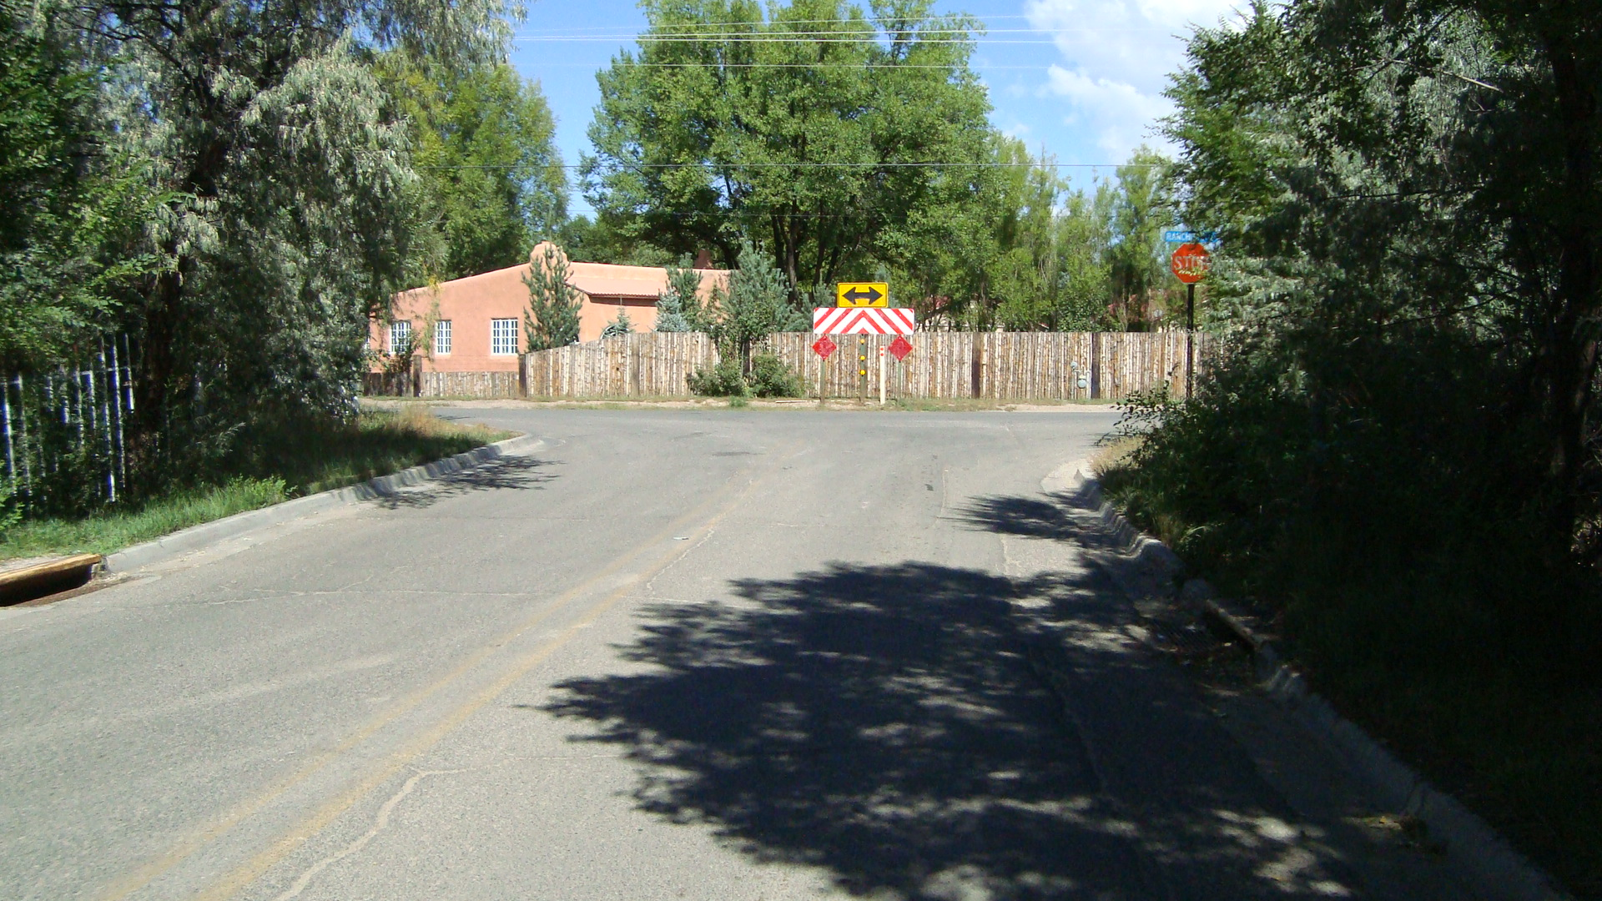
NM‑240 (Ranchitos Road) Intersection at Camino del Medio

Slide 8
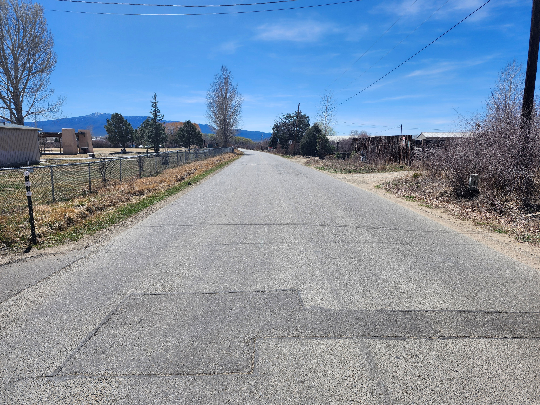
Camino del Medio and Lovato Ditch — Corridor Conditions

Slide 9
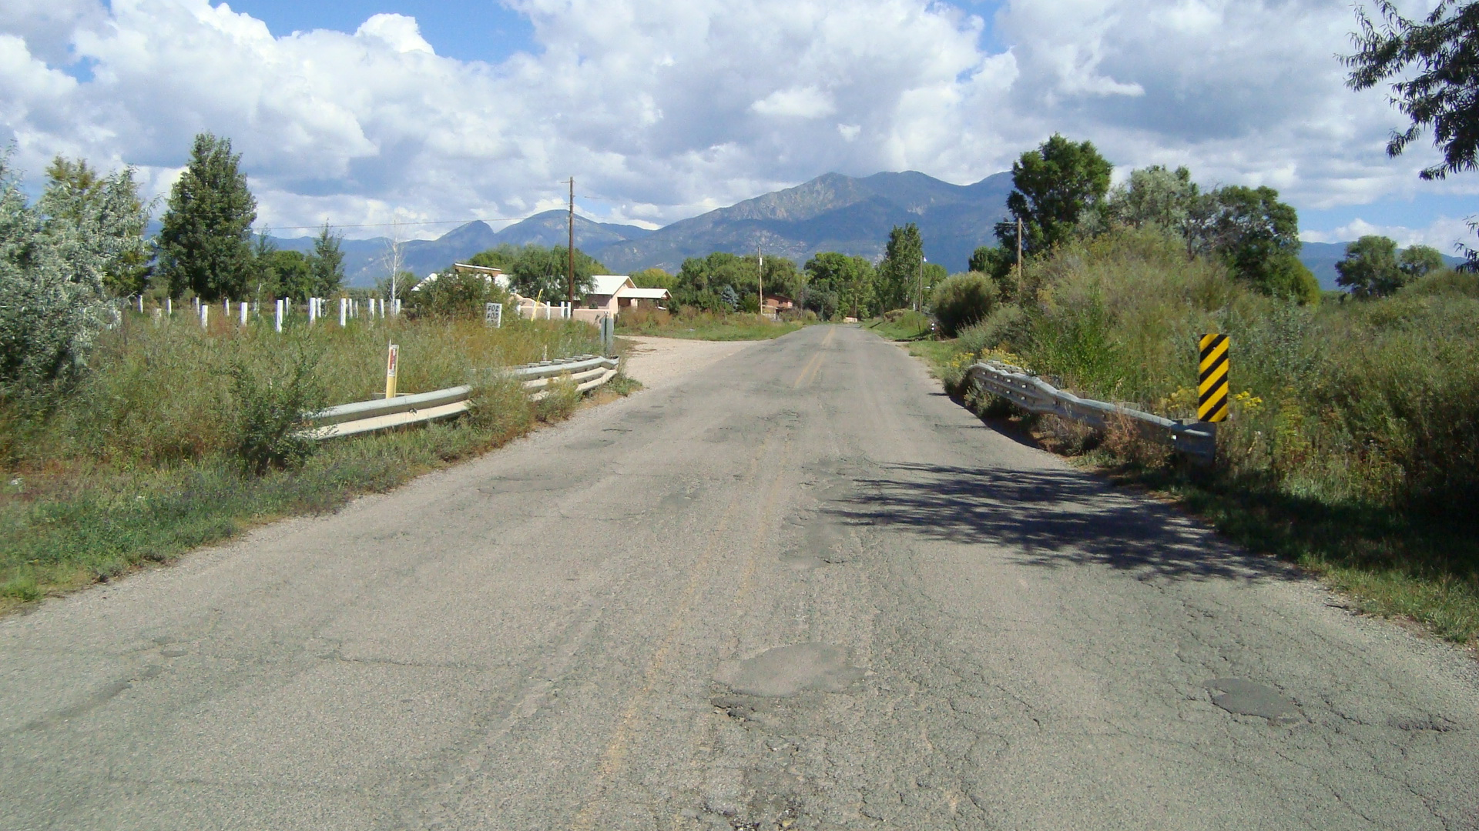
Rio Fernando Bridge Crossing — Within Project Limits

Slide 10
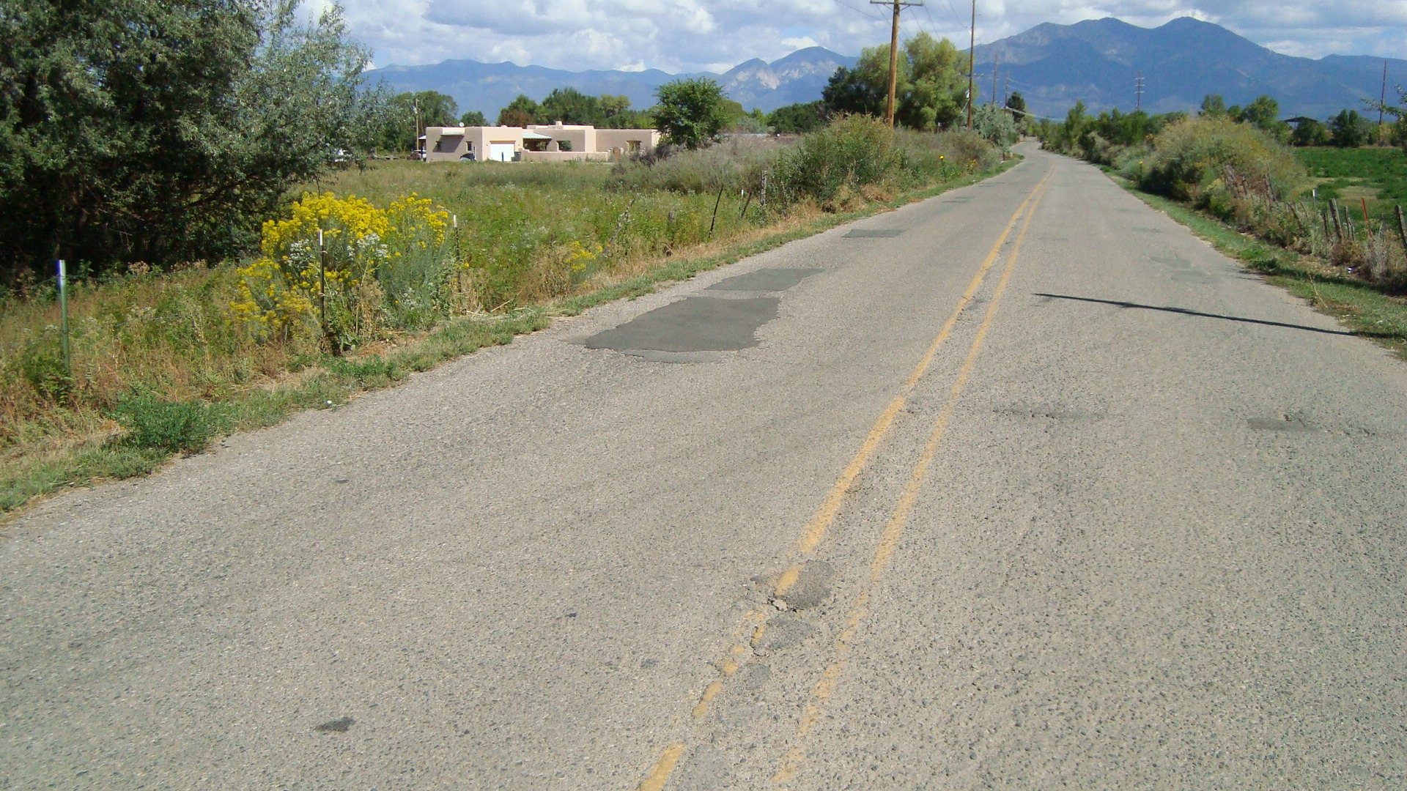
Camino del Medio — Pavement and Shoulder Conditions

Slide 11
Irrigation Structure
Plugged Drainage Pipe

Slide 12
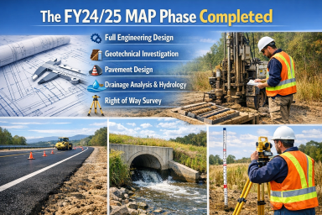
Project Description: Level of coordination with RTPO and NMDOT in project development
🔄 Project advances prior MAP‑funded phase (design, ROW, geotechnical, drainage, and public involvement completed 11/30/2018).
🏛️ Project ties into NM‑240 and requires a District 5 Letter of Support. District review is part of the FY27 cycle.
🗣️ NMDOT participated in public meetings during the MAP phase and coordinated on design elements.
🤝 RTPO coordination ongoing throughout FY27application development and review.

Slide 13
Justification: Economic Impact and Project Need
🏡 Corridor supports residential neighborhoods, agricultural properties, irrigation infrastructure, local businesses, and school/commuter traffic.
🛑 Project need includes pavement distress, inadequate drainage, shoulder erosion, and lack of pedestrian and bicycle facilities.
🌾 Reconstruction strengthens east‑west mobility and improves access to services, commerce, and community destinations.
“See traffic data (Slide 9) for AADT, crash history, and trip‑generation supporting this need.”

Slide 14
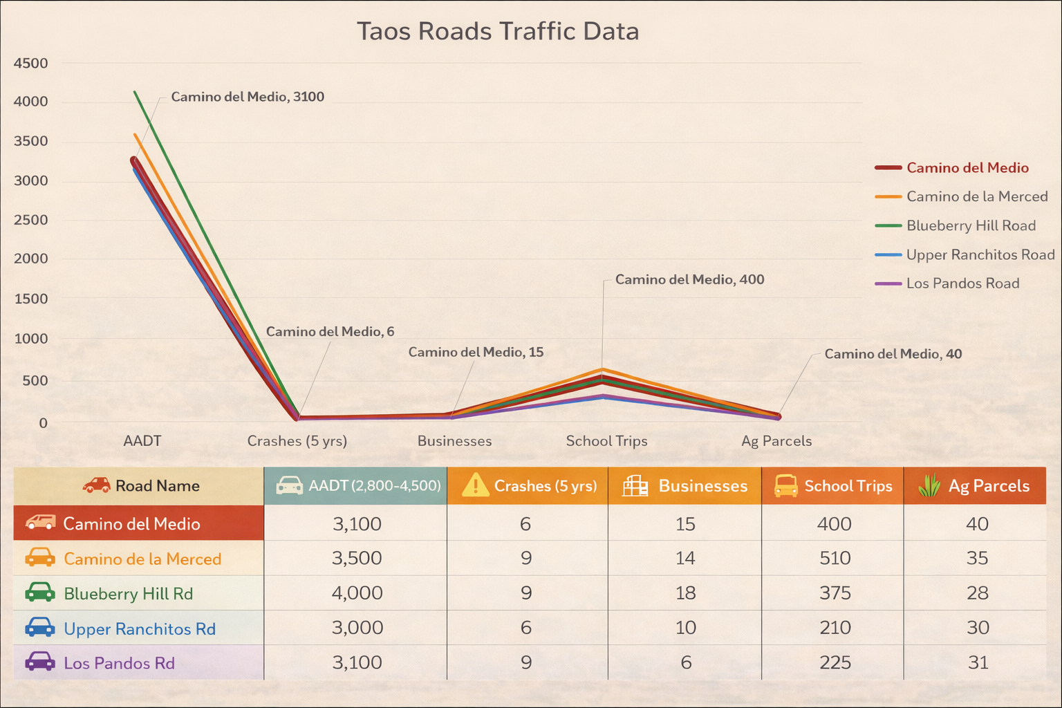

Slide 15
Justification: Quality of Life, Safety, and Environmental Sustainability
🔆 Reconstructed roadway improves mobility, reliability, and access for residents, businesses, and agricultural users.
🚸 Multimodal accommodations enhance pedestrian and cyclist safety. Guardrail and safety features reduce crash risk.
💧 Drainage upgrades reduce erosion and flooding. FY26-27 PFF
confirms no environmental or cultural impacts.
🌿 No federal funding is used; NEPA does not apply, supporting efficient project delivery.

Slide 16
Request Readiness: R-O-W Acquisition, Clearances, Planning Docs, Timeline
📐 Design completed under FY24–25 MAP phase. Completed technical work includes geotechnical investigation, drainage analysis, hydrology, ROW survey, and public involvement.
🌿 FY27 PFF confirms no environmental or cultural impacts and no federal funding.
💵 Town match (5%) committed. Total construction cost $2,916,805.00.
📅 Project is shovel ready. Procurement and bidding begin immediately upon award. Construction schedule included in FY27 Gantt chart.

Slide 17
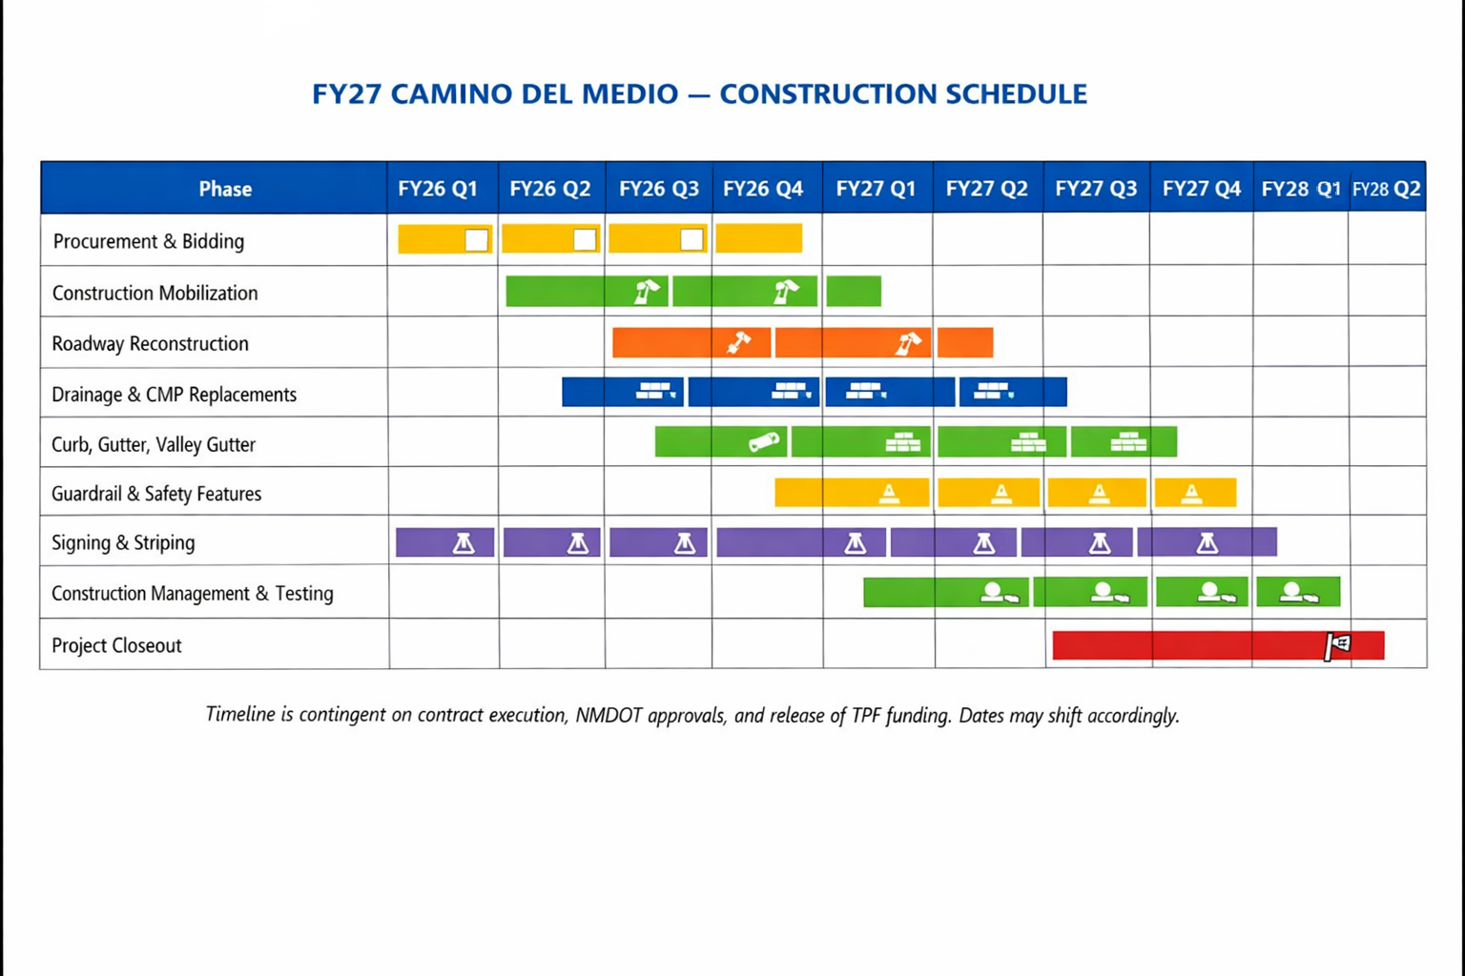

Slide 18
🛠️ Phase 1 – Drainage and Structural Work Across the Full Corridor
(Delivered only if full FY27 TPF funding is not awarded)
Phase 1 covers the entire project termini from NM 240 to Camino de la Merced. This phase focuses on the corridor where drainage structures, subgrade failures, and shoulder erosion are most severe. Work includes replacement of deteriorated culverts, riprap protection, subgrade correction, base course placement, and guardrail improvements near the Rio Fernando crossing. These items address the primary causes of roadway failure and prevent continued deterioration. All work can proceed immediately because the MAP design is complete.
Phase 1 Cost Breakdown
• Construction: $2,003,141
• 10 percent contingency: $200,314
• GRT at 9.175 percent: $184,149
• Total Phase 1 Cost: $2,387,604
🚧 Phase 2 – Surfacing and Final Features
(Requires future funding: TPF, MAP, COOP, or Capital Outlay)
Phase 2 completes the corridor with asphalt surfacing, signing, striping, and final cleanup. Because all design work is complete, Phase 2 can move directly to construction once funding is secured.
Phase 2 Cost Breakdown
• Construction: $425,657
• 10 percent contingency: $42,566
• GRT at 9.175 percent: $60,978
• Total Phase 2 Cost: $529,201
📊 Total Project Cost (Phases 1 and 2 Combined)
• Total Construction Cost: $2,916,805
• State share at 95 percent: $2,770,965
• Town match at 5 percent: $145,840

Slide 19
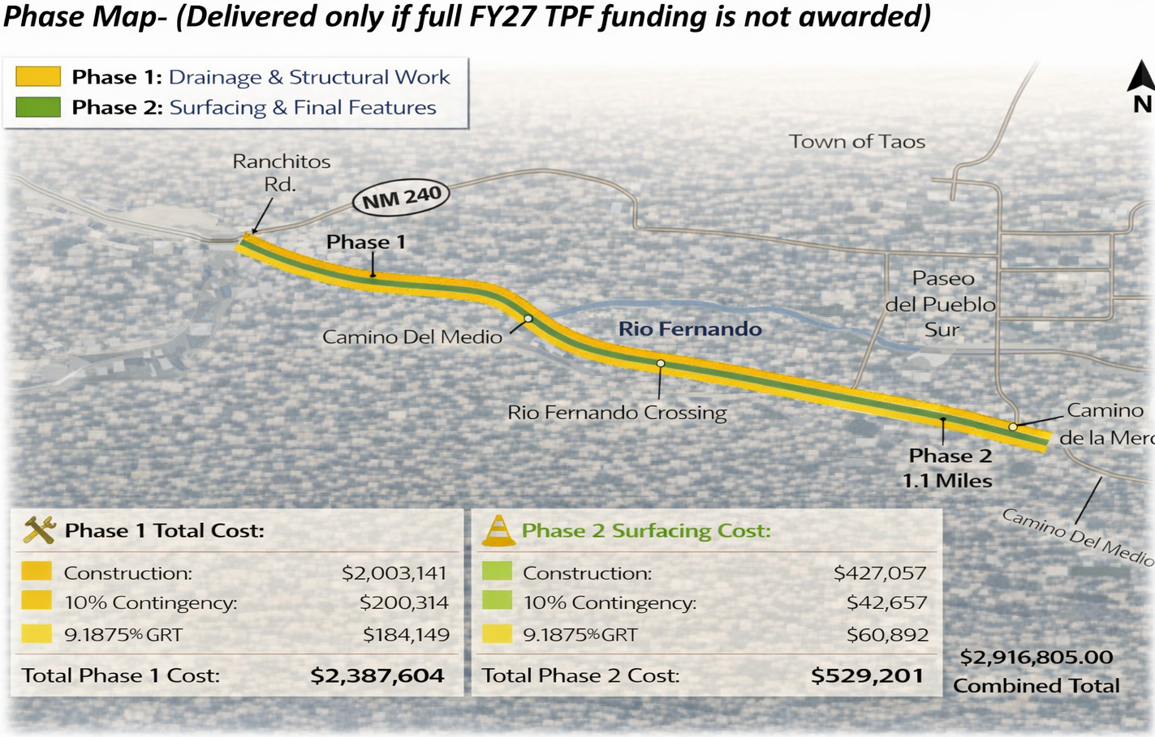

Slide 20
Project Summary
Camino del Medio Reconstruction – Project Readiness Summary
Shovel Ready Corridor (1.1 miles)
Fully designed from NM 240 to Camino de la Merced. All design, geotechnical, drainage, right of way, and public involvement work were completed under the FY24–25 MAP phase. No additional studies or federal clearances are required.
Scope of Improvements
Reconstruction of roadway; upgraded drainage; new curb, gutter, and valley gutter; safety enhancements; and multimodal accommodations for pedestrians and cyclists. The project addresses pavement failure, inadequate drainage, shoulder erosion, and the absence of facilities for people walking or biking. Drainage deficiencies include undersized CMPs, erosion at ditch crossings, and subgrade failures documented in the MAP design.
Acequia Protection and Coordination
The project preserves and protects all irrigation infrastructure along the corridor, including multiple crossings and the desague of the Lovatos Ditch. Through direct consultation with the mayordomo, the Town verified that the facility along the east side of the roadway is a desague that carries post irrigation water back to the Rio Fernando and is not an acequia lateral. The final approach will maintain continuous water delivery, preserve the function of the desague, and improve safety by reducing irrigation infrastructure within the roadway right of way. The selected remedy will be finalized through consultation with the Mayordomo before construction mobilization.
Construction Readiness
Total construction cost is $2,916,805 with the Town providing the required five percent match.
All technical work is complete, no environmental or cultural impacts have been identified, and the project meets all TPF readiness criteria and is positioned for timely procurement and construction upon award.

