Slide 1
Northern Pueblos RTPO
FY 2026 TPF Proposal:
Village of Questa Road Projects
Presentation by Valerie vigil and Jacob Lafore
April 01, 2026

Slide 2

Planning: Secured other Funding Sources, Matching Funds
Priority 1: Embargo Road (SHOVEL READY PROJECT) Priority 2: Old Red River Rd/La Lama Rd
Plan & Design have been completed for Embargo Road as of March 2025.
NMDOT/MAP | L500523 | $25,483.00 balance
NMDOT/MAP | L500602 | $153,333.00
NMDOT/MAP | L500648 | $227,185.00
In-Kind | Chevron | $23,020.00
 |  | TTL Unused funds $429,021.00
Phase 1 | Plan and Design | $180,782.46
No funds secured to date | Seeking TPF Funding for Plan and Design
Phase 2 | Construction & CM | $1,216,117.54
No funds secured to date
TOTAL PROJECT COST |  | $1,396,900.00
TPF funding request to COMPLETE the Embargo Road Project is $1,220,536.06
Project Cost $1,363,233.69 | Minus (-) funds on hand $429,021.00 | Plus (+) 10% Contingency $136,323.37 | Plus (+) Construction Management $150,000.00 | (=) Total TPF Request $1,220,536.06
The Village of Questa will not seek match waivers for these TPF asks

Slide 3

Planning: Support from existing planning documents and/or federal or state agencies
Priority 1: Embargo Road Priority 2: Old Red River Rd/La Lama Rd
[Scoring range: 0-5 points]
Currently listed on FY 2027-2031 ICIP and ranked #4
NMDOT ROW letter of support will be needed as Embargo Road touches NM 522
No Federal funding has been sought or acquired for this roadway project
Construction and Construction management proposals have been received that address the SOW
Plan & Design has been completed (March 2025) PROJECT IS SHOVEL READY!
Currently listed on FY 2027-2031 ICIP and ranked #19
NMDOT ROW letter of support will not be required
No Federal funding has been sought or acquired for this roadway project
Engineer’s probable cost estimate has been received for Plan & Design, Construction, and Construction Mgmt.
Plan & Design can be completed in 2026 if TPF funded

Slide 4
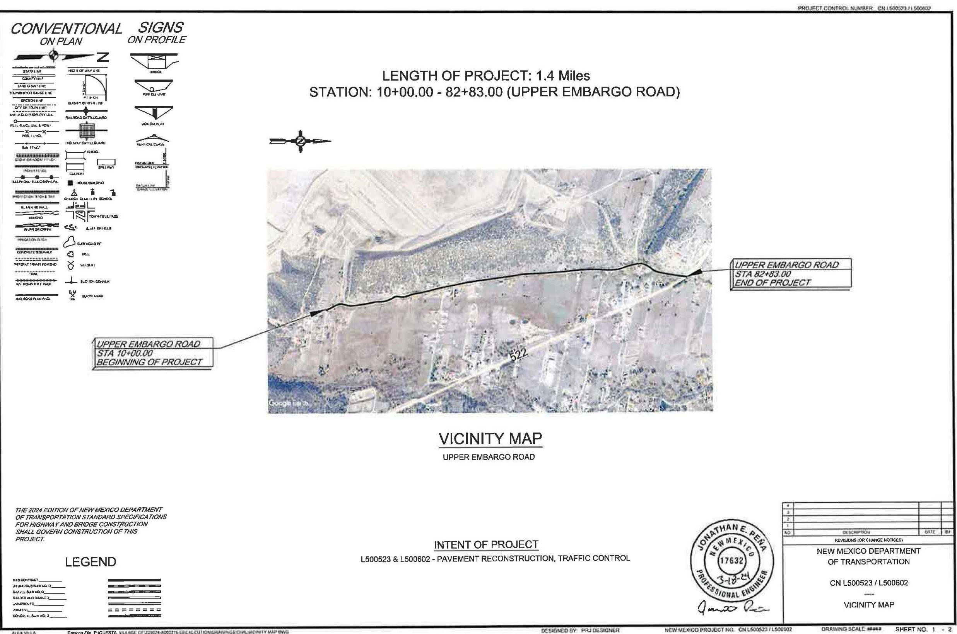

Project Description: Location of Project, and Details of Proposed Development
Priority 1: Embargo Road
Embargo Road begins at STA 1+00 and ends at STA 7+120 for a total mileage of 1.44 miles. Embargo road begins at the intersection of NM State Hwy 522 and continues Northwest
The proposed development for this project will include drainage and culvert improvements, pulverizing existing pavement into base, new pavement, adjusting utility boxes and meters to grade, miscellaneous improvements, and construction management.

Slide 5
Project Description: Location of Project, and Details of Proposed Development
Priority 2: Old Red River Rd/La Lama Rd
Old Red River Rd/La Lama Rd begins at STA 10+00 and ends at STA 32+19 for a total mileage of .44 miles. Old Red River Rd/La Lama Rd road begins at the intersection of Lower Embargo Rd and continues Southwest.
The proposed development for this project will include drainage and culvert improvements, pulverizing existing pavement into base, new pavement, adjusting utility boxes and meters to grade, miscellaneous improvements, and construction management.

Slide 6

Project Description: Level of coordination with RTPO, NMDOT, and State entities in project development
Embargo Road & Old Red River Rd/La Lama Rd
The Village of Questa has coordinated with the following entities:
Priority 1: Embargo Road
Priority 2: Old Red River Rd/La Lama Rd
NMDOT | MAP Funding Received
NMDOT | ROW Letter of Support Needed
NPRTPO | PFF & TPF Presentation
Capital Outlay | FY 2027-2031 ICIP Ranking #4
Legislative Council Service/57th Legislature | FY2026 LCS Web ID #495
Office of the Governor Capital Outlay Request | FY2026
NMDOT | MAP Letter of Interest submitted FY2026/2027
NMDOT | ROW Letter of Support not required
NPRTPO | PFF & TPF Presentation
Capital Outlay | FY 2027-2031 ICIP Ranking #19

Slide 7



Justification: Economic Impact and Project Need
Embargo Road
Embargo road serves as a main point of access for our community residents to approach NM 522 and for Chevron Employees/Contractors to access the Chevron Remediation Site. Embargo road begins at the intersection of NM 522 for a distance of aproximately 1.44 miles and is a main roadway for approximately 100 residents.
Embargo road serves as a main roadway for residents to access NM 522 to commute to work in Taos, Red River, and the Chevron mining site. Embargo Road is also one of Questa School bus routes and serves 17 students; 4 with special needs.
Embargo road is also the main artery that provides access for the YDI head start, North Central Food Pantry, & the Questa Senior Center facilities.
The Village of Questa has the match requirement for this roadway project, and it is shovel ready.

Slide 8
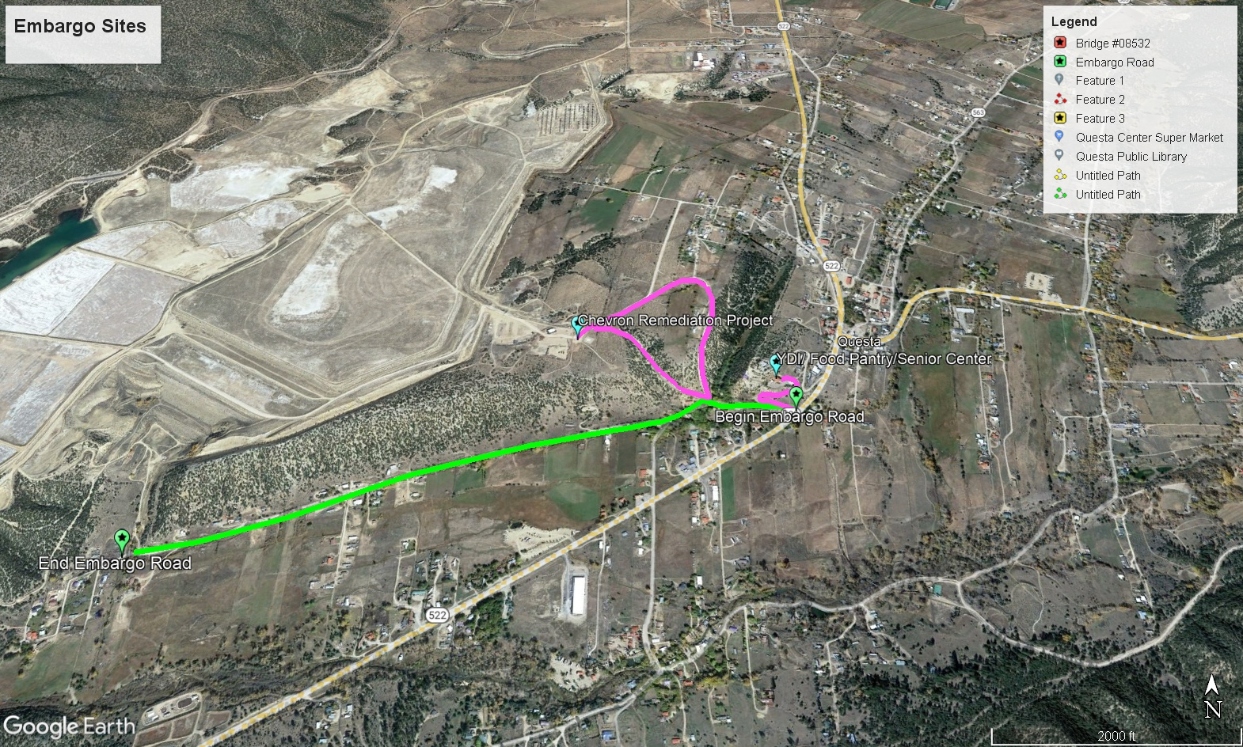
Justification: Economic Impact and Project Need

Slide 9

Justification: Economic Impact and Project Need
Old Red River Rd/La Lama Rd
Old Red River Rd/La Lama Rd road serves as a main point of access for our community residents to approach NM 522 and for residents and tourists to access recreational sites. Old Red River Rd/La Lama Rd road begins at the intersection of Lower Embargo Road for a distance of approximately .44 miles and is a main roadway for approximately 37 residents.
Old Red River Rd/La Lama Rd serves as a main roadway for residents to access NM 522 to commute to work in Taos, Red River, and shop at local businesses. Old Red River/La Lama Rd is also one of Questa School bus routes and serves 17 students.
Old Red River Rd/La Lama Rd is also the main artery that provides access to recreational facilities like Molycorp Field and the Red River Restoration Fishing habitats and the La Lama Foundation community.
The Village of Questa has the match requirement for this TPF funding request for Plan and Design.

Slide 10
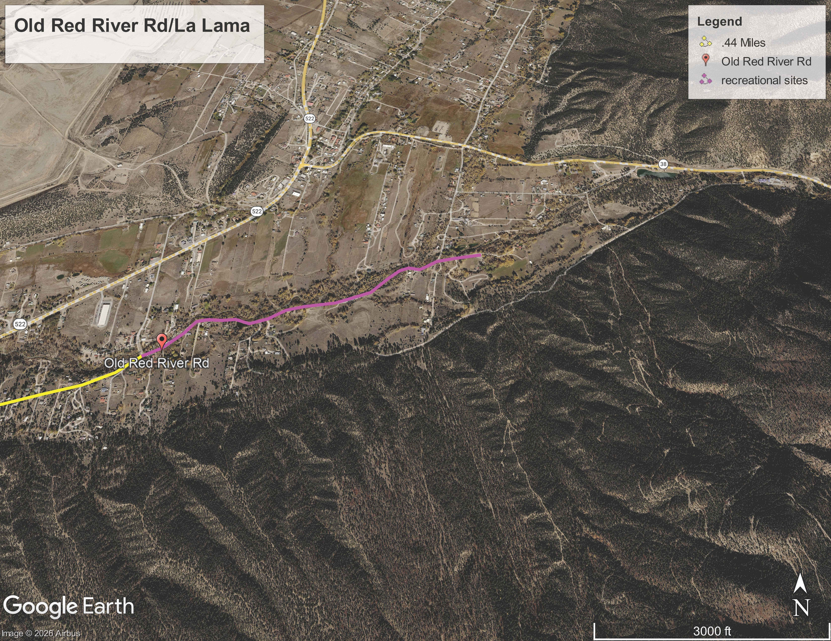
Justification: Economic Impact and Project Need

Slide 11




Justification: Quality of Life, Safety, and Environmental Sustainability
The proposed road projects contribute to our community's economic sustainability by providing convenient routes to State NM 522 and NM 38, which are the two main arteries which serve the Village of Questa and provide access to jobs, businesses, education, and parks & recreation.
Our proposed road projects need rehabilitation up to and including pulverization of existing pavement, drainage and culvert improvements, new pavement, bringing utility boxes and meters to grade, miscellaneous improvements, and construction management. These improvements enhance the safety of our commuters and residents. Improved roads will allow our Public Safety Departments and school bus operators to easier serve our community.
By utilizing the existing roadway’s pave and pulverizing it, we are cutting down on the base course material production cost of the project.

Slide 12
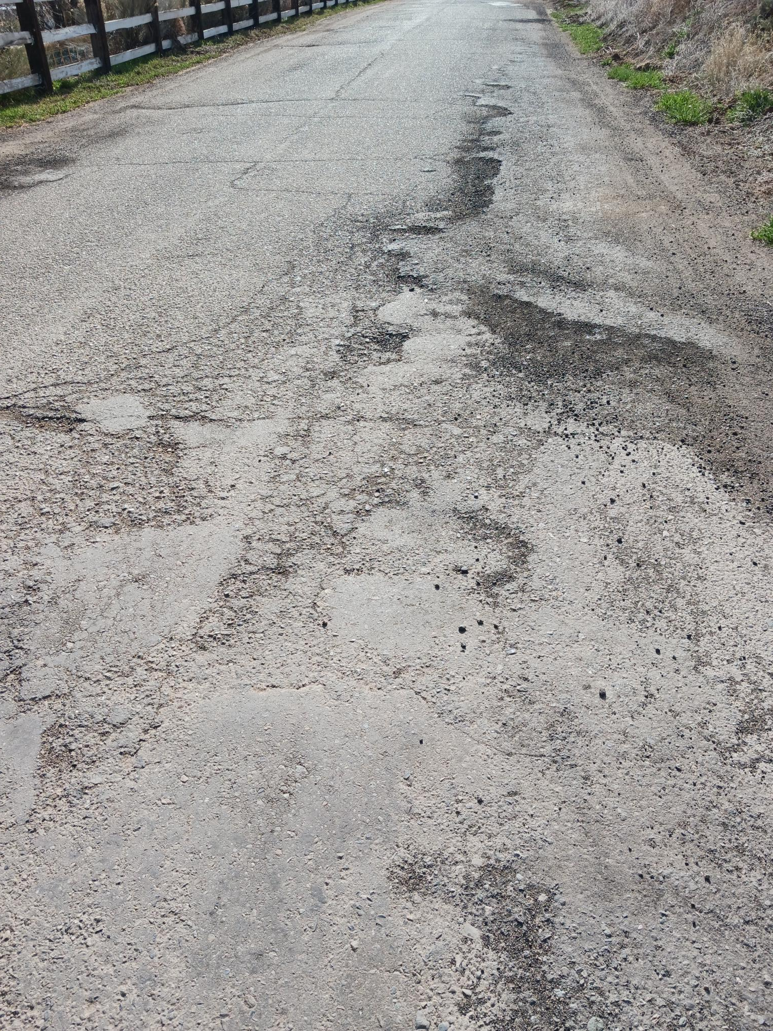
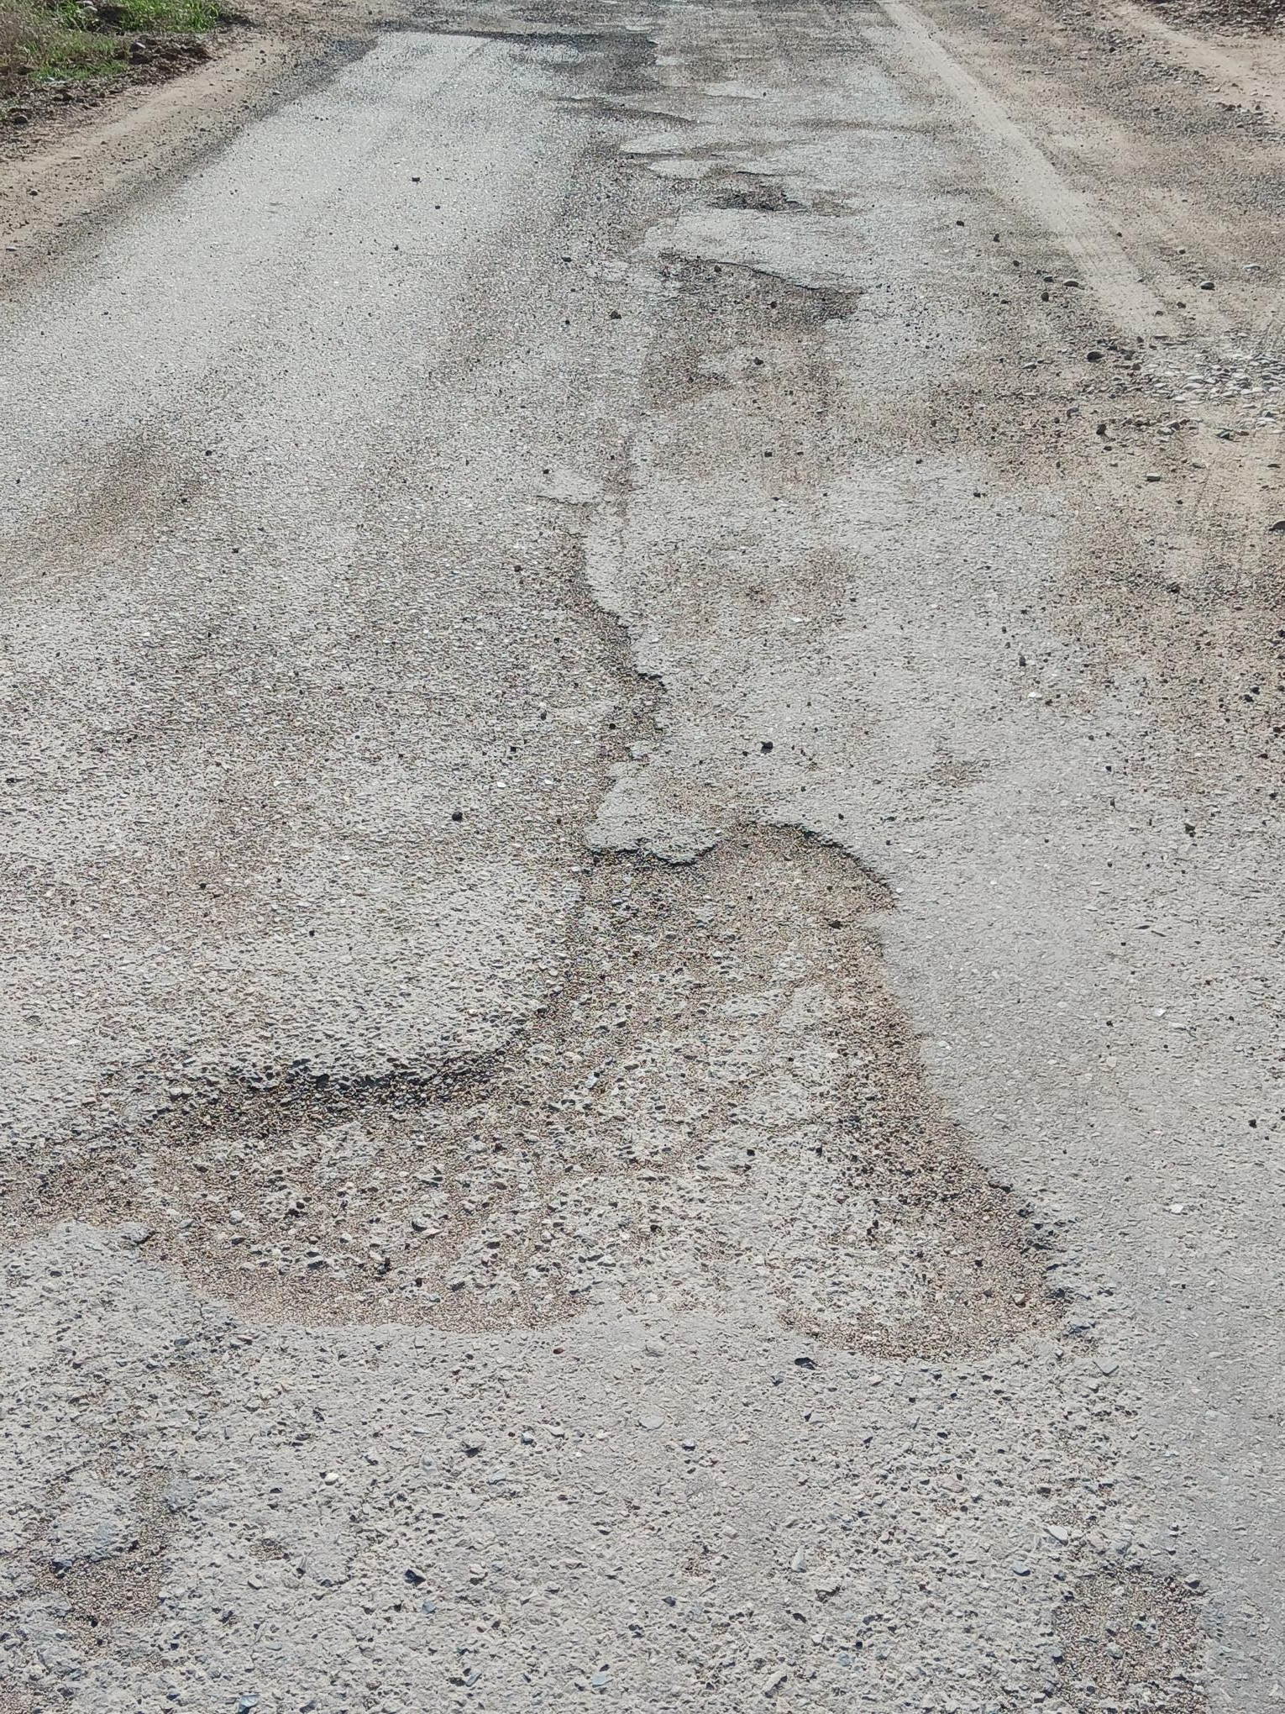
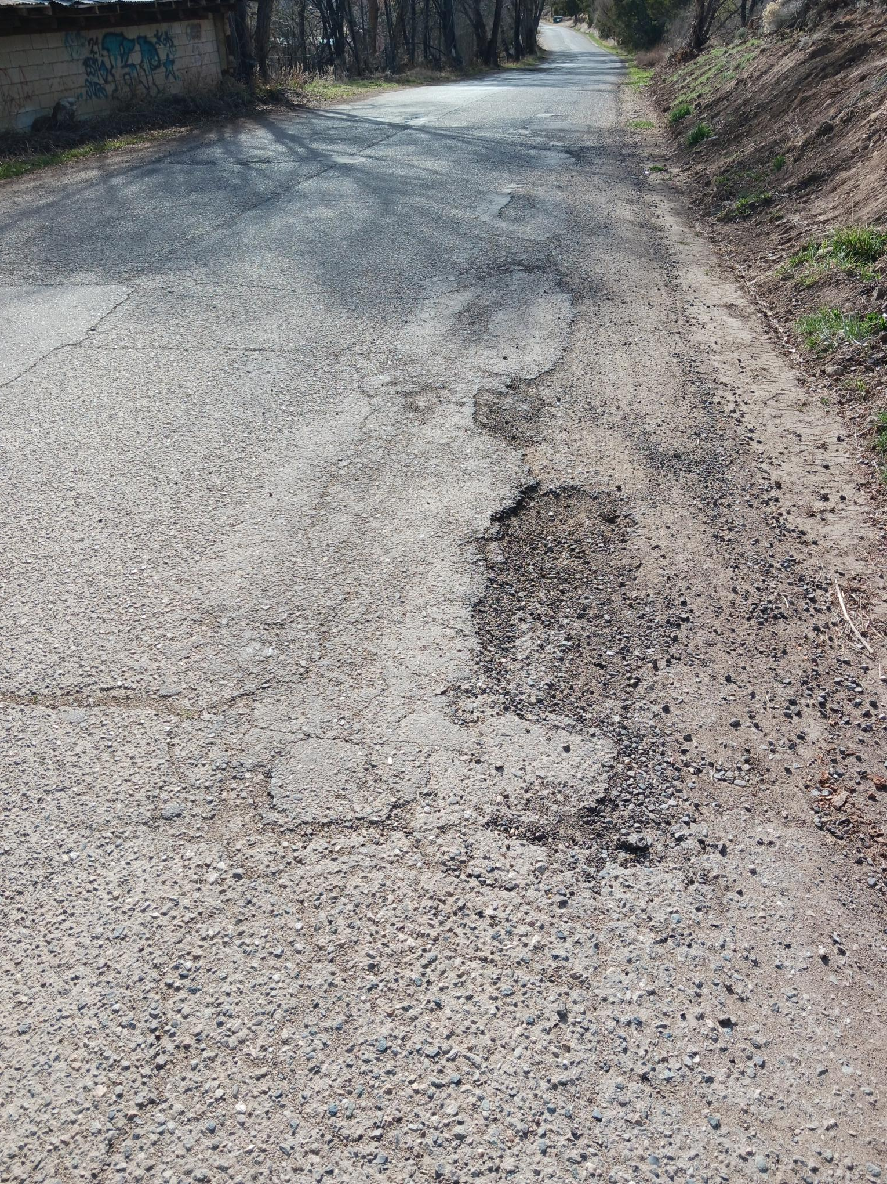
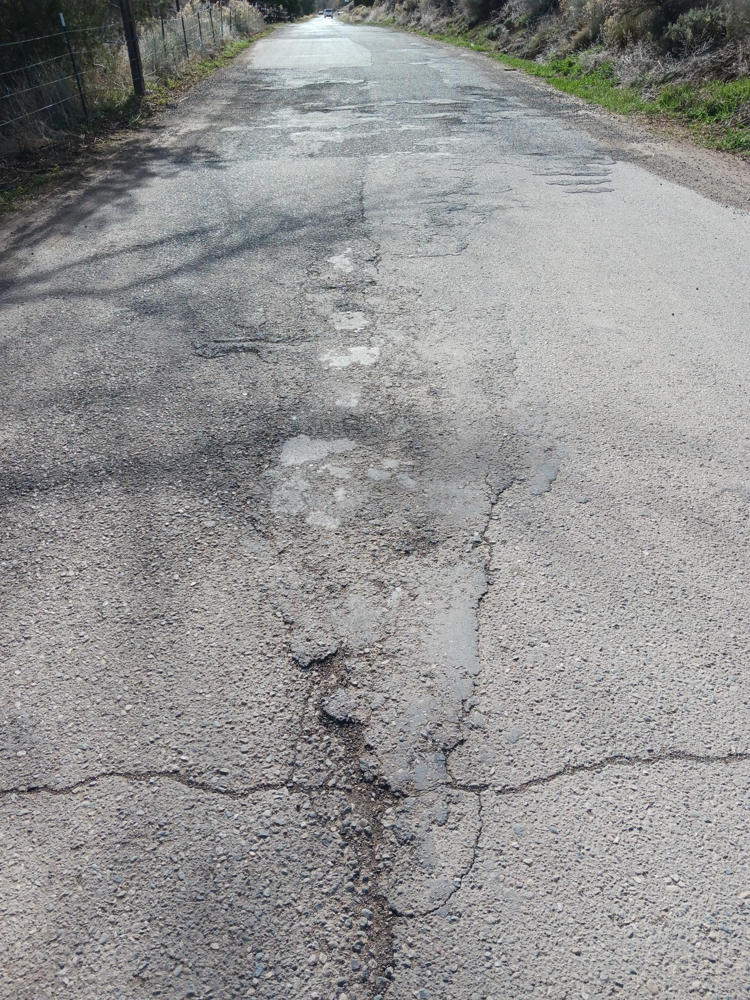
Justification: Quality of Life and Safety.
Embargo Rd:

Slide 13
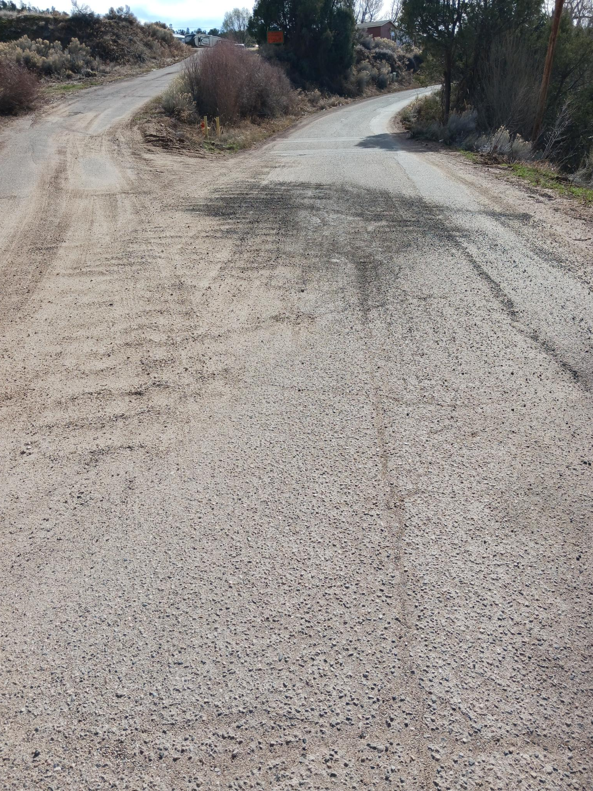
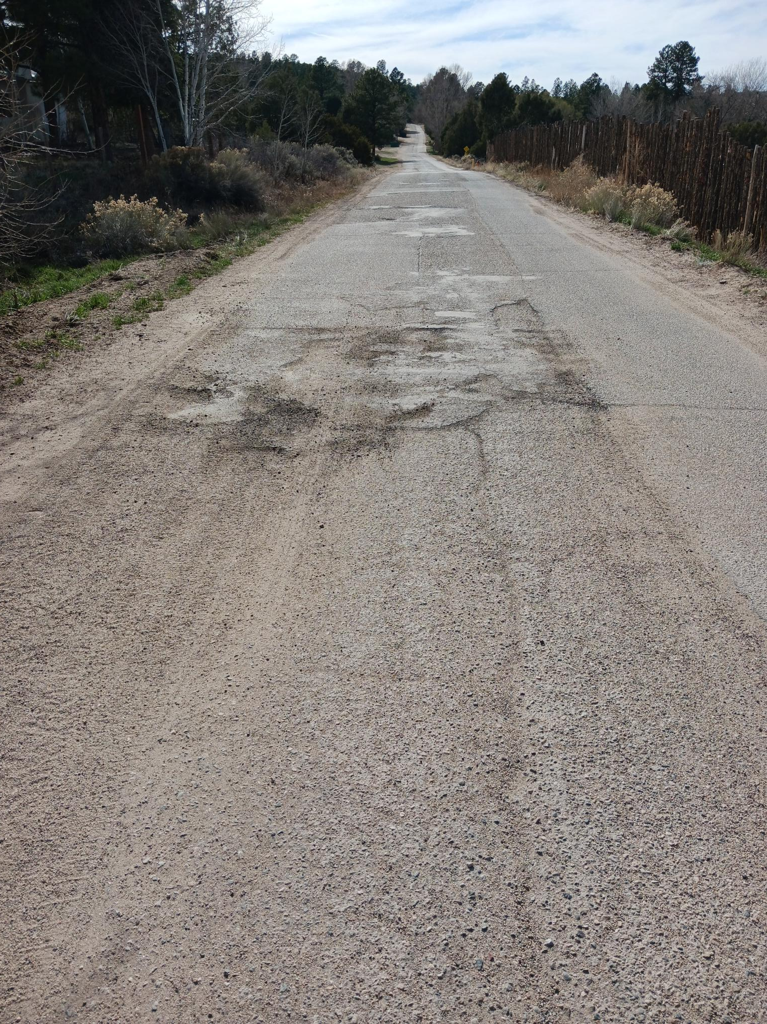
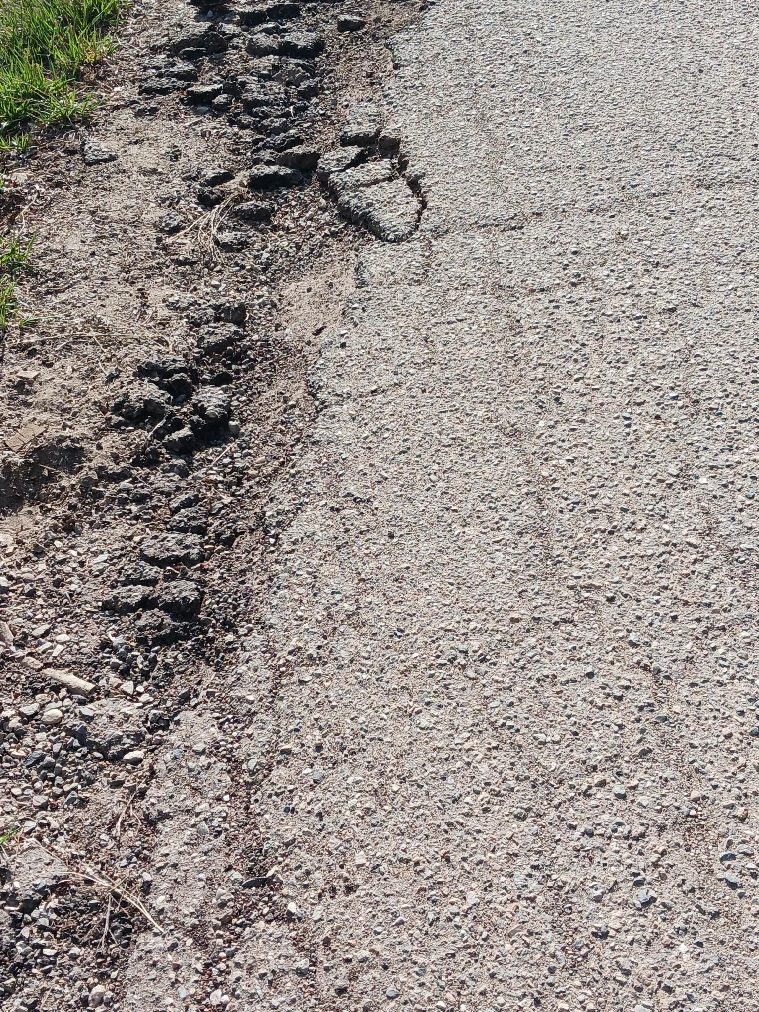
Justification: Quality of Life and Safety.
Old Red River Rd/
La Lama Rd:

Slide 14
Request Readiness: R-O-W Acquisition, Clearances, Planning Docs, Timeline
Priority 1: Embargo roadway project. SOW is based on keeping the roadway improvements within the existing ROW. NMDOT ROW Letter of Support is needed for this roadway project as it touches NM 522. Plan & Design has been completed, and this Project is Shovel Ready! If we are fortunate to receive funding for construction and construction management for Embargo Road the Village will be able to complete the project in full and meet grant timelines.
Priority 2: Old Red River Road/La lama Road, SOW is based on 2 phases:
Phase 1 – Plan and Design – Current TPF request for FY2026/2027 – if funded plan and design can be completed by end of 2026
Phase 2 – Construction and construction management cost estimates received, and the Village has submitted a MAP letter of interest and will continue to seek all funding opportunities to complete this roadway project

Slide 15
NMDOT FUNDING/HIGHLIGHTING PROJECT SUCCESSES
PROJECT ROADWAY | FUNDING SOURCE | TIMELINE TO COMPLETE
CABRESTO ROAD (1.35 miles) | CAPITAL OUTLAY | TO BE EXPENDED BY JUNE 30, 2026
Because of NMDOT funding: P&D has been | NMDOT LGRF | TO BE EXPENDED BY JUNE 30, 2026
completed for all 3 phases, drainage and | NMDOT TPF | TO BE EXPENDED BY JUNE 30, 2026
culvert replacement has been completed and | NMDOT TPF | TO BE EXPENDED BY JUNE 30, 2026
this roadway will be completed in full 2026 | NMDOT LGRF | TO BE EXPENDED BY JUNE 30, 2026
LOWER EMBARGO ROAD (0.33 miles) | NMDOT TPF | TO BE EXPENDED BY JULY 31, 2026
P&D complete/roadway will be completed in full 2026
EMBARGO ROAD (1400 LF) + (1.18 miles) 1.44 | NMDOT MAP | TO BE EXPENDED BY JUNE 30, 2026
P&D complete/partial construction 1400 LF will | NMDOT MAP | TO BE EXPENDED BY JUNE 30, 2026
be completed by summer 2026 | NMDOT MAP | TO BE EXPENDED BY JUNE 30, 2026
BRIDGE #8532 (0.37 miles) | NMDOT TPF | TO BE EXPENDED BY JUNE 30, 2026
Substantial rehab done 2025/remaining work to be completed 2026 |  | TO BE COMPLETED BY JUNE 30, 2026
SHIRLEY ROAD ( 0.167 miles) | NMDOT MAP | TO BE EXPENDED BY MAY 31, 2026
P&D complete/roadway to be completed 2026 | NMDOT LGRF | TO BE EXPENDED BY MAY 31, 2026
All these projects are under contract and will be completed by June 30, 2026. THANK YOU!

Slide 16

Project Summary
In summary the Village of Questa is requesting funding to complete the Embargo Road project and Plan and Design of Old Red River Rd/La Lama Rd; which both roadways need rehabilitation and new pavement improvements. Potholes, cracks, drainage issues, the deterioration of the existing pavement and inadequate signage are the contributing factors to unsafe and problematic roads.
Given the opportunity to rehabilitate and reconstruct these roadways will benefit the quality of life for our residents, reduce wear and tear on personal vehicles, provide safer roadways for Questa school bus routes, Emergency and Public Safety Response vehicles, provide adequate access to NM 522 and NM 38, and attract tourists to recreational venues and local businesses throughout our community which will increase our GRT base.
The Village of Questa thanks you for your consideration when ranking our projects!

