Slide 1
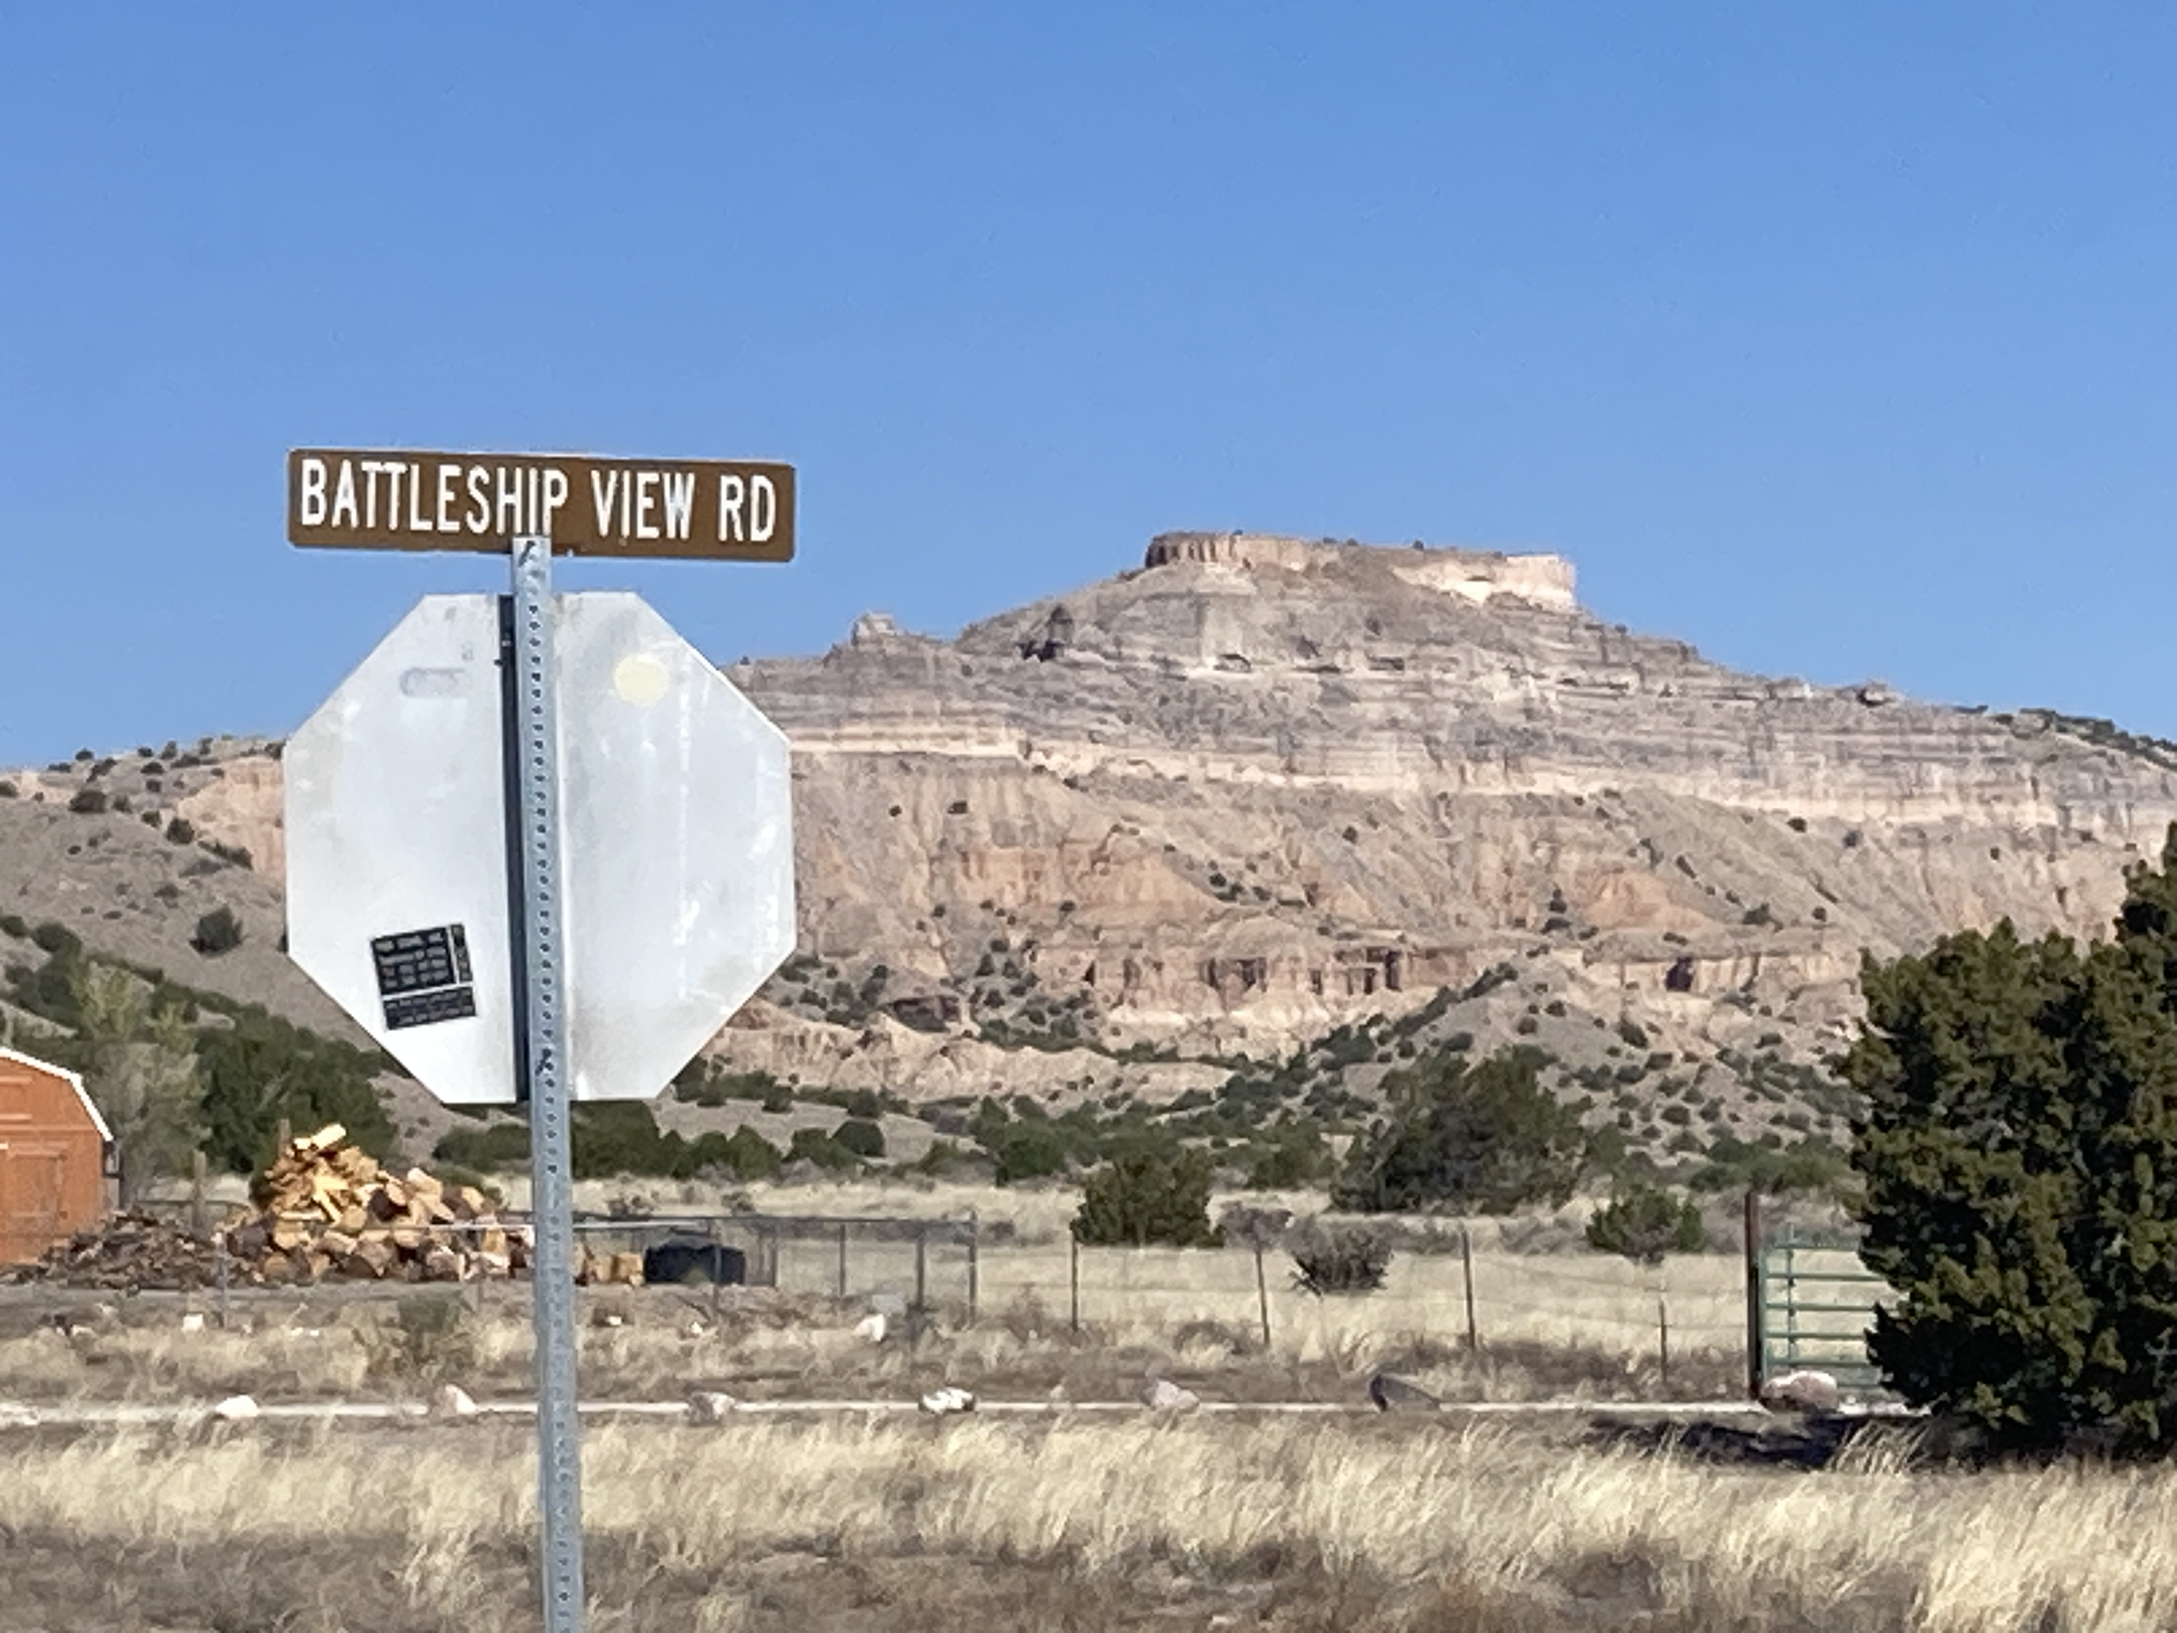
Northern Pueblos RTPO FY 2027 TPF Proposal:
NM-30 & Battleship intersection improvements
Presentation by Pueblo De San Ildefonso; April 1, 2026

Slide 2
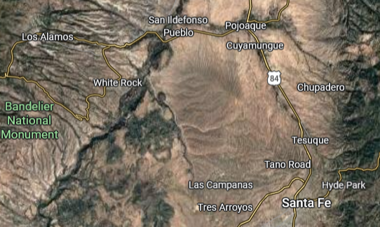
Project Description:
Location

Slide 3
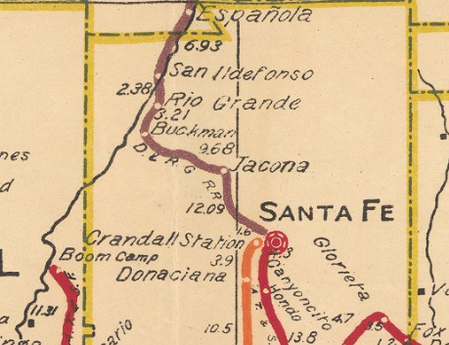
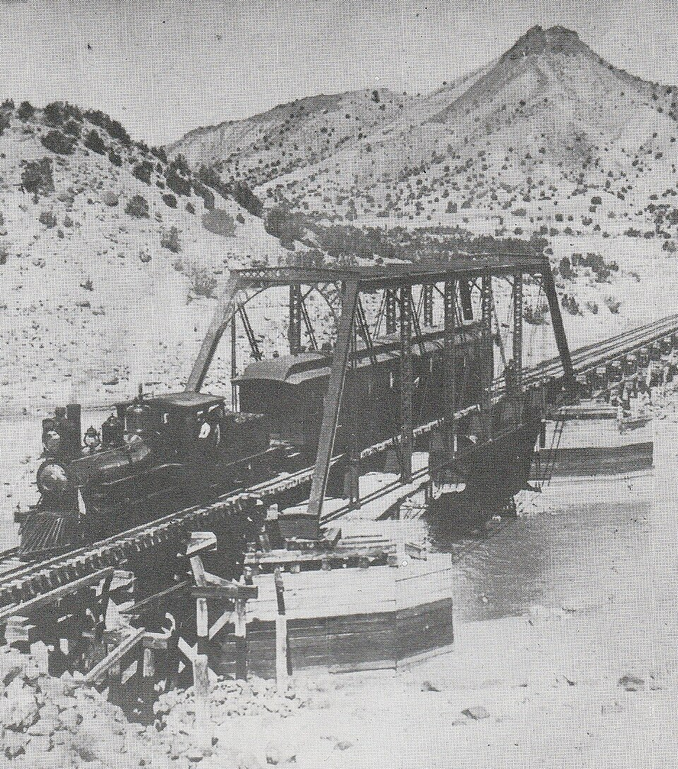
Project Description: Historical Context – 1913 / 1890

Slide 4
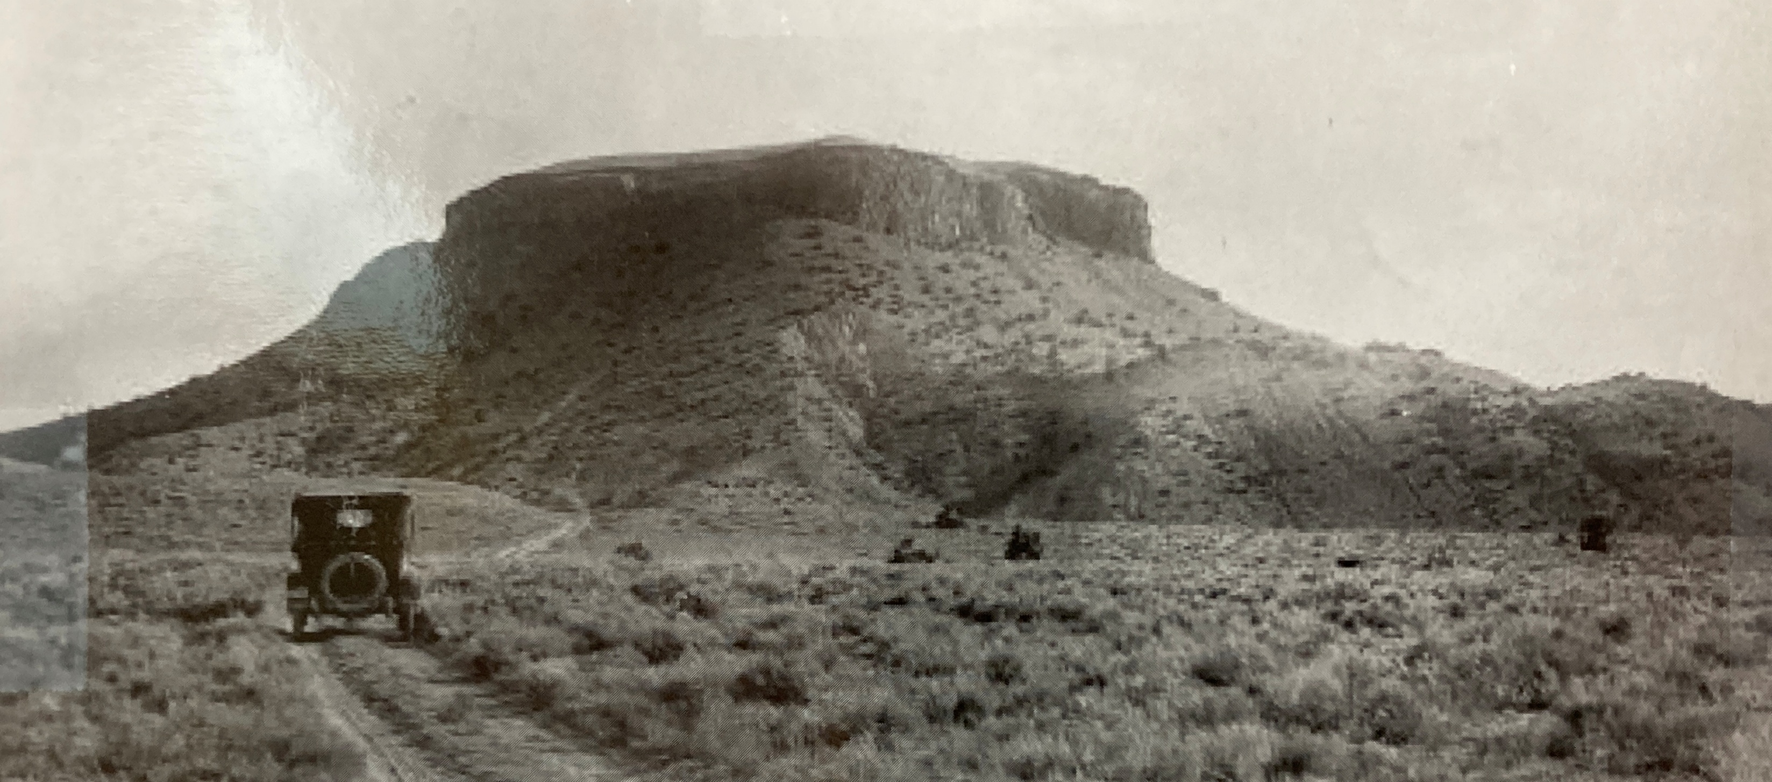
Project Description: Historical Context

Slide 5
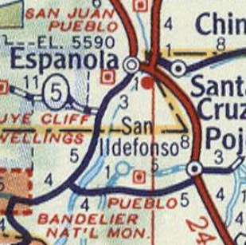
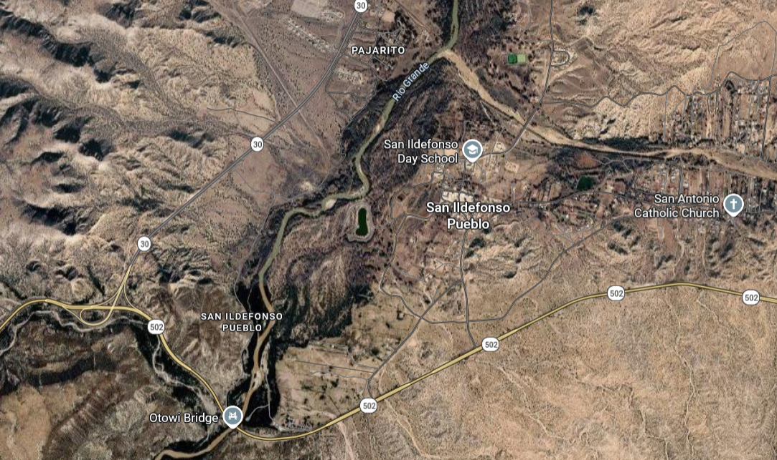
Project Description:
Location

Slide 6
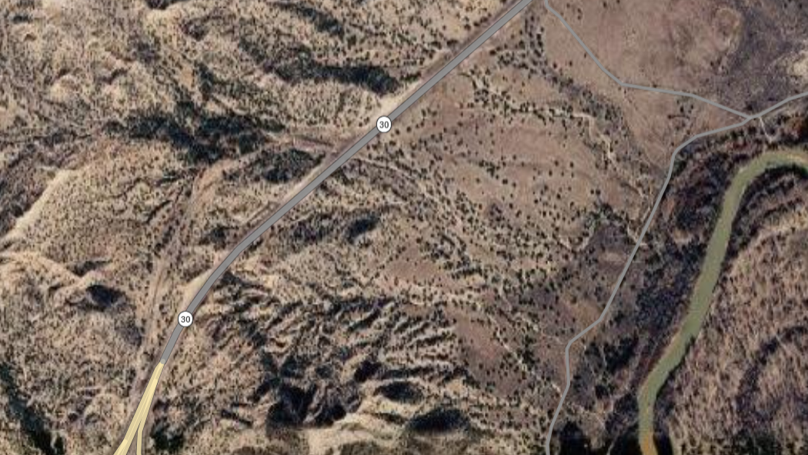
Project Description: Historical Context

Slide 7
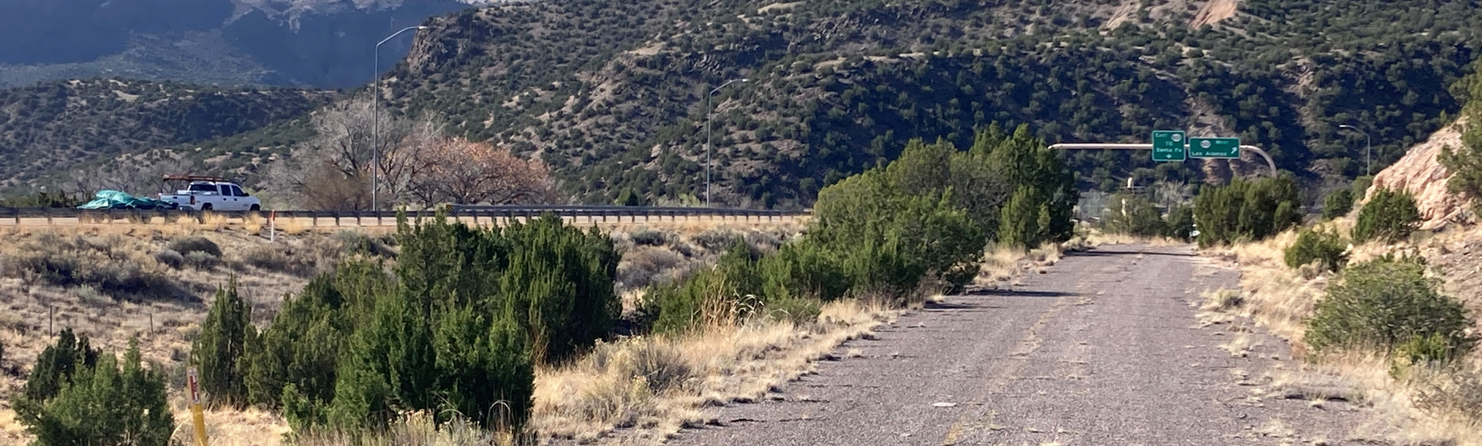
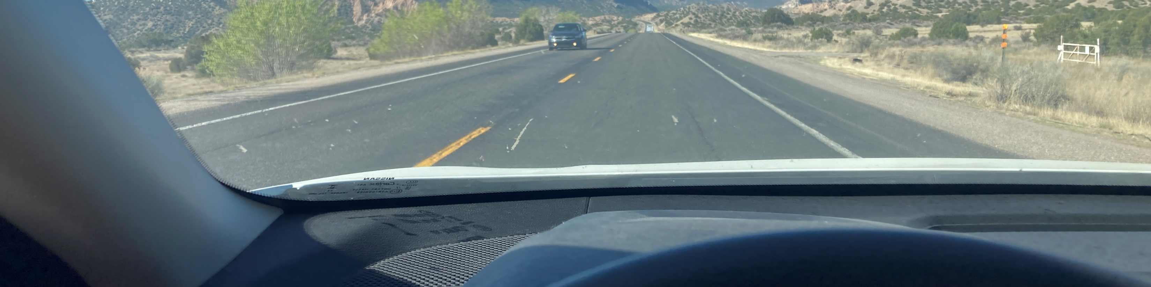
Project Description: Accelerated Road Profile

Slide 8
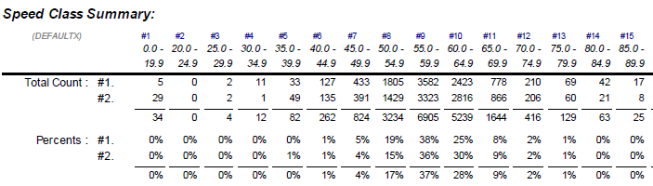
Project Description:
Speeding Breakdown
Speeding rate = 75%
35% over 60 mph

Slide 9

Project Description:
Average daily traffic
Ca. 10,000 cars per day

Slide 10
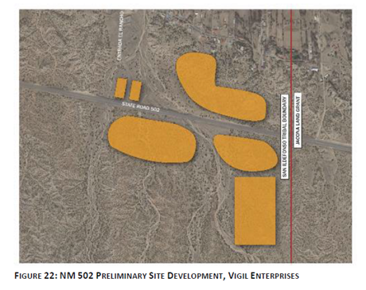
Project Description:
Future Development: Comprehensive Land Use Plan

Slide 11
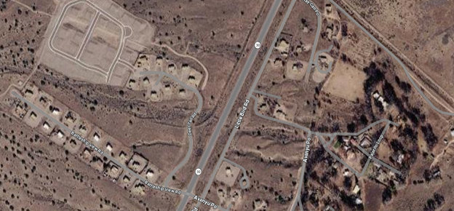
Project Description:
Future Development: Housing Expansion

Slide 12
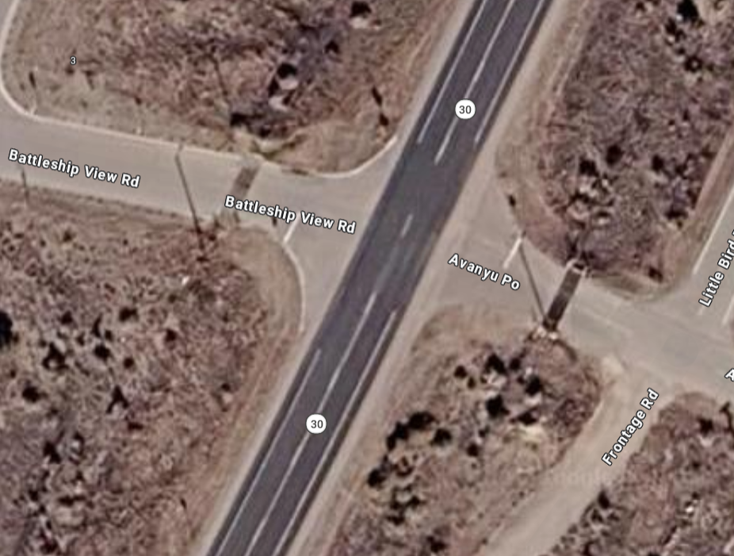






Project Description:
Analysis
Dangerous pedestrian crossing
Speeding (70%)
Dangerous overtaking
Traffic noise impacting residential area
Long waiting times to turn onto highway

Slide 13
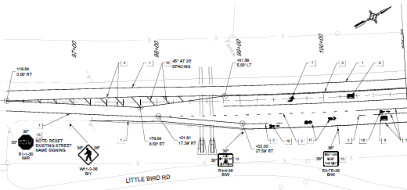
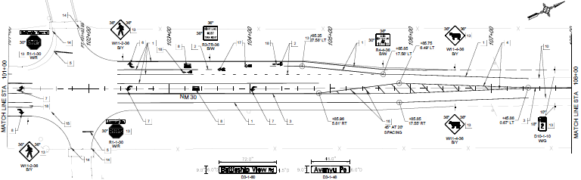
Project Description:
Details of Proposed Development
road widening - intersection - road widening
improvements

Slide 14
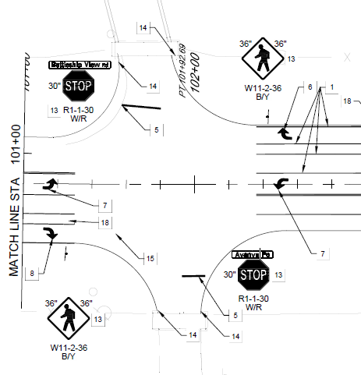
Project Description:
Details of Proposed Development
Left turn lanes
Deceleration lanes
Bike lanes
Night lighting
Flashing speed indicators
Reduced speed limit

Slide 15
Planning: Secured other Funding Sources, Matching Funds
Funding request:
$1,060,127.04 + 12% phase 3 services
= 1,187,342.24
No other sources
Matching funds are requested.
[Scoring range: 0-5 points]

Slide 16
Planning: Support from existing planning documents and/or federal or state agencies
Bohannan Houston Plans
90% plans in consultation with SAN-I Pueblo
essentially “shovel ready”.
RFP-ready
[Scoring range: 0-5 points]

Slide 17
Project Description: Level of coordination with RTPO and NMDOT in project development
High
3+ meetings with DOT
5+ meetings with RTPO
Close coordination to create a short term solution to this critical area.
[Scoring range: 0-5 points]

Slide 18
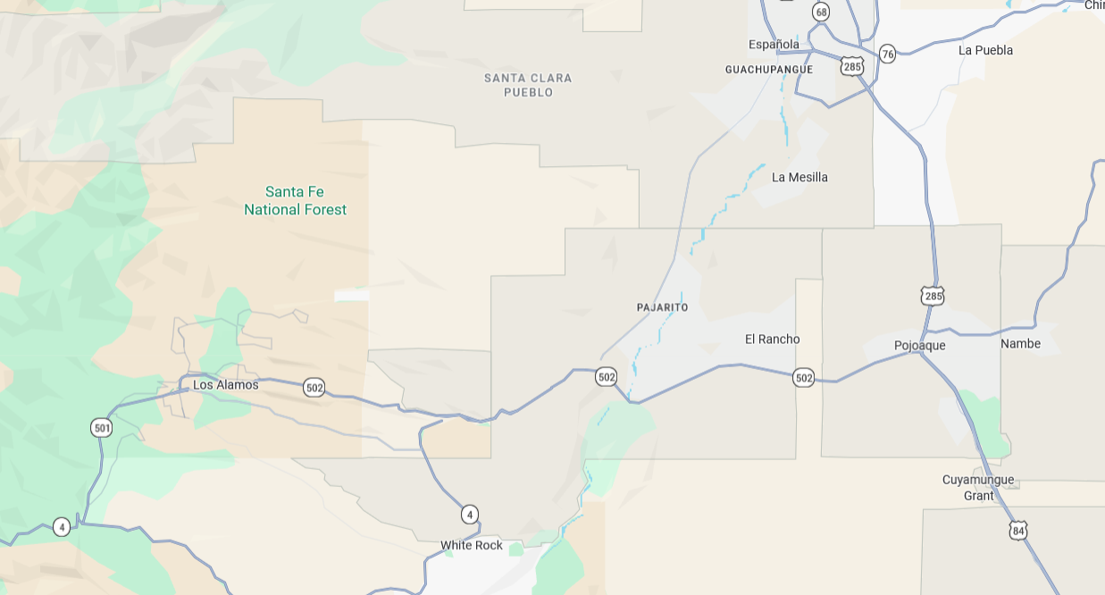
Justification: Economic Impact and Project Need
Main commuter corridor Espanola – Los Alamos

Slide 19
Justification: Economic Impact and Project Need
Main locus of future residential and commercial development
Transformation from “wild west” to high-quality mixed use development
Design quality matters

Slide 20
Justification: Quality of Life, Safety, and Environmental Sustainability
Reduce speed
Reduce collision risk (deceleration lanes)
Reduce noise / residential quality
Reduce traffic danger
Increase nighttime safety (lighting)
Improve multimodality (bike lane)
Improve school bus viability for children

Slide 21
Request Readiness: R-O-W Acquisition, Clearances, Planning Docs, Timeline
ROW Acquisition not needed
Cleared through DOT process
Shovel ready 2027
[Scoring range: 0-10 points]

Slide 22
Project Summary
Critical interim measure for traffic safety on NM-30
Shovel-ready
High economic, social and ecological dividends
Professionally planned by BH
Funding request: $= 1,187,342.24
Implementation 2027

