Slide 1
NPRTPO FY 2027 TPF #1:
Bridge Rehabilitation and Replacement Project
Presentation by TOWN OF RED RIVER AND DEC
April 1, 2026

Slide 2
Project Scope
Project scope is plan, design, and construction of a bridge rehabilitation and replacement project.
The Town has 7 vehicular bridges that are in need of rehabilitation or replacement.
Bridges were constructed between 1954 and 1997 with no to limited information available for as-built conditions.
High Street
Mallette Canyon
Jay Hawk Tr.

Slide 3
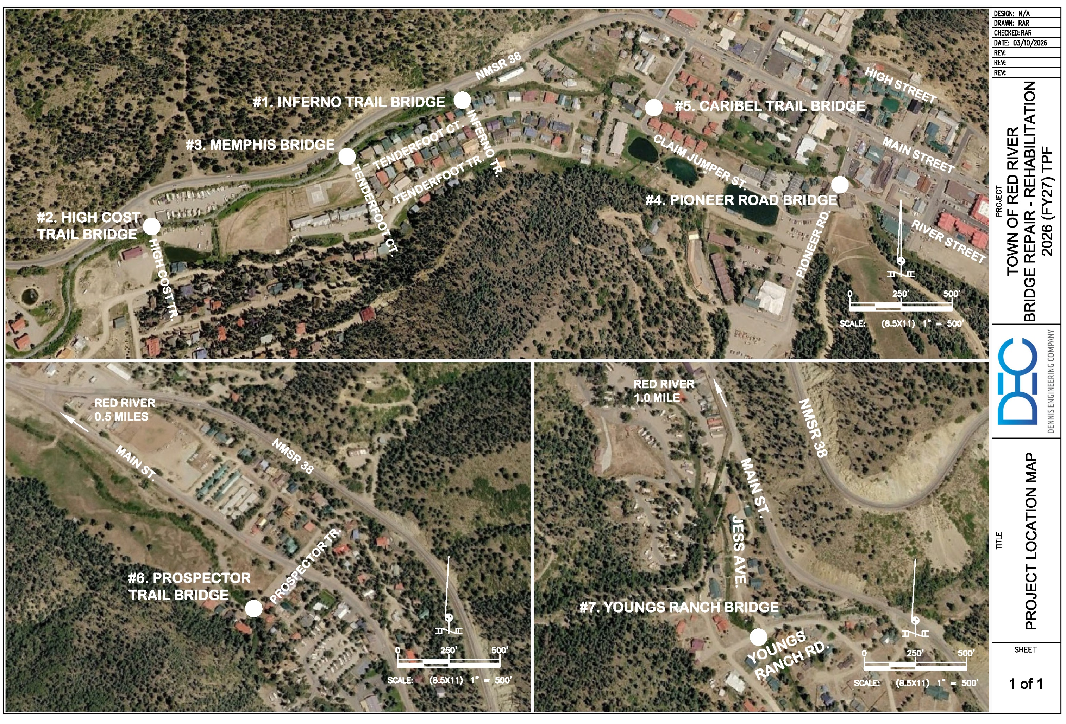
Project Location Map
High Street
Mallette Canyon
Jay Hawk Tr.

Slide 4
Planning: Secured other Funding Sources, Matching Funds
The Town has had scoping reports prepared for each of the bridges (October 2025). These reports provide a general understanding of the condition for each of the bridges and suggest corrective actions and prepare preliminary estimates to rehabilitate the bridges.

Slide 5
Planning: Secured other Funding Sources, Matching Funds
In addition to the requested funding from the TPF program, the Town has secured Capital Outlay (C5243325) in the amount of $325,000 to put toward the bridge project.
The matching funds for the project will come from the Town’s street fund.

Slide 6
Project Description: Level of coordination with RTPO and NMDOT in project development
The project has been discussed with Northern Pueblo RTPO and NMDOT.
The project is not on an NHS route or ROW owned by NMDOT.

Slide 7
Justification: Economic Impact and Project Need
These bridges provide critical passages across the Red River for emergency personnel, delivery of critical goods, etc. as well providing egress/ingress to:
                Red River Charter School
                Fire Department
                Public works equipment yard
                Local Businesses
                Outdoor Recreation/Trailheads
                Apartments, Homes and Condominiums

Slide 8
Justification: Quality of Life, Safety, and Environmental Sustainability
This project will improve the quality of life and safety for the residents and tourists by providing safe passages from the north side of town to the south side.

Slide 9
Request Readiness: R-O-W Acquisition, Clearances, Planning Docs, Timeline
No additional R.O.W. will need to be acquired. The Town owns the R.O.W. for each of the bridges.
A Professional Services Agreement (PSA) is in place and the project can commence immediately after funding is received (anticipated to be in the fall of 2026).

Slide 10
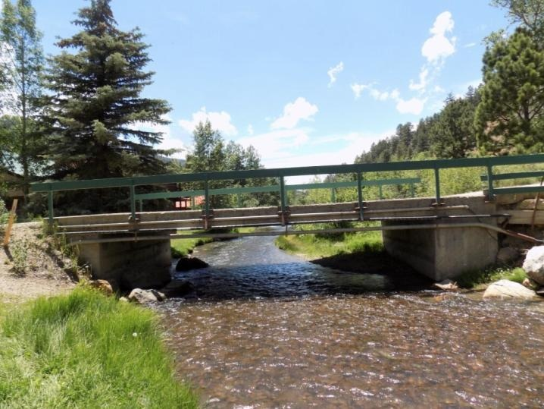
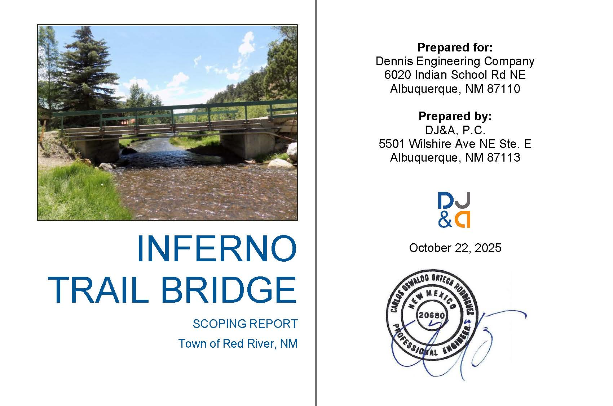
Inferno Trail Bridge

Slide 11
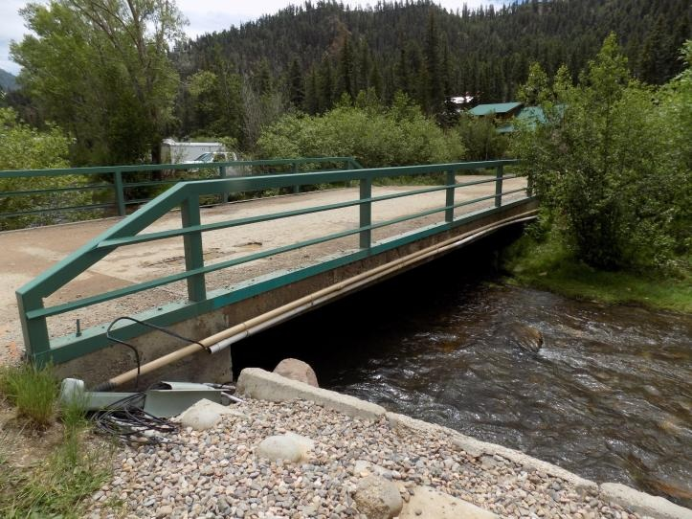
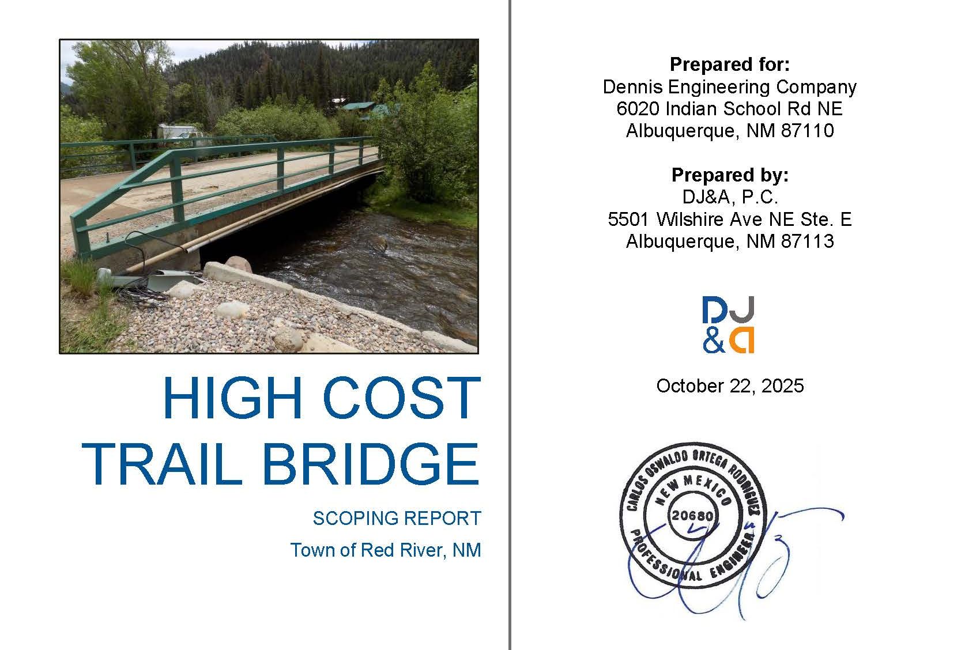
High Cost Trail Bridge

Slide 12
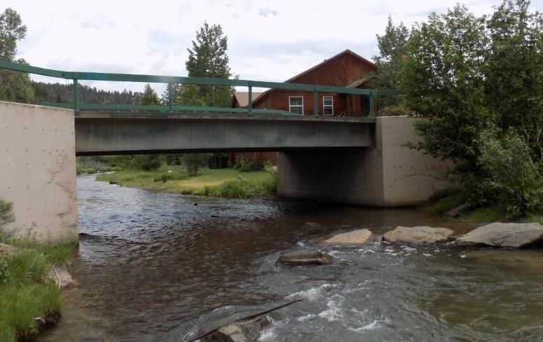
Memphis Bridge

Slide 13
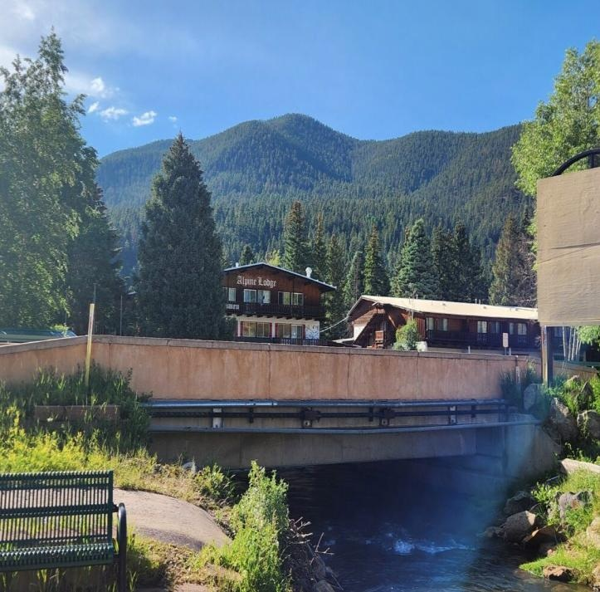
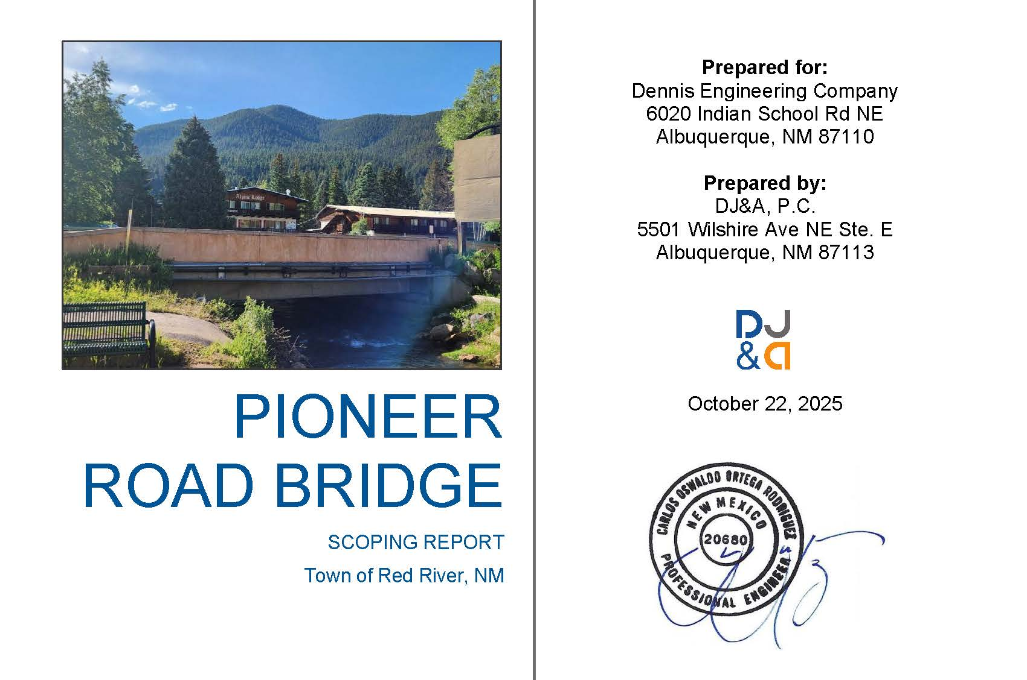
Pioneer Road Bridge

Slide 14
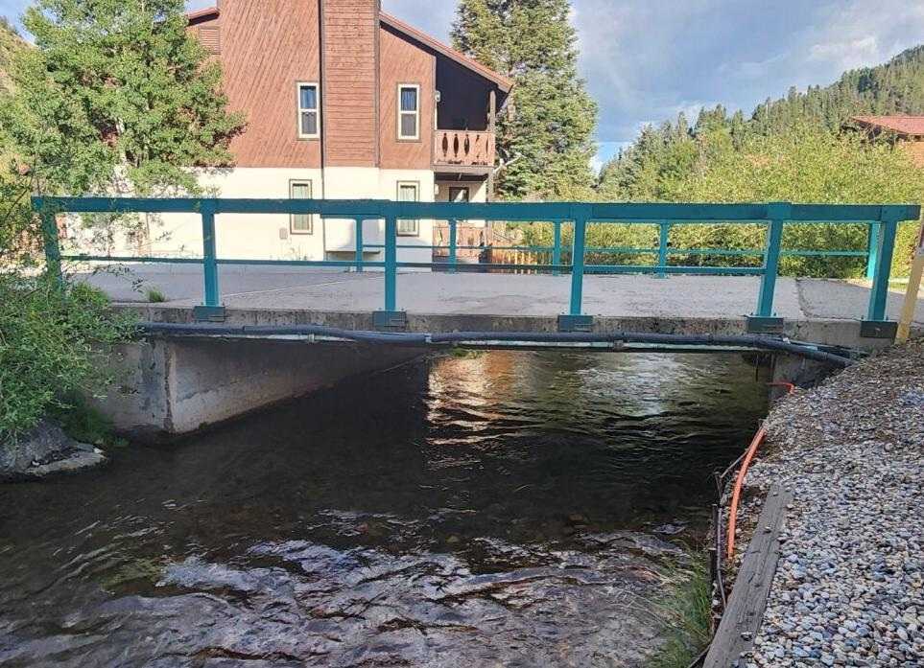
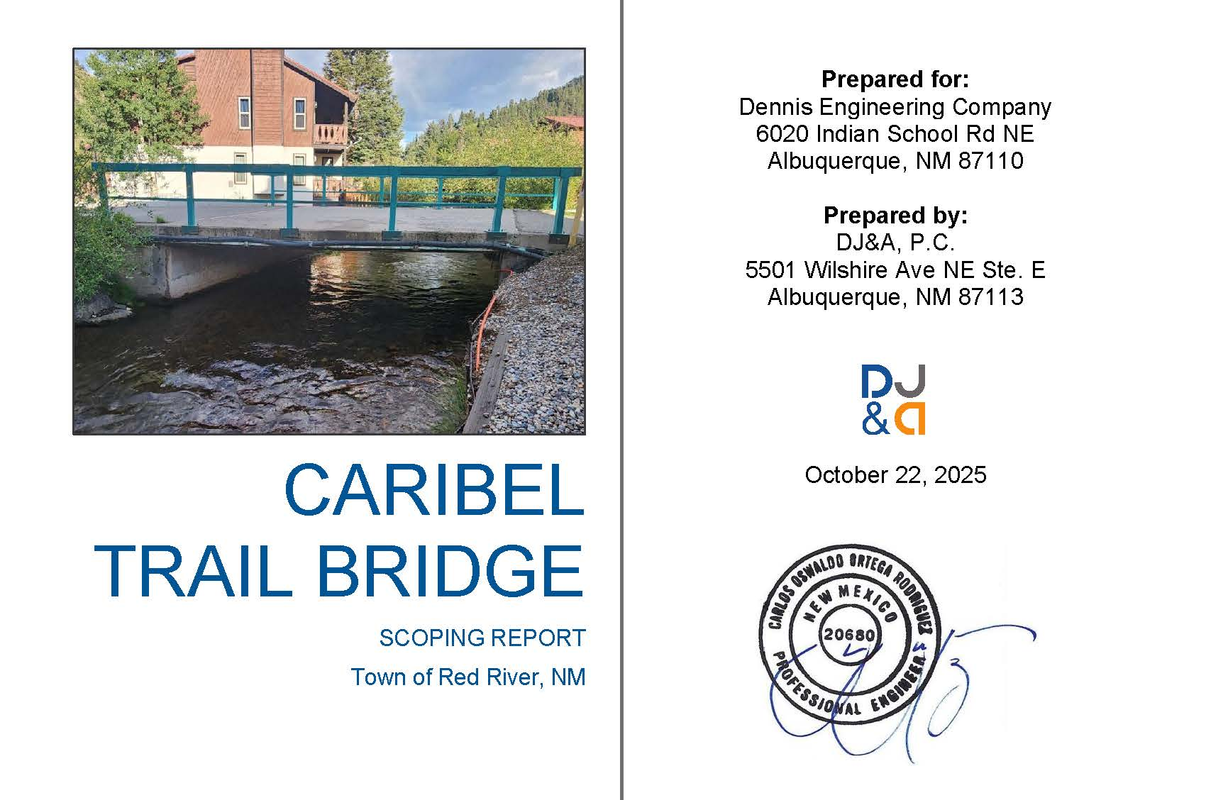
Caribel Trail Bridge

Slide 15
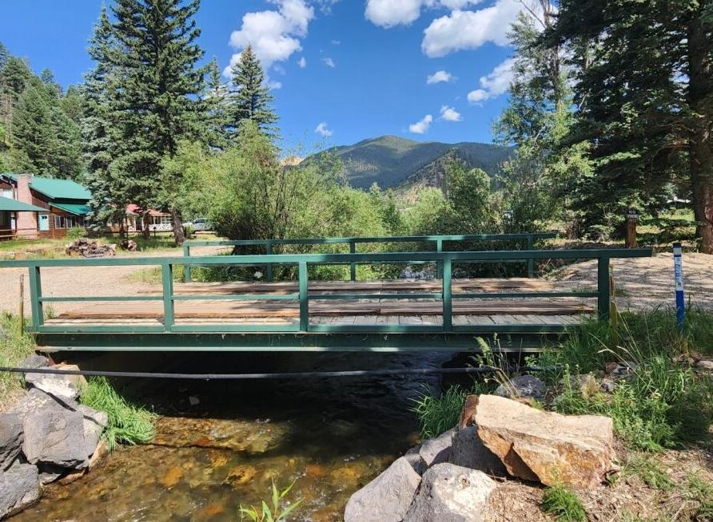
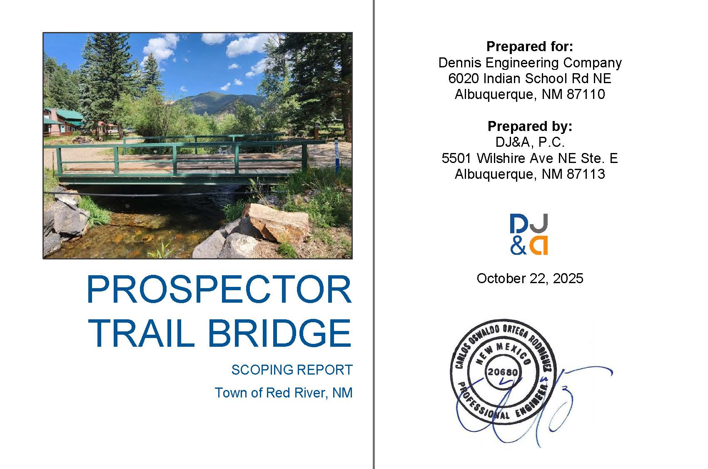
Prospector Trail Bridge

Slide 16
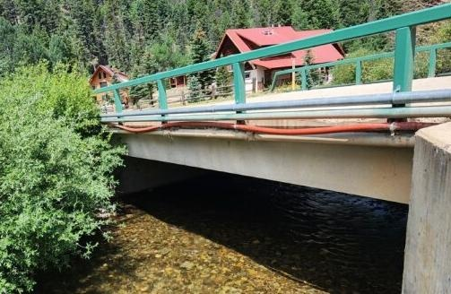
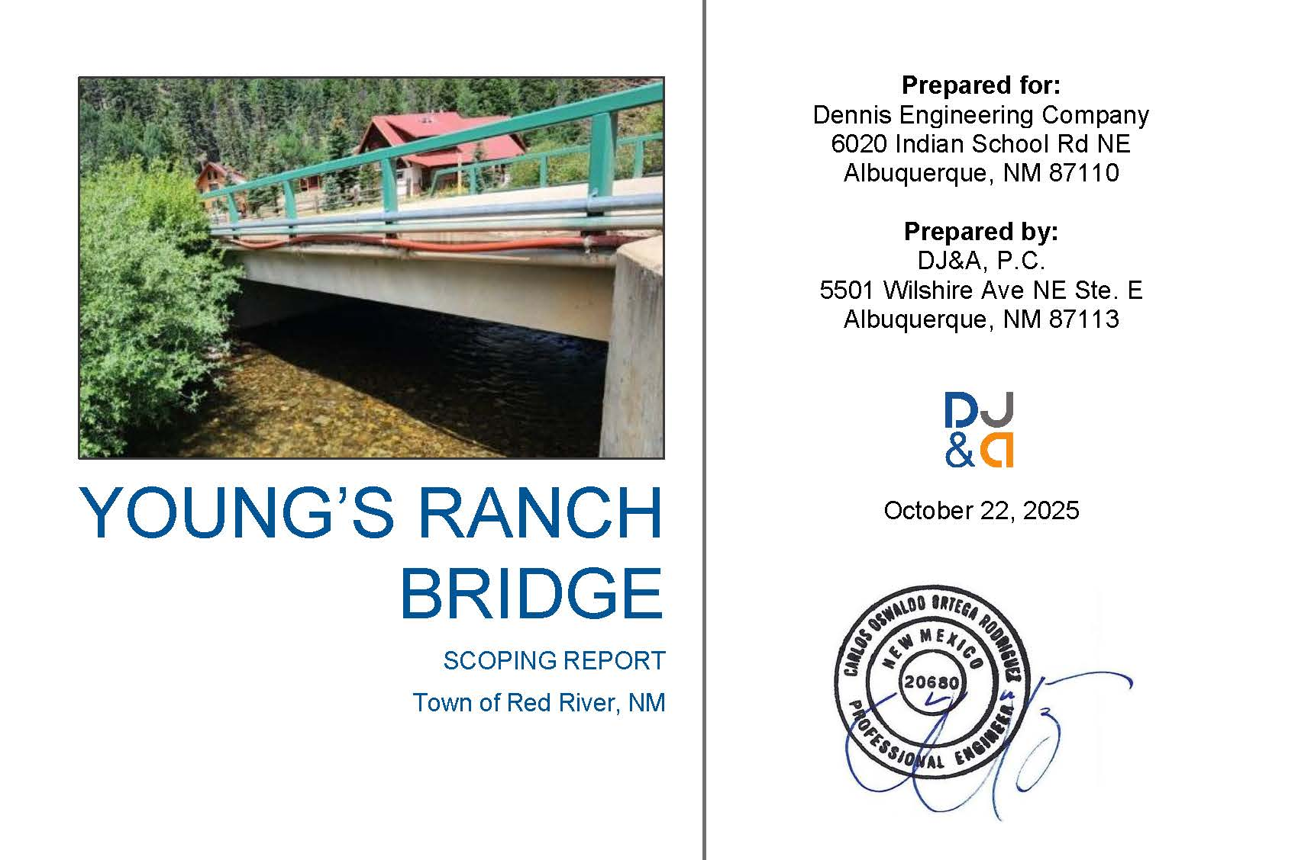
Youngs Ranch Bridge

Slide 17
Project Summary
Bridge issues include:
    Leaching Honeycombing
      Delamination Improperly attached utilities
      Spalling Abutment erosion
      Deterioration Undermining of backfill behind wingwalls
      Concrete cracks Insufficient erosion protection
Total Estimated Project Cost is $2,000,000

Slide 18
The End
The Town of Red River sincerely appreciates your interest in this project.
THANK YOU

