Slide 1
Northern Pueblos RTPO
FY 2027 TPF Proposal:
Silkey Way
Presentation by City of Española
April 1, 2026

Slide 2

Planning: Secured other Funding Sources, Matching Funds
$400,000 secured Capital Outlay
City will provide 5% match

Slide 3
Planning: Support from existing planning documents and/or federal or state agencies
Silkey Way Expansion Project – City of Española
Listed in multiple ICIP cycles FY2022-2027
Project ID: 37698
Category: Transportation (roads)

Slide 4
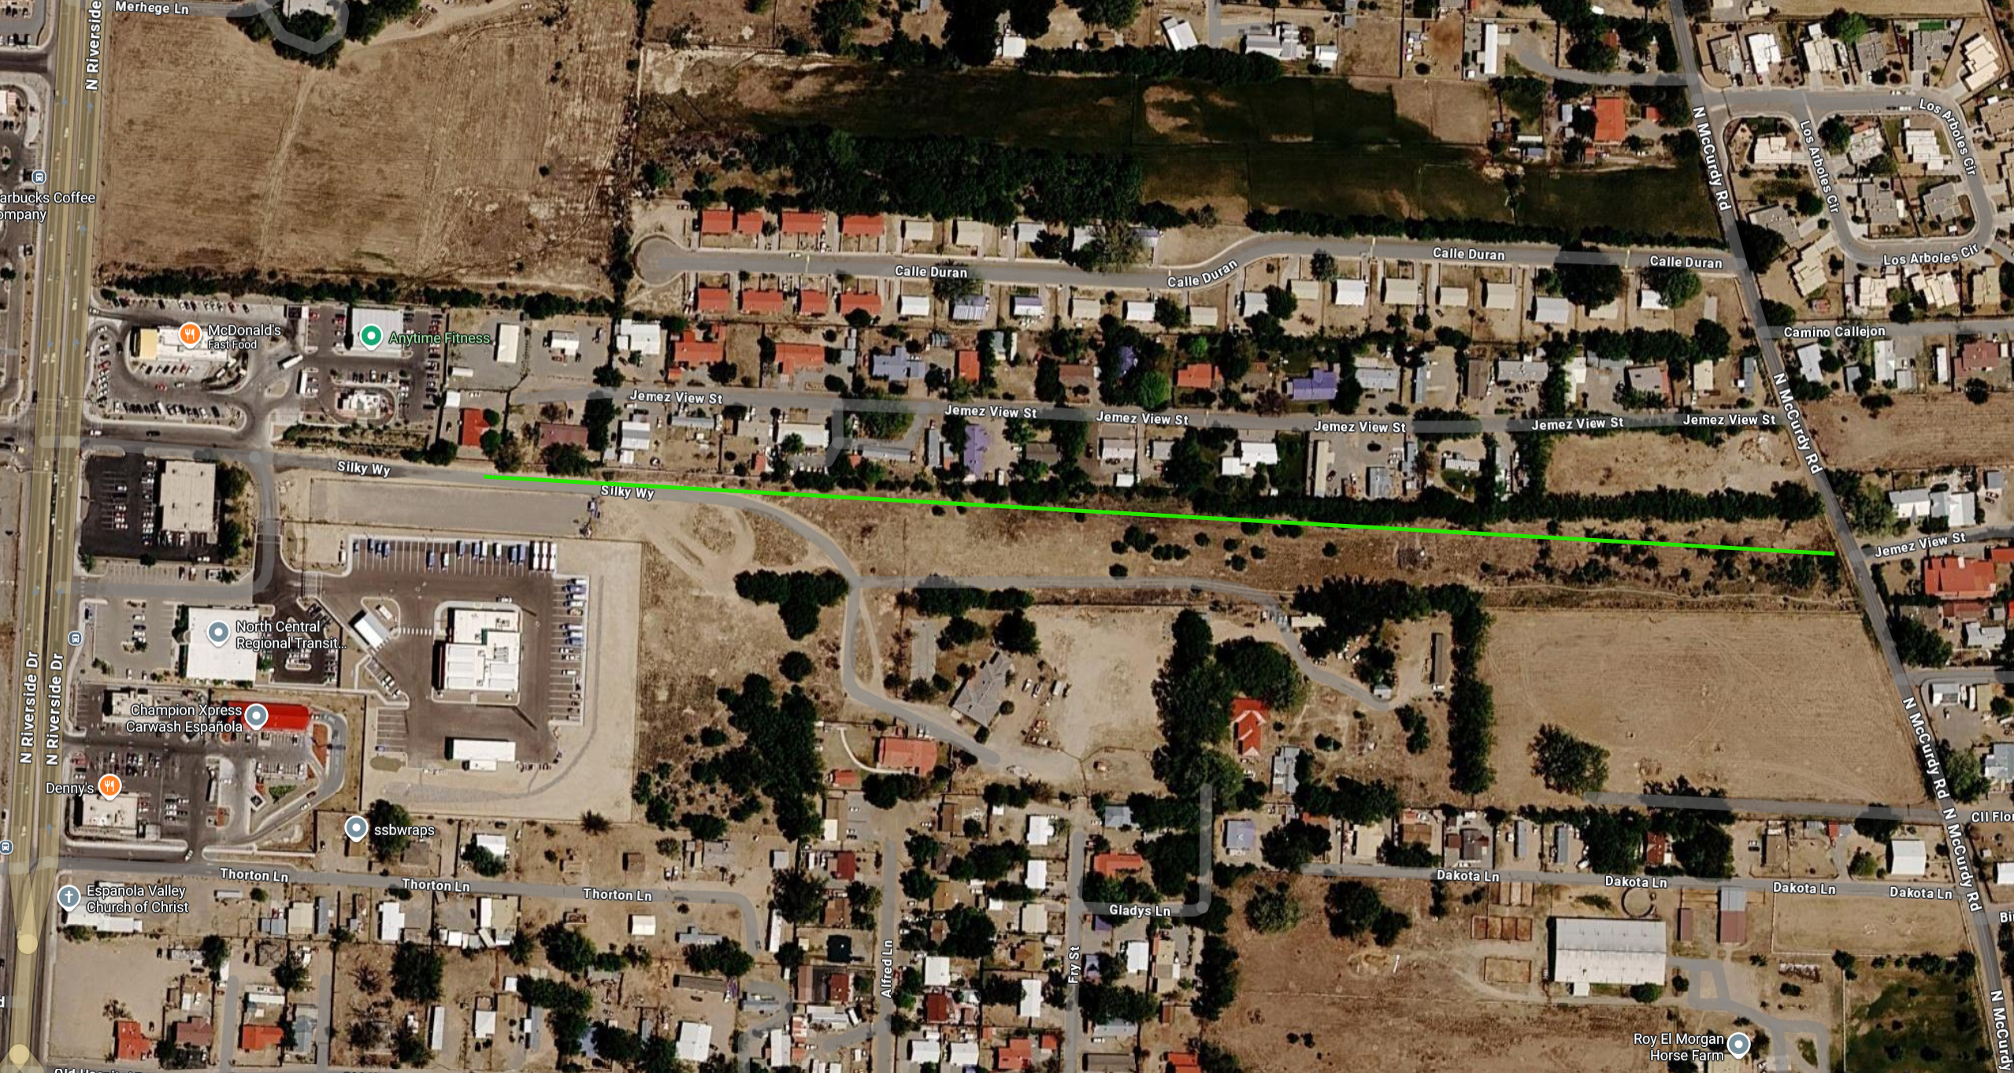
Project Description: Location of Project, and Details of Proposed Development
located on Silkey Way between NM68 and N McCurdy Road
New roadway and the development of 13 new lots for housing

Slide 5
Project Description: Level of coordination with RTPO and NMDOT in project development
Prior funding from NMDOT has made it possible for engineering and the beginning construction phase of this project.
Gives alternative route from NMDOT road
RTPO TPF funding can help finish the roadway portion of construction.

Slide 6

Justification: Economic Impact and Project Need
Job opportunities made easier with affordable housing
Housing opportunities for residents and NCRTD employees

Slide 7
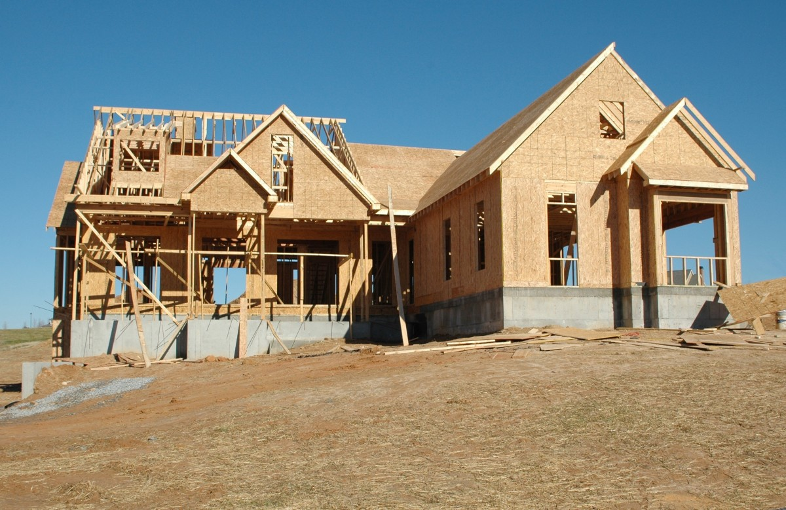
Justification: Quality of Life, Safety, and Environmental Sustainability
Improves access for residents
Enhances safety and mobility
Supports future development
Adds additional relief from NM68

Slide 8
Request Readiness: R-O-W Acquisition, Clearances, Planning Docs, Timeline
This project is ready to go,
No R-O-W is needed
All engineering is complete
As soon as funding is secured we can begin the contractor process

Slide 9
Project Summary
Adds relief from NM68
TPF funds will complete roadway construction
New housing opportunities
Beneficial to the entire community and NCRTD

