Slide 1
Local Governments Road Fund House Transportation and Public Works Committee Dolores Gallegos, Financial Director March 10, 2015

Slide 2
Local Governments Road Fund
Was established under NMSA 1978, Section 67-3-28 and Section 67-3-28.2 to provide funds to Local Governments for projects where Local Entities take the lead in developing and contracting construction and maintenance projects.
The funding is eligible for project development, construction, reconstruction, improvement, maintenance or repair of public highways, streets and public school parking lots, and acquisition of right-of-way.
State Funding
75% State Match
25% Local Entity Match

Slide 3
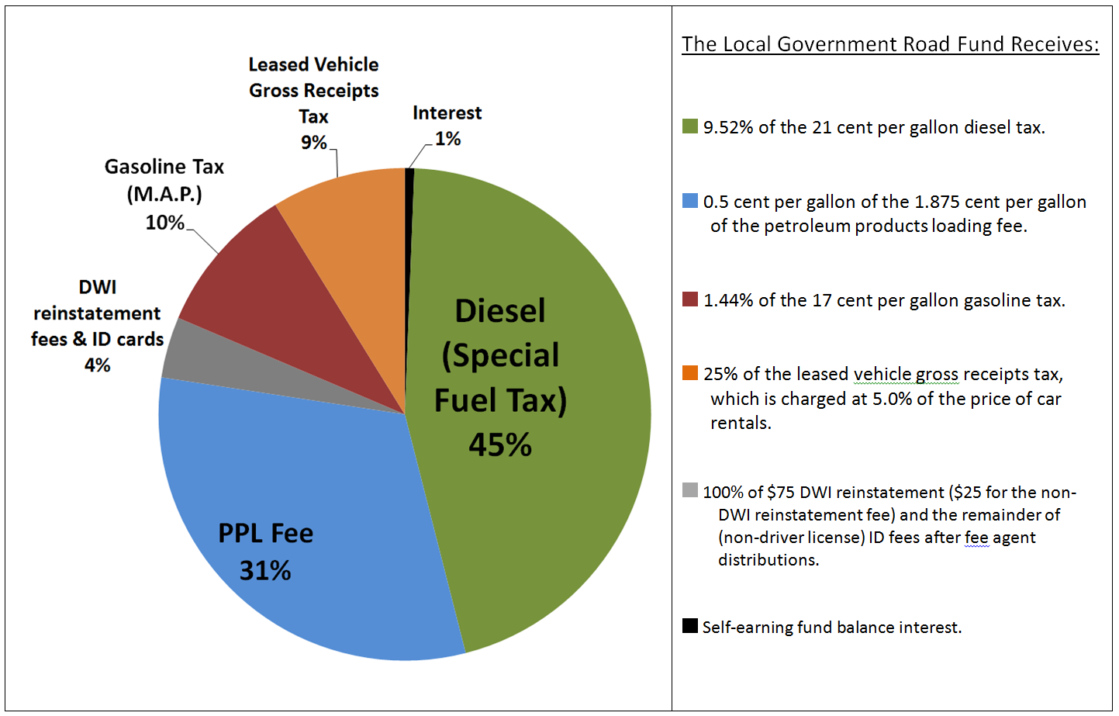
The total FY 2016 Local Government Road Fund revenue forecast is $22.5 million.

Slide 4
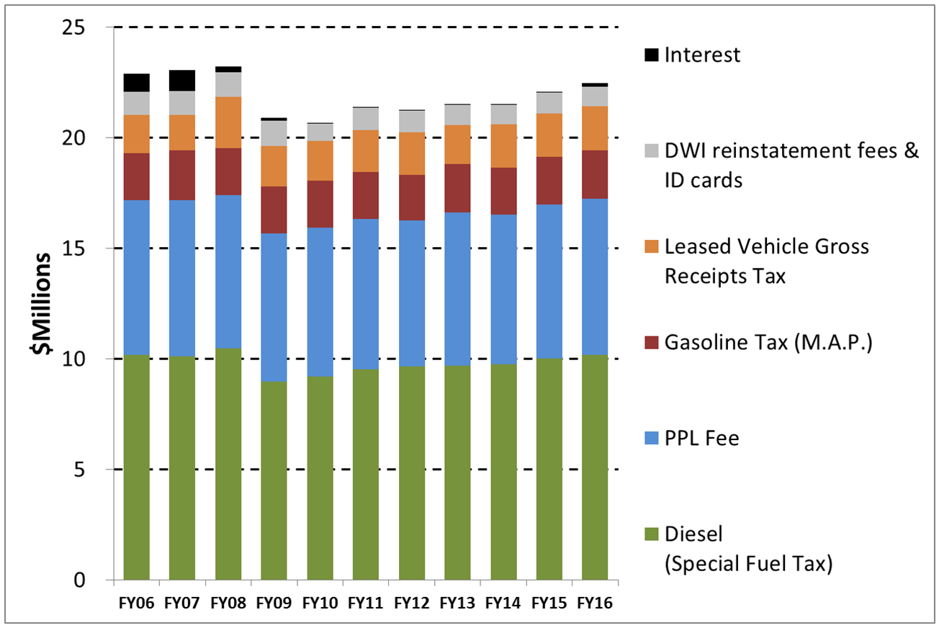
Local Government Road Fund Revenue History:
FY 2006 - 2016 Forecast

Slide 6
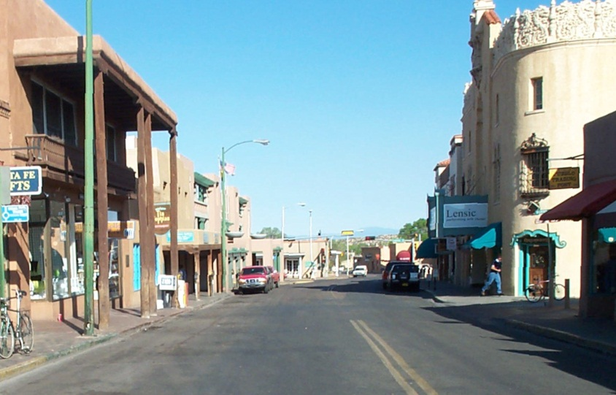
Local Government Road Programs
The four primary Programs funded by Local Government Road Fund:
Cooperative Agreement Program – SP
County Arterial Program – CAP
School Bus Route Program – SB
Municipal Arterial Program - MAP

Slide 7
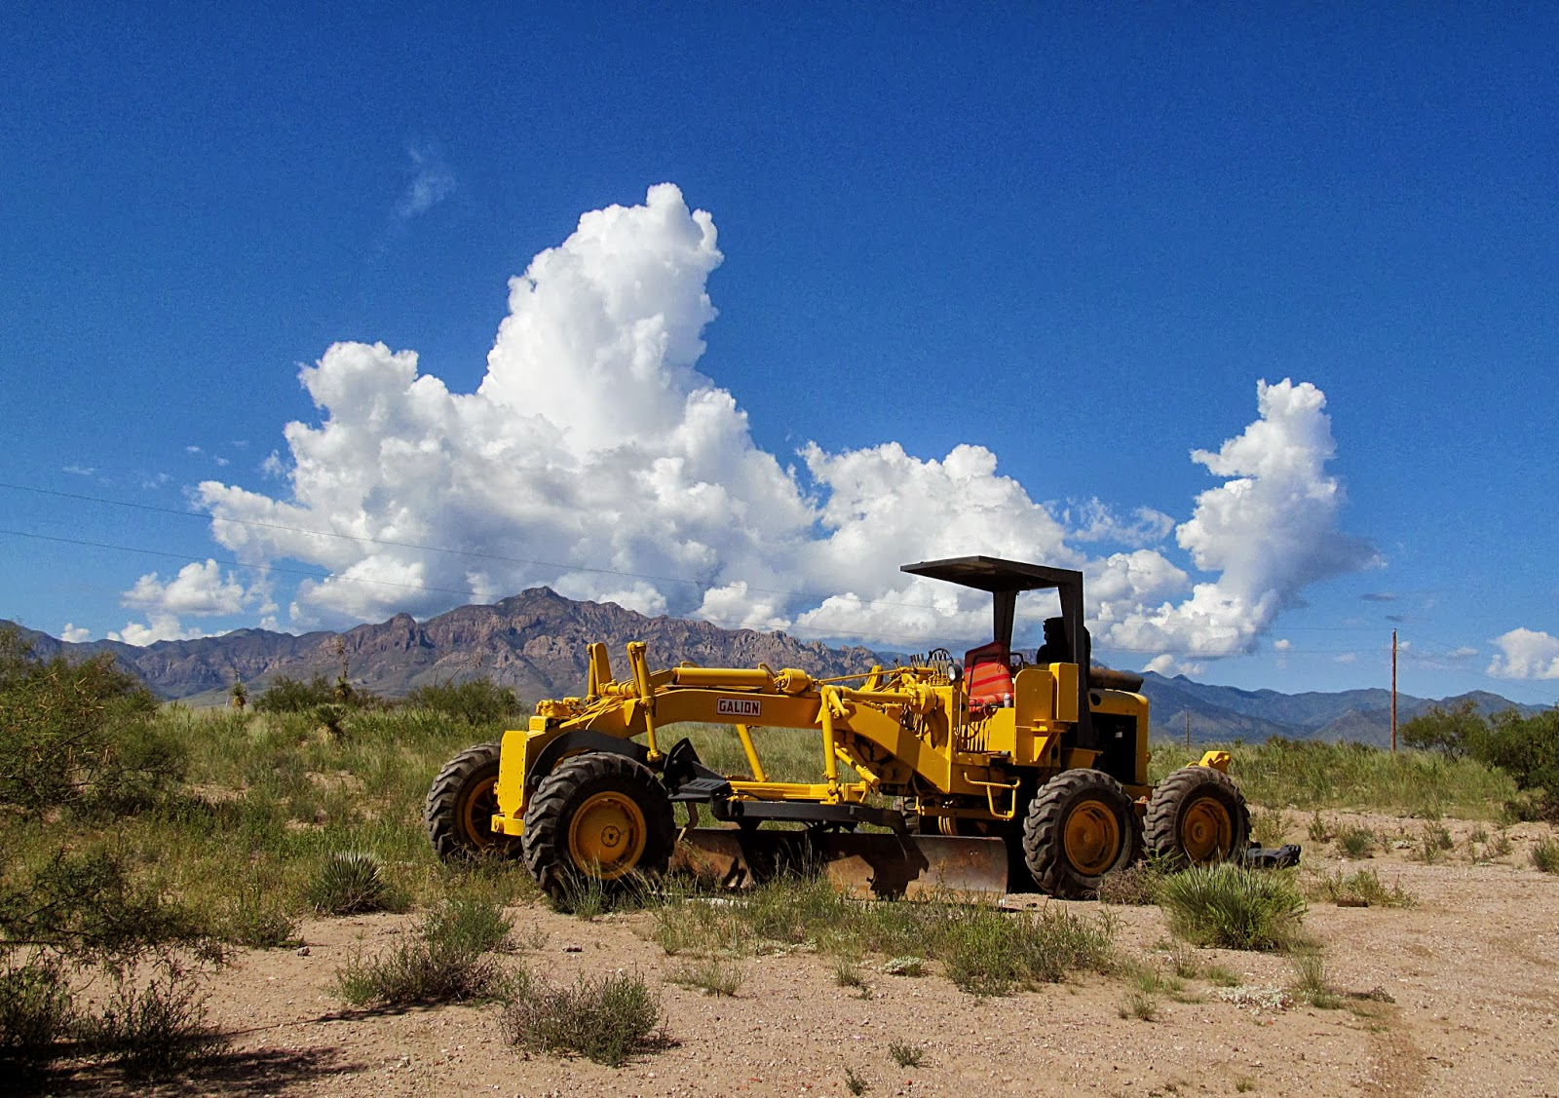
Local Government Road Programs
Two Waiver Programs
Road Equipment Waiver Program ($500,000)
Match Waiver Program ($1,000,000)

Slide 8
Local Government Road Fund
Cooperative Agreement Program
Allocated 42 percent of the Local Government Road fund to be used solely for the Cooperative Agreements entered into pursuant to NMSA 1978, Section 67-3-28.2 and in accordance with the match authorized pursuant to NMSA 1978, Section 67-3-32; provided, however, that distribution amounts made pursuant to this paragraph in each year shall be based on the following allocations:
Thirty-three (33) percent for agreements entered into with counties;
Forty-nine (49) percent for agreements entered into with municipalities;
Fourteen (14) percent for agreements entered into with school districts;
Four (4) percent for agreements entered into with other entities;

Slide 10
Local Government Road Fund
Municipal Arterial Program
Allocated (16) percent of the Local Government Road Fund to be used solely for the necessary project development, construction, reconstruction, improvement, maintenance, repair, right of way, and material acquisition of and for those streets that are principal extensions of rural state highways and of other streets not on the state highway system but that qualify under the designated criteria established by the Department. In entering into agreements with municipalities to provide funds for any project qualifying for the municipal arterial program, the Department shall give preference to municipalities that contribute an amount equal to a least twenty-five (25) percent of the project cost.

Slide 12
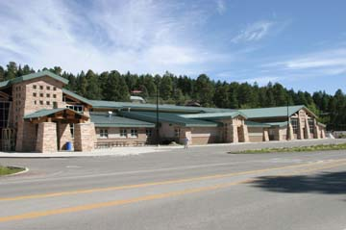
Local Government Road Fund
School Bus Route Program
Allocated sixteen (16) percent of the Local Government Road Fund, to be used solely for cooperative agreements entered into pursuant to NMSA 1978, Section 67-3-28 and in accordance with the match authorized pursuant to NMSA 1978, Section 67-3-32 for acquiring rights of way and constructing, maintaining, repairing, improving and paving school bus routes and public school parking lots.

Slide 14
LGRF Funds
County Arterial Program – CAP
Allocated twenty-six (26) percent of the Local Government Road Fund to be used for project development, construction, reconstruction, improvement, maintenance, repair, right of way, and material acquisition of and for county roads for which individual counties have prioritized road projects. Prior to entering into any agreements for projects with the counties for the following fiscal year, in June of each year the department shall determine and certify the amount to which each county is entitled pursuant to the following schedule:
Road Mileage Category Based on Number of Miles Maintained
By a County: | Entitlement to County
400 miles or under | $250 for each mile
401 to 800 miles | $100,000 plus $200 for each mile over 400 miles
801 to 1200 miles | $180,000 plus $150 for each mile over 800 miles
1201 to 1600 miles | $240,000 plus $100 for each mile over 1200 miles
Over 1600 miles | $300,000 plus $50 for each mile over 1600 miles

Slide 16
Project Proposal Submittal: County Arterial- Cooperative-School Bus Route Projects
Local Entities shall submit a complete project proposal addressed to the District Engineer before or on the March 15th deadline containing the following:
Letter of Intent from governing body or agency head. Must list scope, termini & reference estimated project cost.
Location of proposed project including route designation & termini – include a map showing the location.
Scope of work to be performed.
Project estimate, including the amount of State participation requested.
Justification for project construction.
Certification that proposed work is on a public highway and necessary for the public good and convenience and to serve the public of the municipality, county and/or school district.

Slide 17
Project Proposal Submittal: Municipal Arterial Projects
Local Entity request package sent to Statewide LGRF Coordinator in Santa Fe by March 15th shall include the following:
Map of project limits (including proposed phasing).
Current and 20-year projected traffic volumes.
Pavement design criteria (10-year min.).
Typical section.
Major intersection & traffic signal analysis.
Drainage reports.
Preliminary cost estimate (include State share & Municipality share).
Local Government resolution of support for the project.
Project data sheet summarizing existing & proposed project information.

Slide 18
Local Government Road Fund Timeline
April:
Upon receipt Municipal Arterial project proposals the annual allocation is divided among the Entities.
Each District will disburse Tentative funding awards letters. (County Arterial, School Bus Routes and Cooperative programs only)
Local Entity provides written acceptance/rejection of awards. Acceptance letter must include:
Project scope of work.
Route designation. (which streets/roads)
Termini. (beginning mile post and ending mile post)
Summary of estimated costs and quantities.

Slide 19
Local Government Road Fund Timeline
May:
NMDOT presents proposed projects to the State Transportation Commission for approval.
Local Entity receives notification of State Transportation Commission’s approval/denial from NMDOT.
June - July:
Local Entity forwards a resolution to NMDOT. Resolution must include:
Adopting the project & verifying its priority standing.
Exact scope of work.
Route designation. (which streets/roads)
Termini. (beginning point and ending point)
Reference the project cost (including State share of 75% and Entity share of 25%).
Project Number. (found on State Transportation Commission notification)
Control Number. (found on State Transportation Commission notification)

Slide 20
Local Government Road Fund Timeline
June – August:
Once the resolution is received an agreement will be drafted and sent to the Entity for signature/approval by appropriate governing body.
When the district receives approved agreements from Entity, they are submitted to the Local Government Road Fund Coordinator for execution.
Upon execution the funds are available for disbursement.

Slide 21
LGRF Disbursements
Upon receipt of all required documentation from the District the Local Government Road Fund Unit shall initiate approval for release of funding
Cover letter from Public Entity requesting disbursement,
Notice of Award/Work Order
Notice to Proceed
Amendments (if applicable)
Summary of costs and quantities
Funds are disbursed in a single lump sum payment
The disbursement shall be in the amount as approved by the State Transportation Commission.

