Slide 1
Northern Pueblos RTPO
FY 2027 TPF Proposal:
Coronado Avenue
Presentation by City of Española
April 1, 2026

Slide 2
Planning: Secured other Funding Sources, Matching Funds
No other funds are being used for Coronado match to be provided by City of Española

Slide 3
Planning: Support from existing planning documents and/or federal or state agencies
There are no agencies currently working on this project

Slide 4
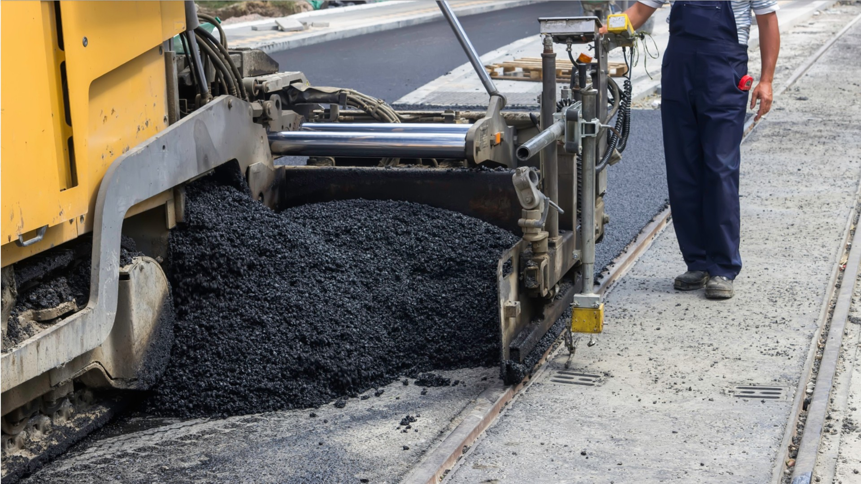
Project Description: Location of Project, and Details of Proposed Development
Coronado Avenue starting at US84/285
Traffic control and safety measures
Surface preparation
3” mill and asphalt inlay
13,520 LF of striping

Slide 5

Project Description: Level of coordination with RTPO and NMDOT in project development
PFF was evaluated with NCNMEDD and the NMDOT

Slide 6

Justification: Economic Impact and Project Need
Improved road safety and drivability
Extends pavement life
Enhances traffic flow and access
Improves accessibility for Hospital and Elementary School

Slide 7

Justification: Quality of Life, Safety, and Environmental Sustainability
The improved roadway will assist with students travel to and from school
Improved roadway makes for easier access to the Hospital
Improved roadway makes for easier access to the Vietnam Veterans Park
Improved striping and crosswalks improve pedestrian and motorist travel

Slide 8

Request Readiness: R-O-W Acquisition, Clearances, Planning Docs, Timeline
Project is shovel-ready
Design and scope prepared
Ready to proceed upon funding approval

Slide 9

Project Summary
Supports community mobility
Serves multitude of Public services
Extends the life of this critical roadway
Ready to go

